Slide 1
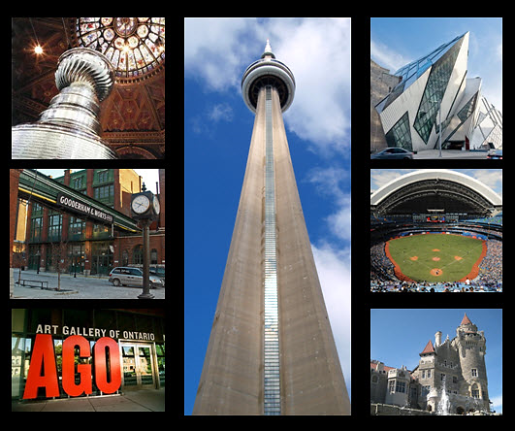
CAPD/ACDP 2016 Annual Meeting
Sept 22-23-24
Toronto

Slide 2
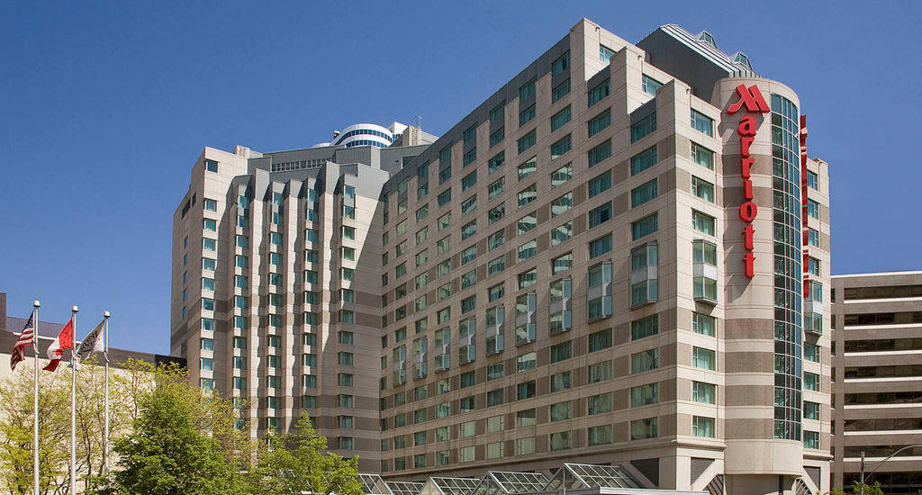
LOCAL ORGANIZING C0MMITTEE
Dr. Raymond Lee
Dr. Franklin Young
Dr. Bob Hustwitt
Conference Venue:
Toronto Marriott Downtown Eaton Centre Hotel

Slide 3
Our Sustaining Sponsors
The 3M Graduate Student Abstract Presentations and Award
The President's Gala Dinner and Dance

Slide 4
Our Silver Sponsors
Speaker Dr. Ann Griffen, Friday Lunch, Saturday Morning Refreshment Break
The Conference Audi-Visual Equipment
Friday Morning Refreshment Break
Friday Afternoon Refreshment Break

Slide 5
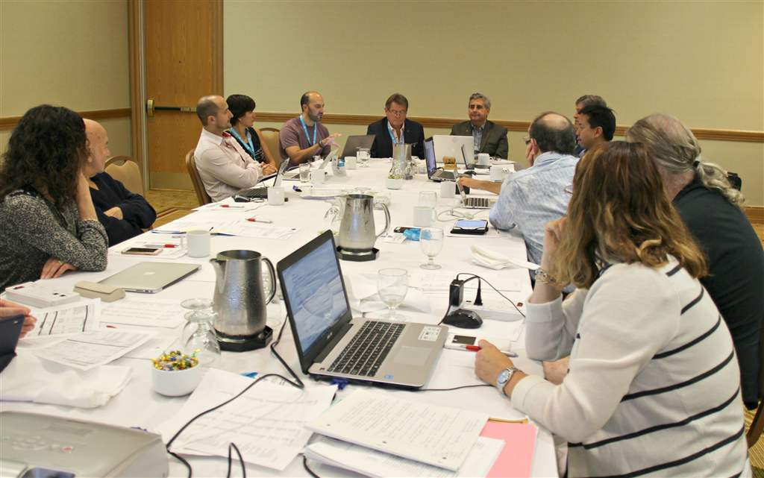
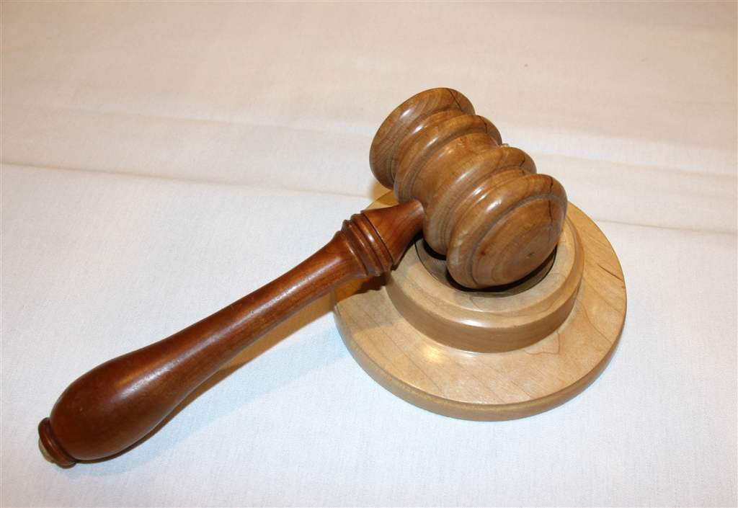
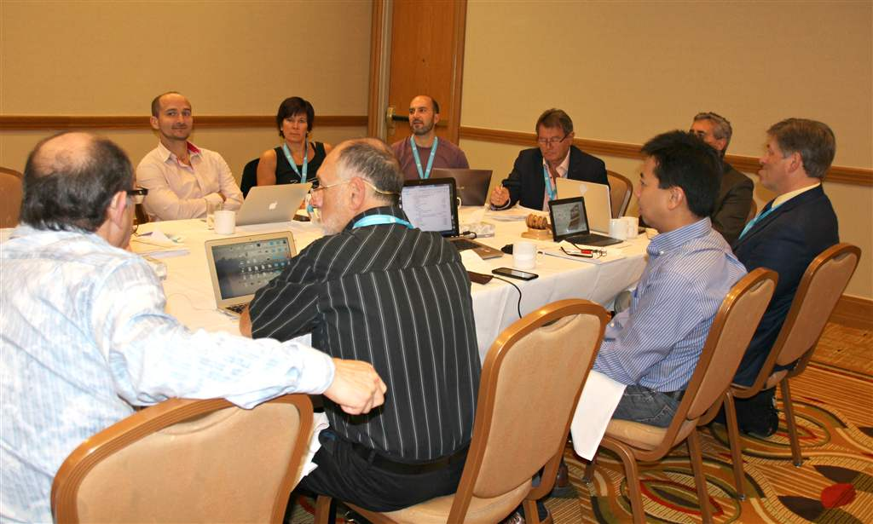
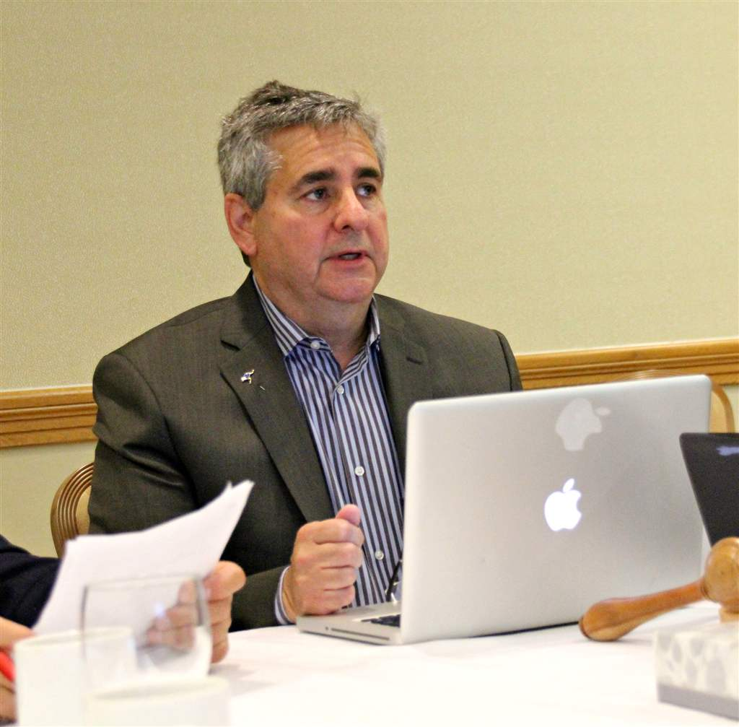
Executive Committee Meeting, September 22

Slide 6
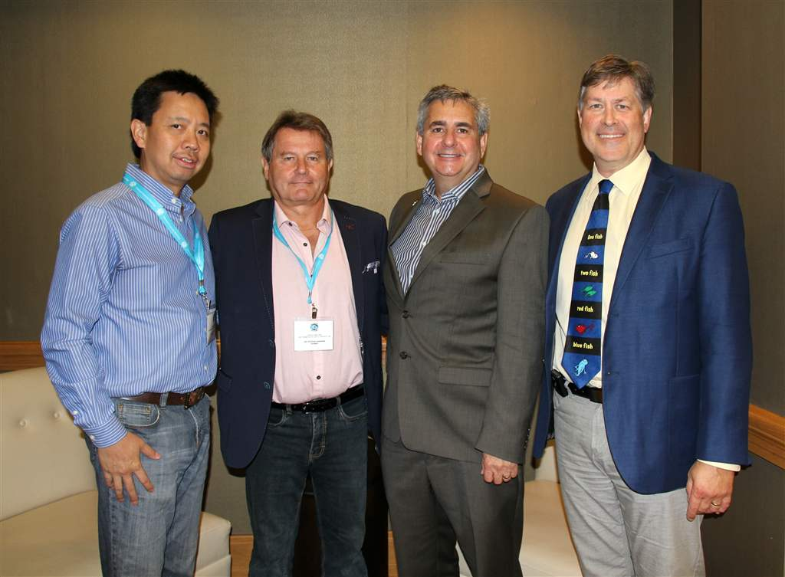
L to R: Drs. Raymond Lee (CAPD/ACDP Vice President), Dr. Patrick Canonne (CAPD/ACDP Past President). Dr. Randall Croutze (President of the Canadian Dental Association), Dr. Paul Andrews (CAPD/ACDP President)

Slide 7
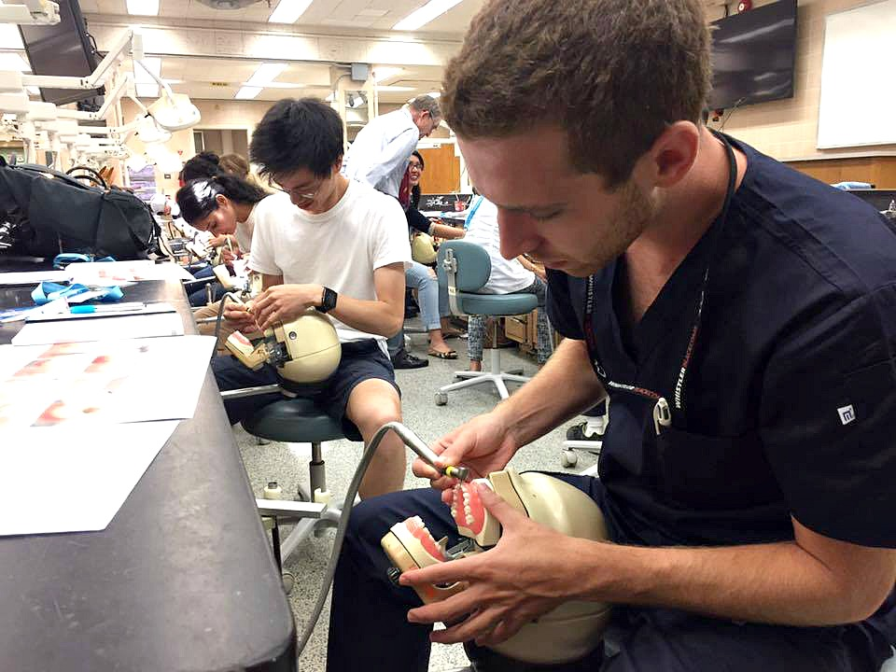
NuSmile's Satellite Symposium on Sept 22 at the U of T School of Dentistry

Slide 8
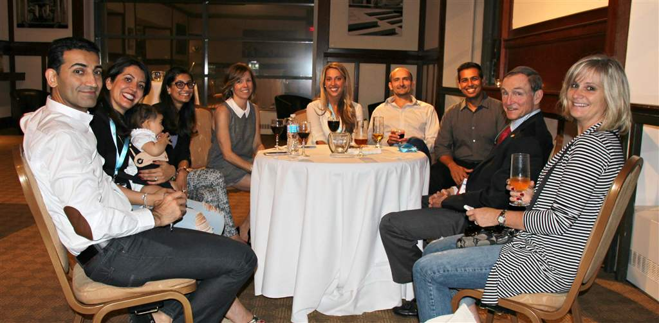
Reception on Sept 22, following NuSmile's Satellite Symposium, with Tara Najm, NuSmile's Education Coordinator in the centre and Dr. Gary Badger (2nd from right)

Slide 9
Friday September 23
Morning Schedule:
Breakfast
Trade Show
Dr. Young Tze Kuah, "Orthodontic Considerations in the Management of Compromised and Hypoplastic Molars"
Morning Break, Sponsored by Henry Schein
Dr. Laura Purcell, "Pediatric Concussions"
Dr. Ann Griffin, "Hypophosphatasia"
Lunch Sponsored by Alexion
Audio Visual Equipment Spsonored by EZPEDO

Slide 10
Trade Show Exhibitors
in addition to the Sustaining and Silver Sponsors

Slide 12
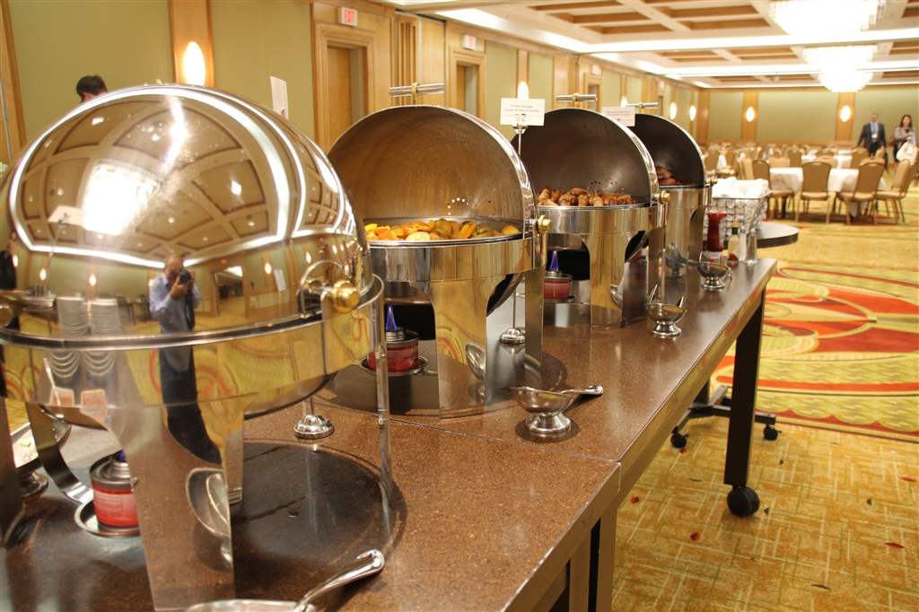
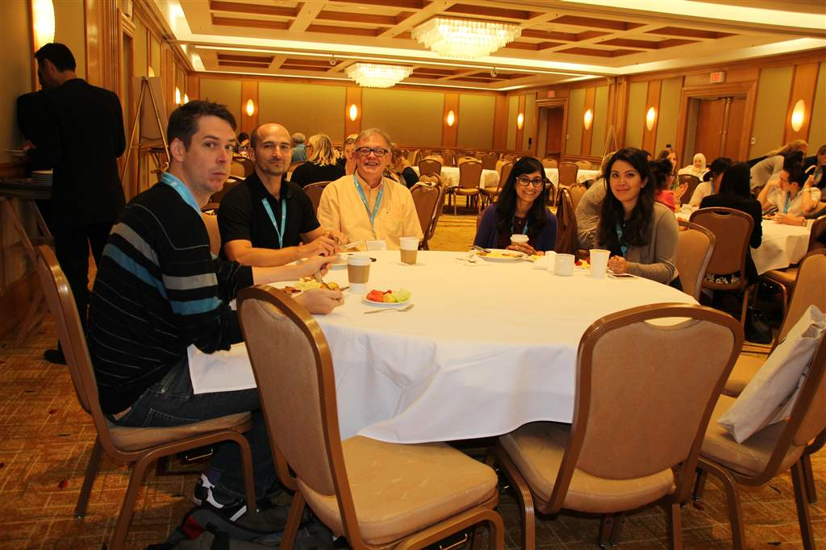
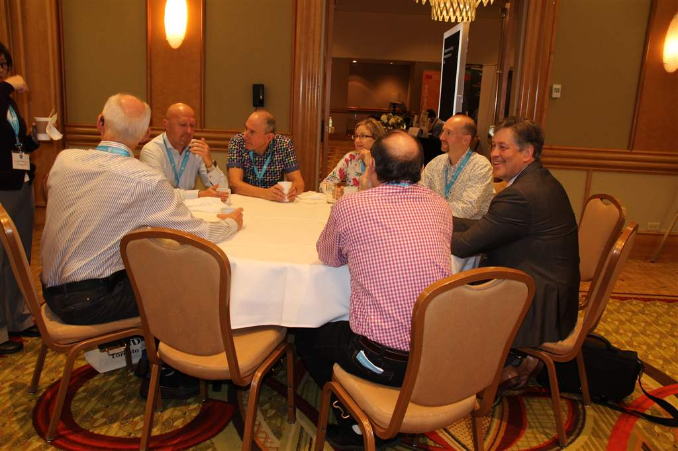
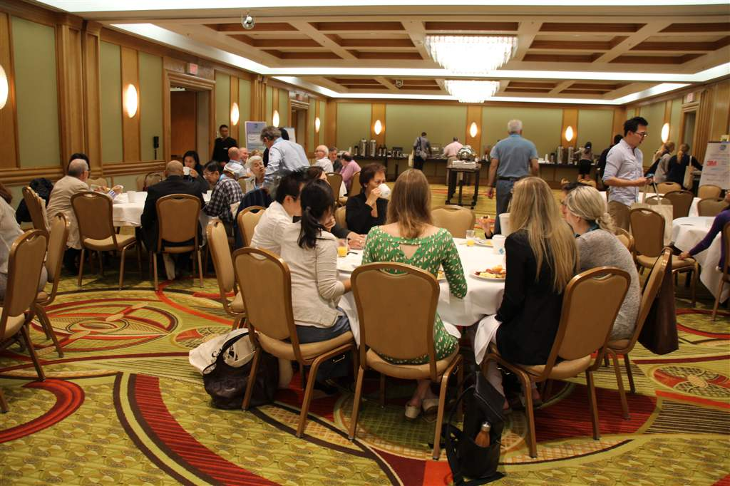

Slide 13
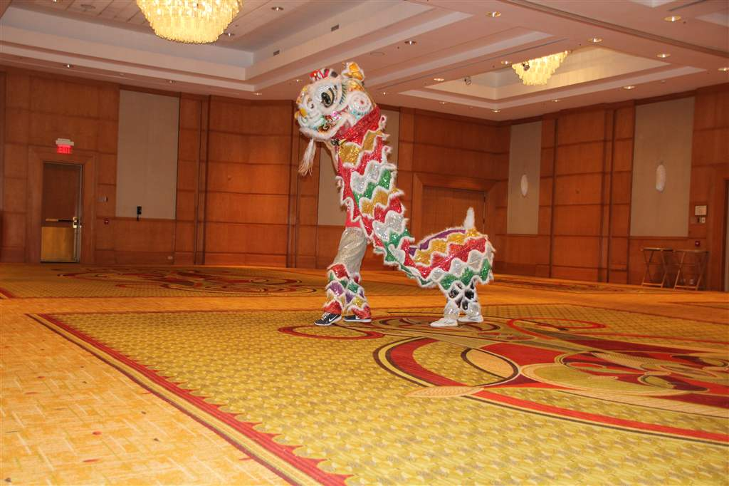
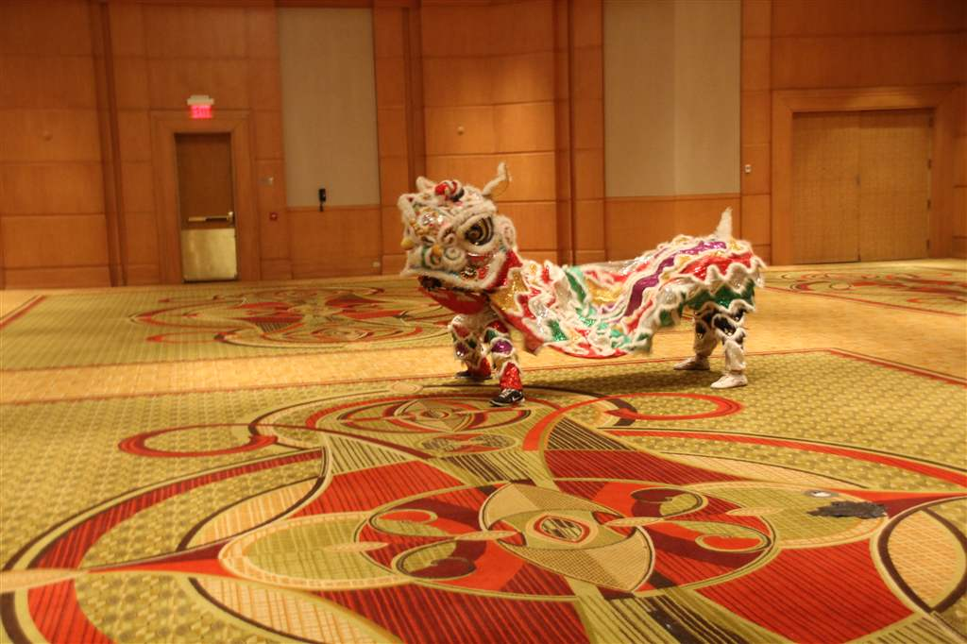
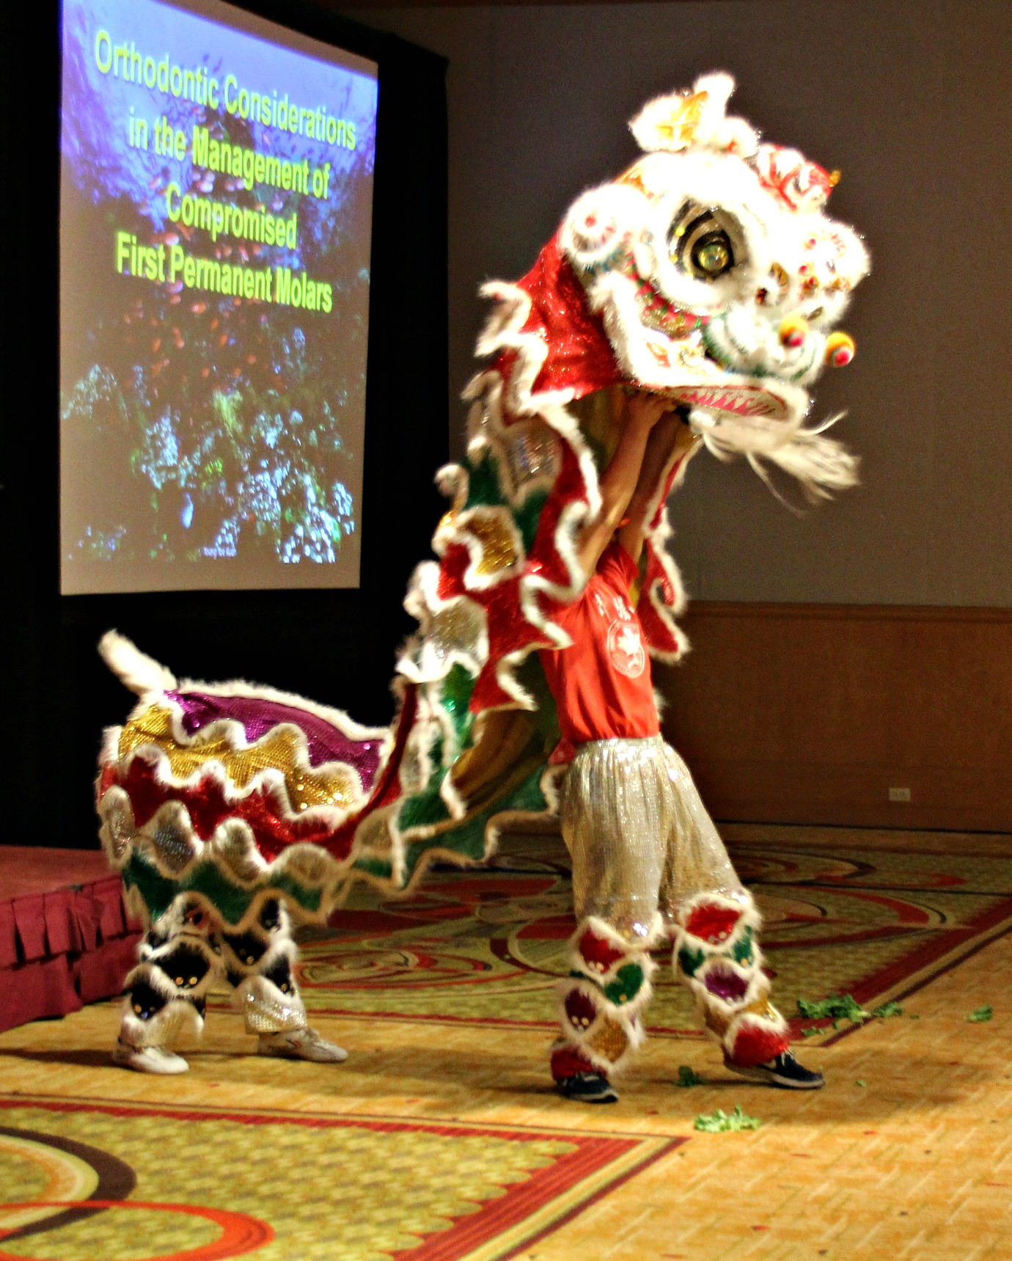
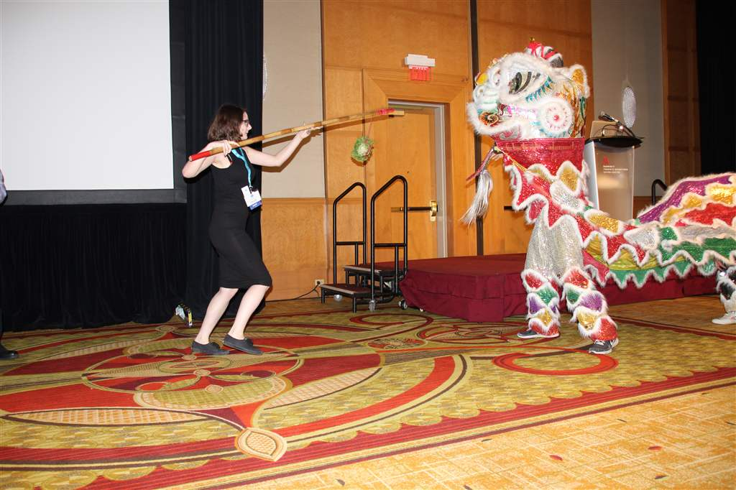
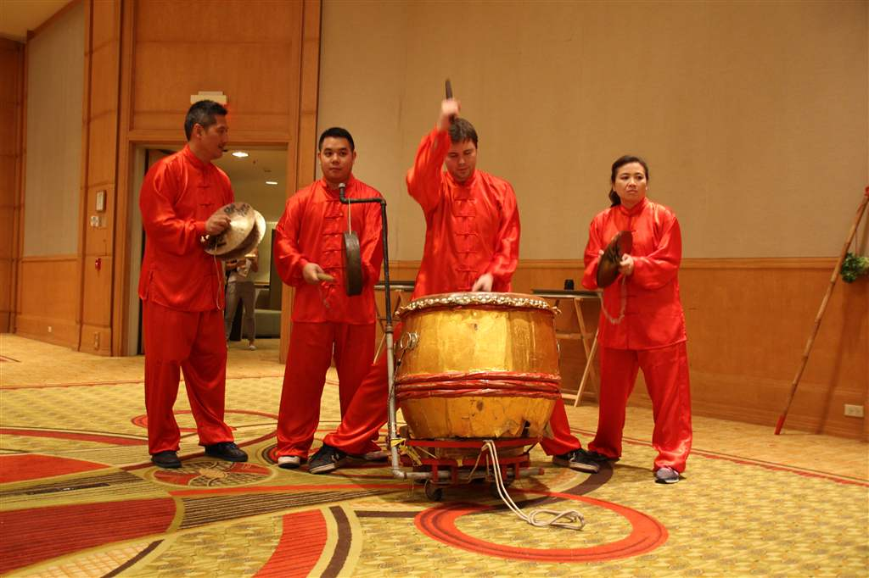
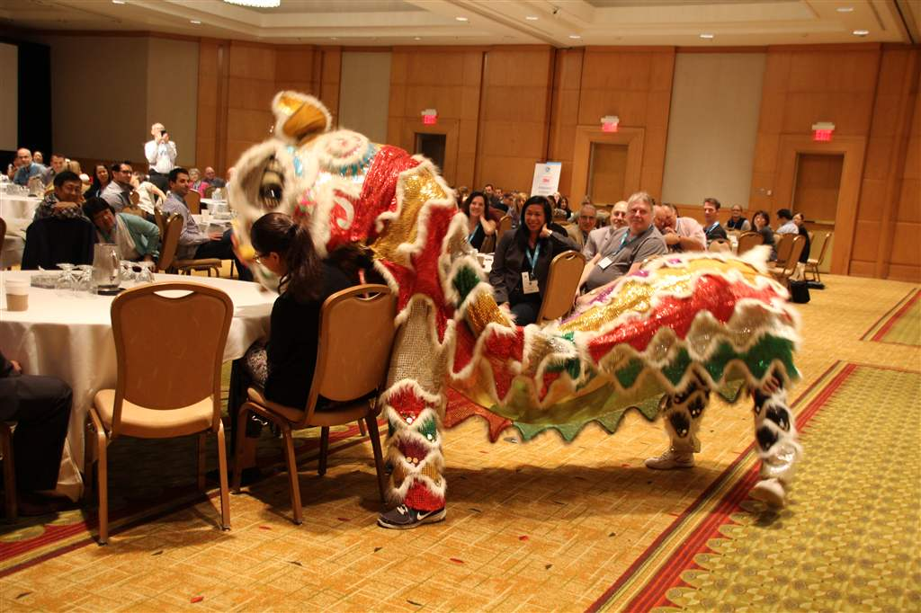
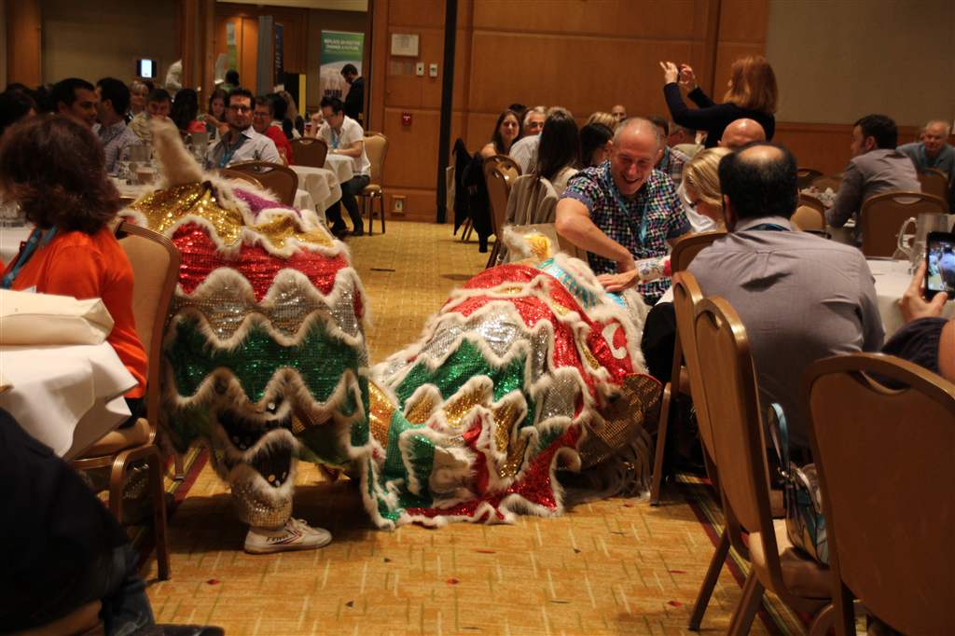
Making sure that only good spirits surround the Annual meeting, courtesy of the Hong Luck Kung Foo Club

Slide 14
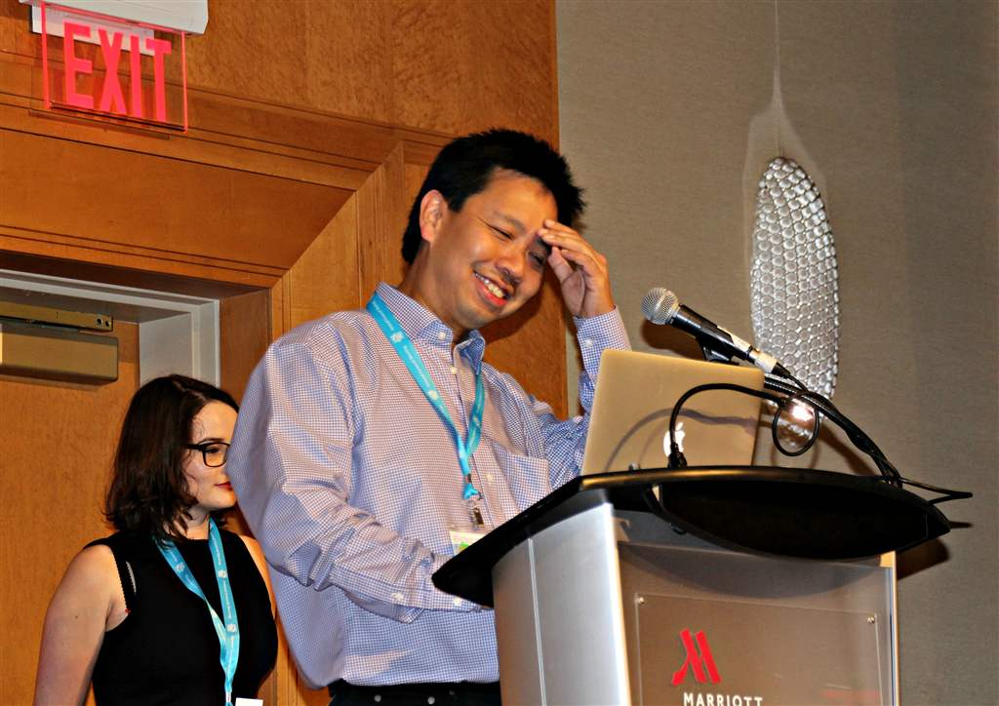

Slide 15
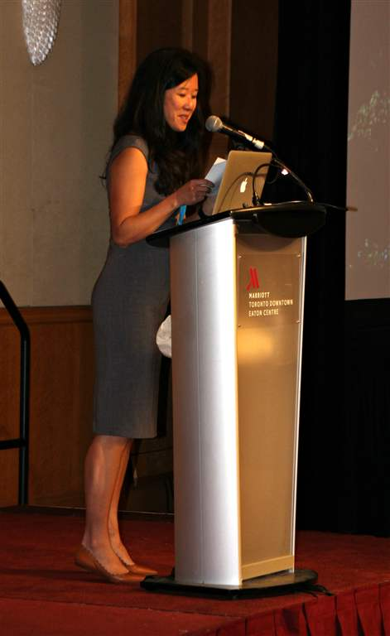

Slide 16
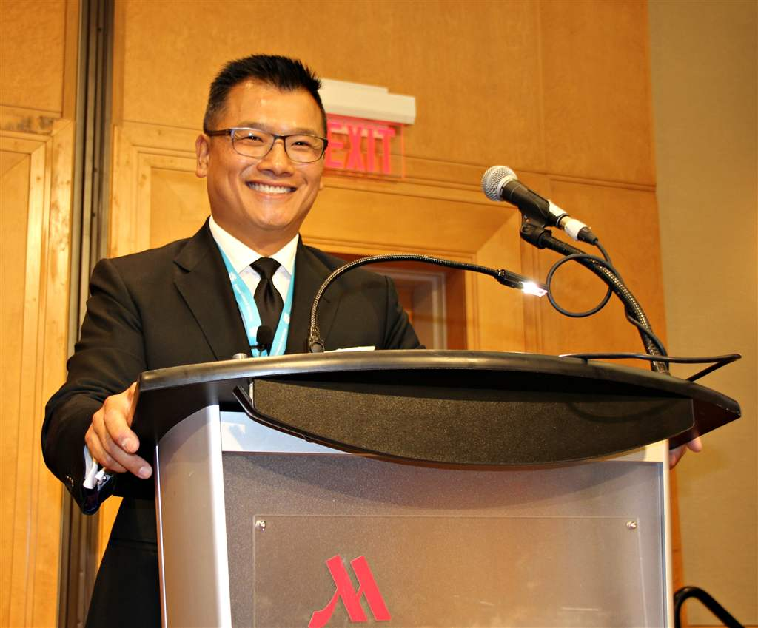
Dr. Young Tze Kuah

Slide 17
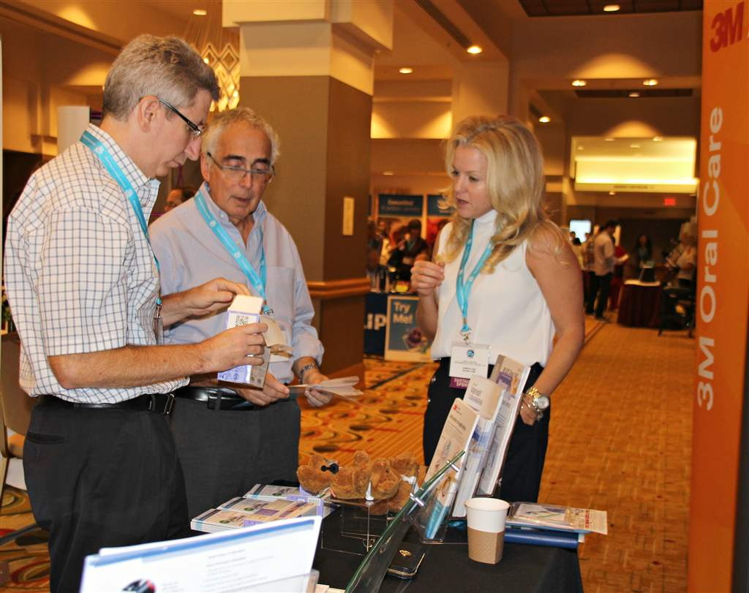
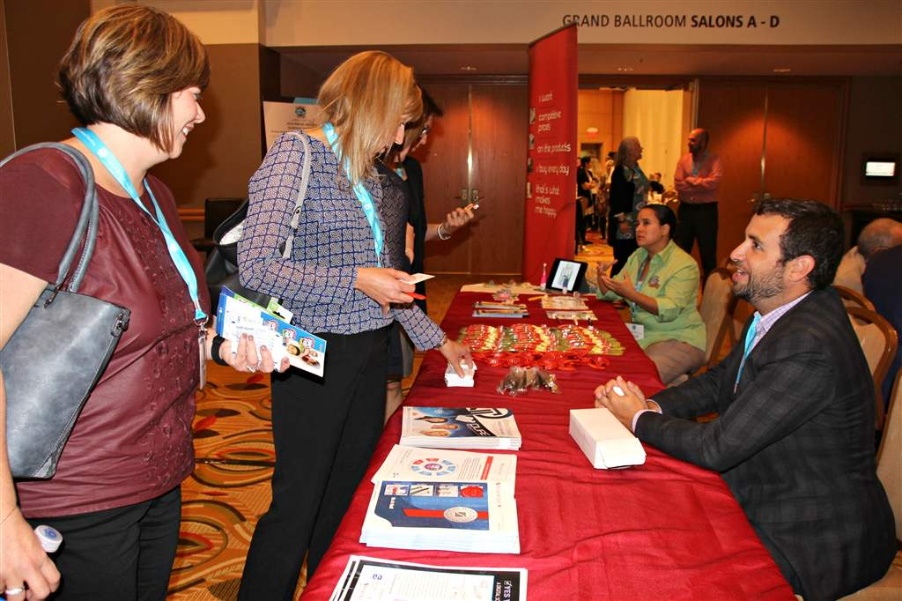
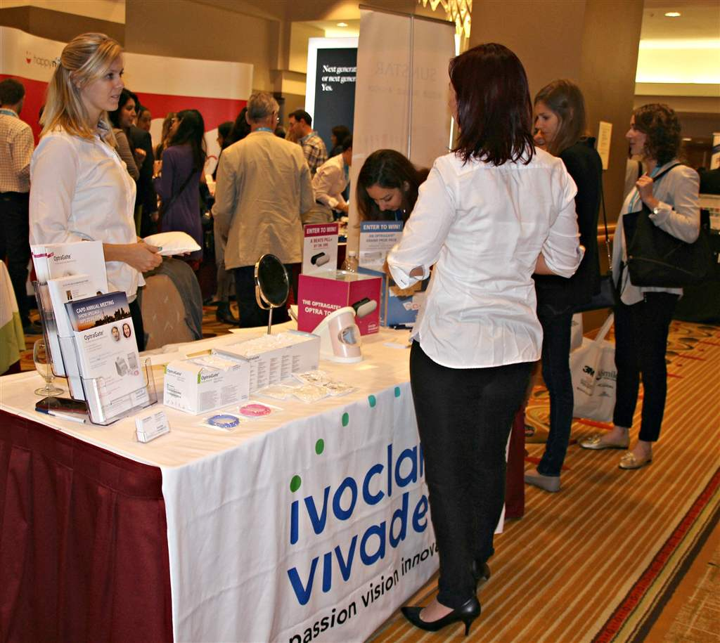
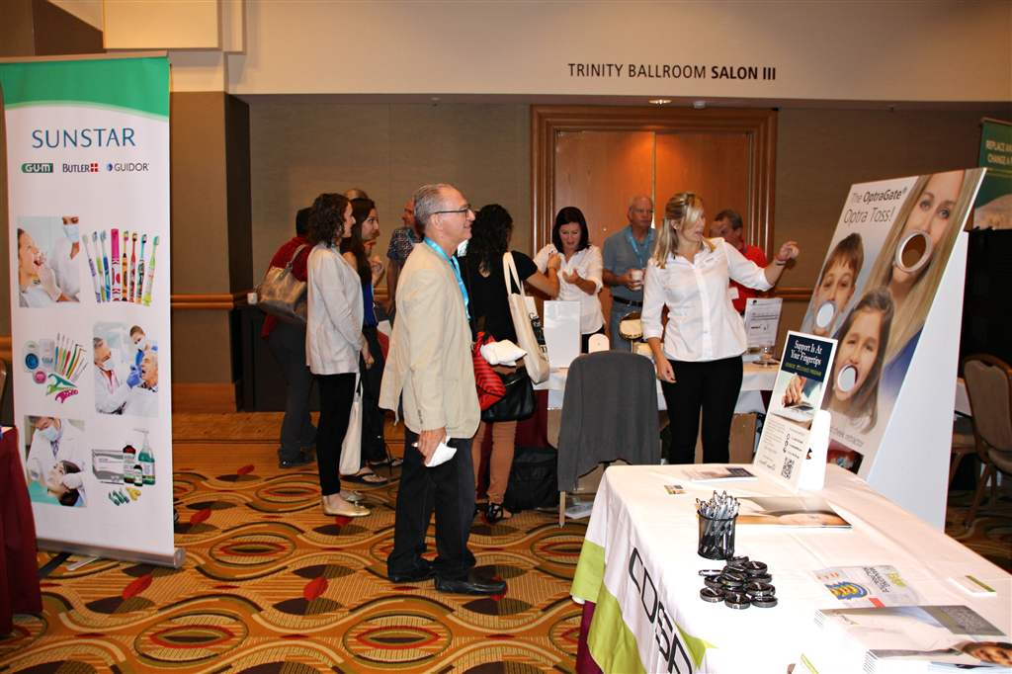

Slide 18
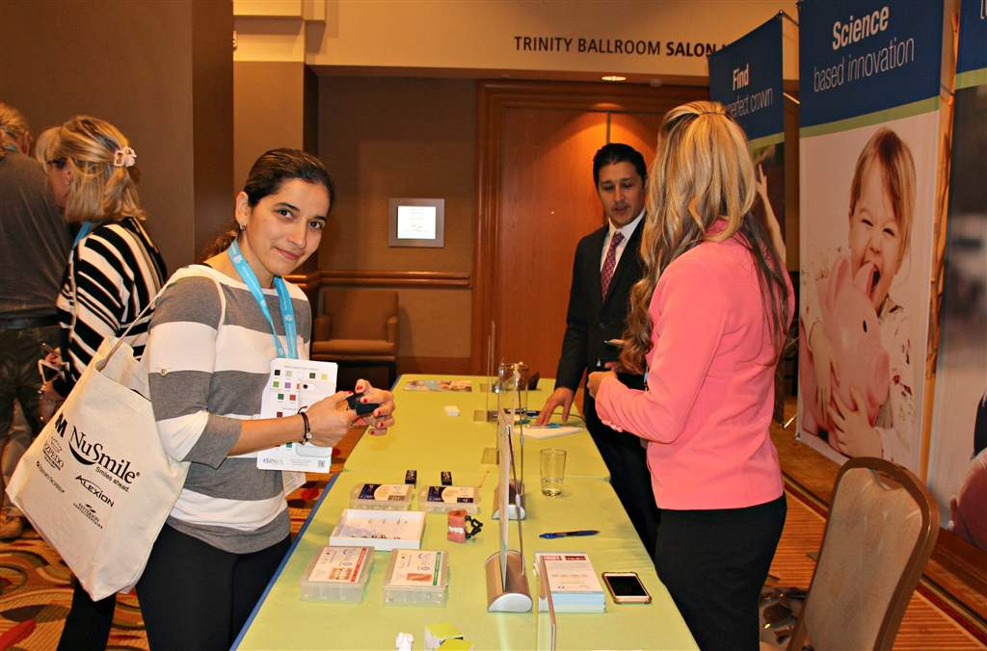
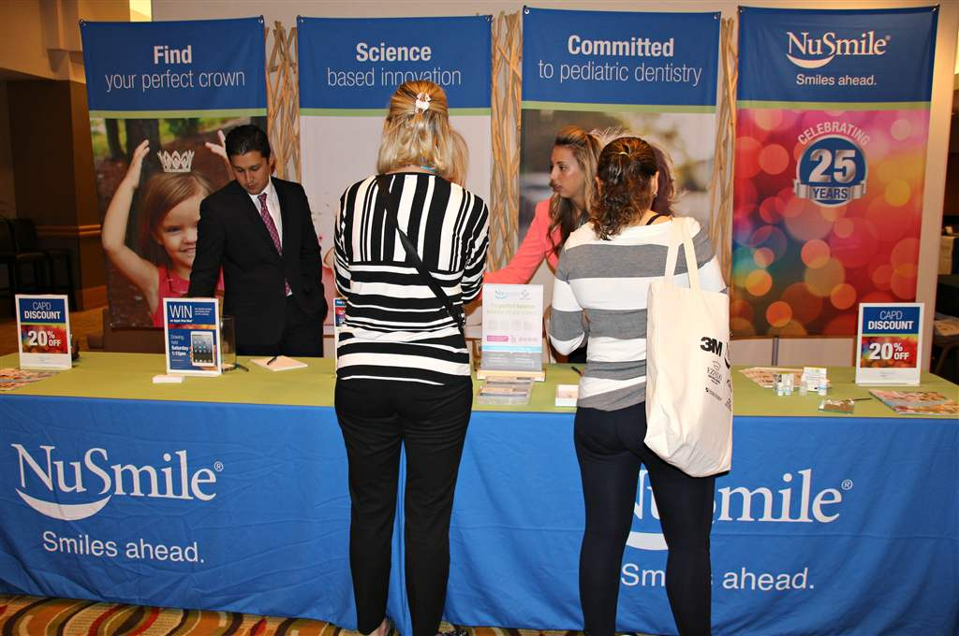
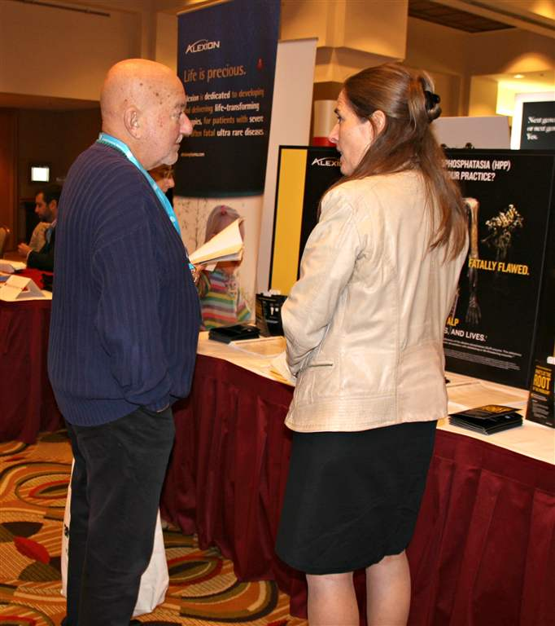
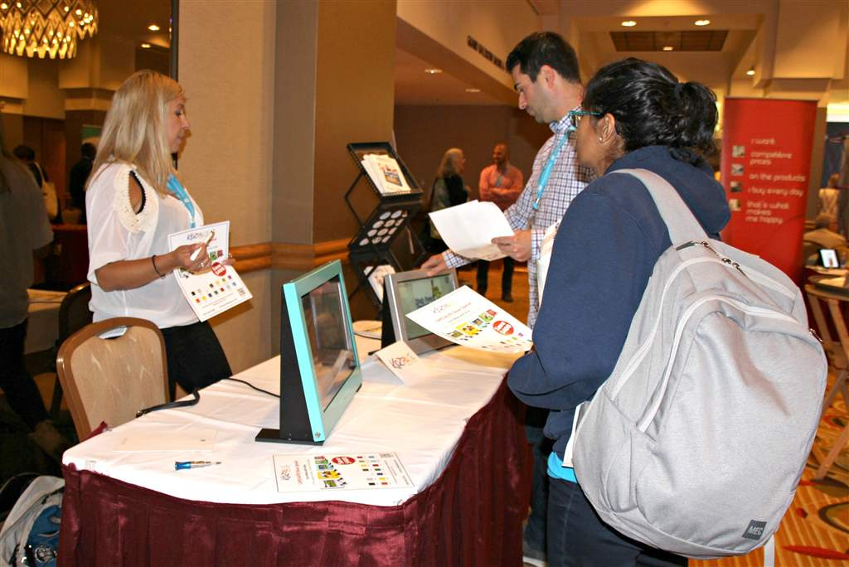

Slide 19
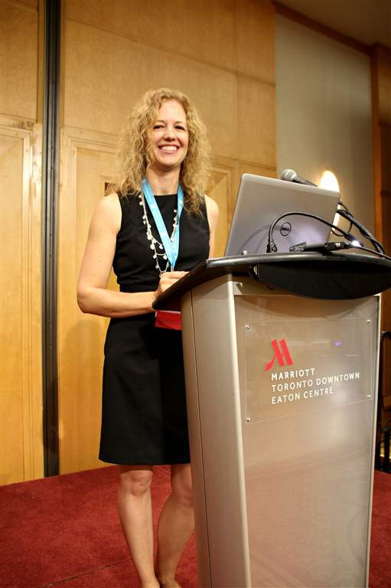
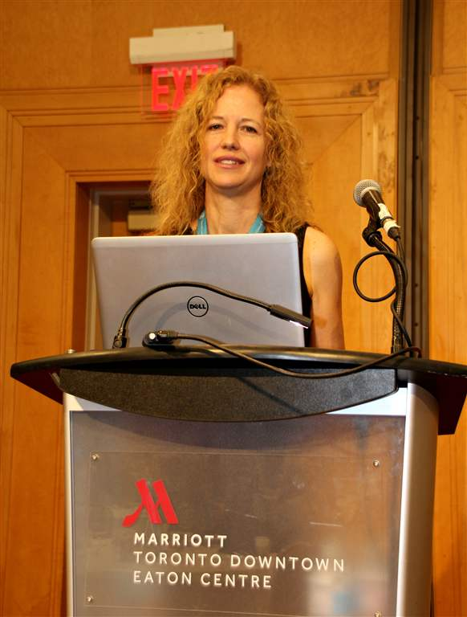
Dr. Laura Purcell

Slide 20
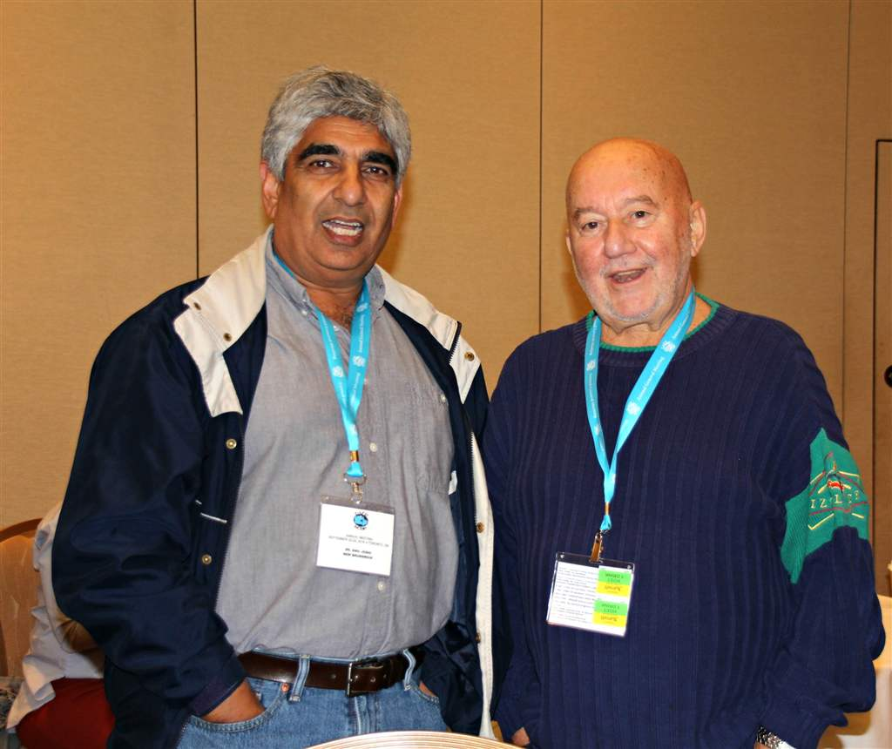

Slide 21
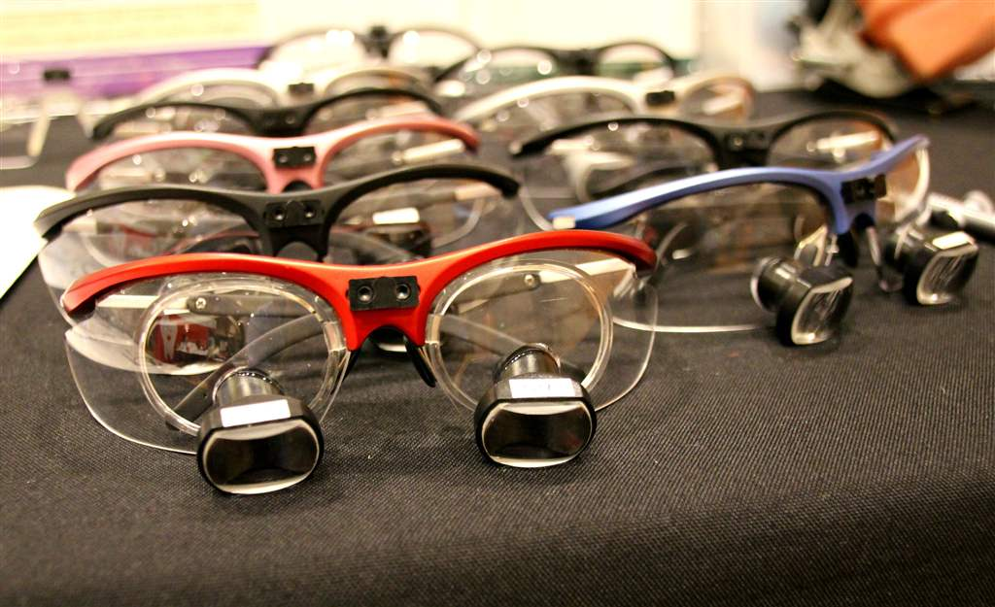
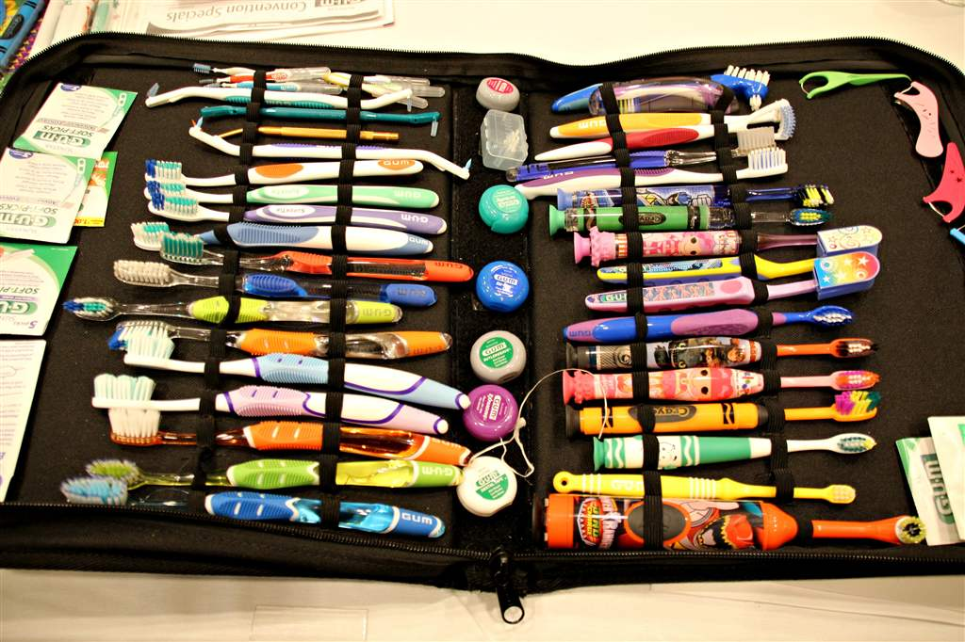
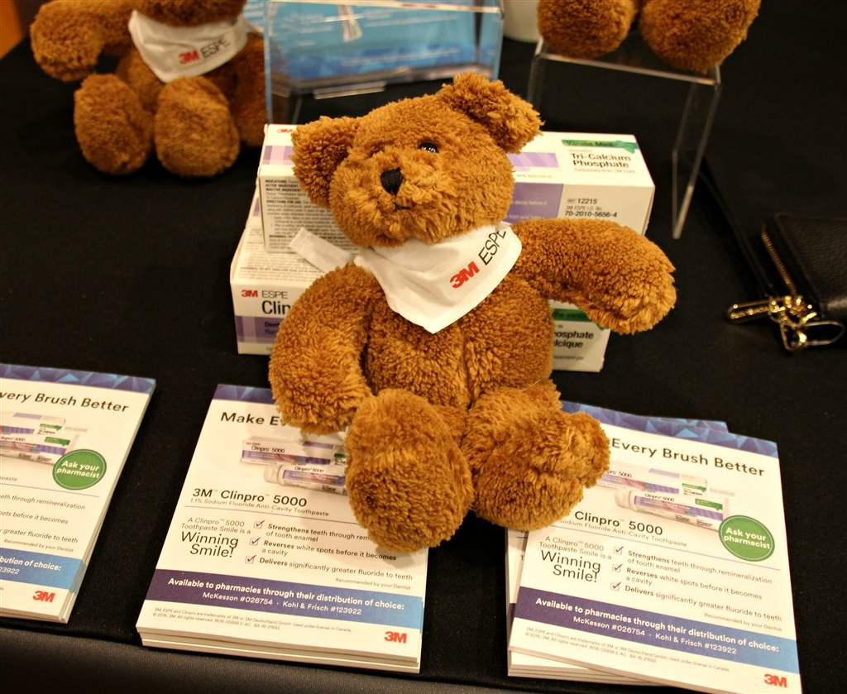
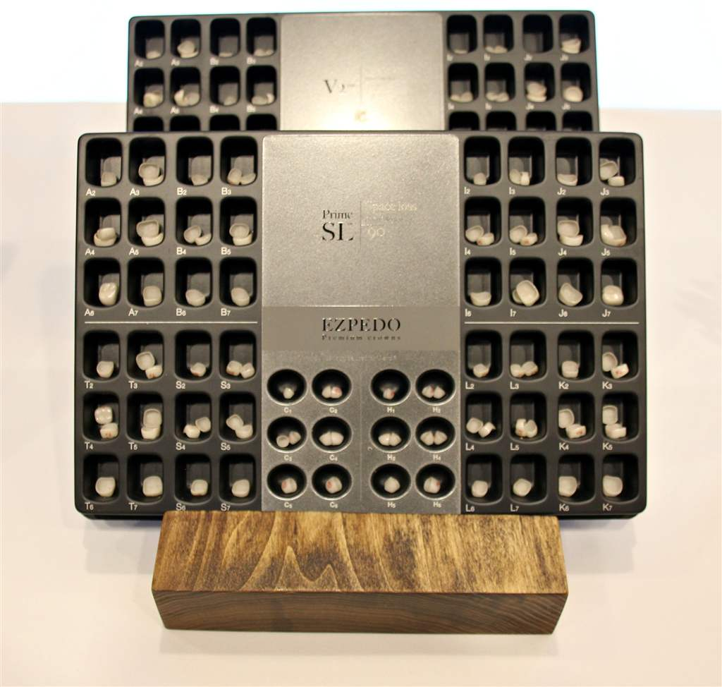

Slide 22
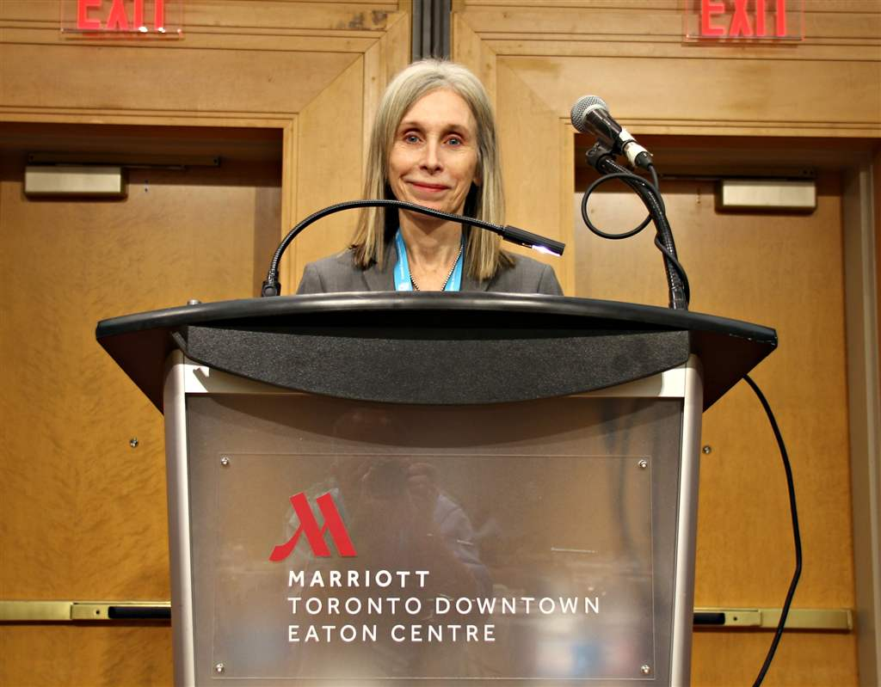
Dr. Ann Griffen

Slide 23
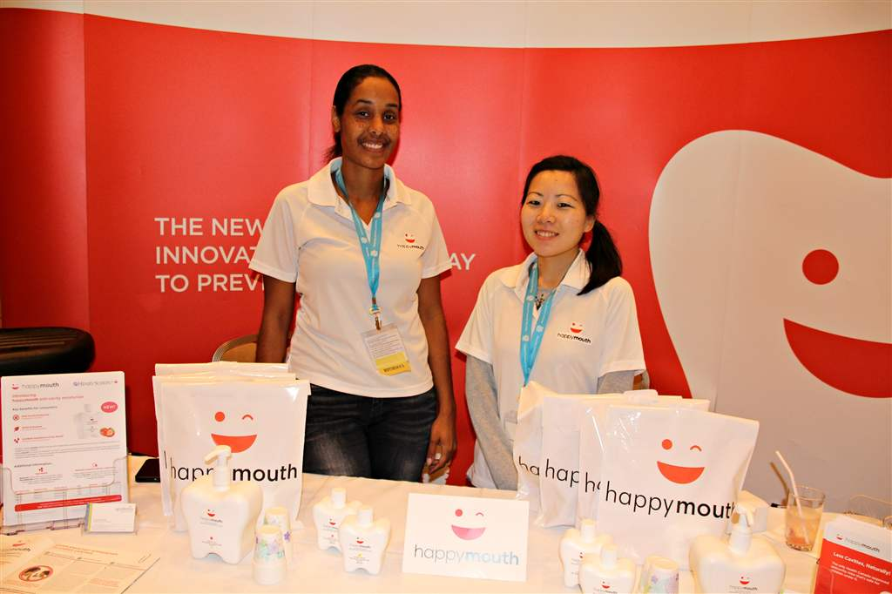
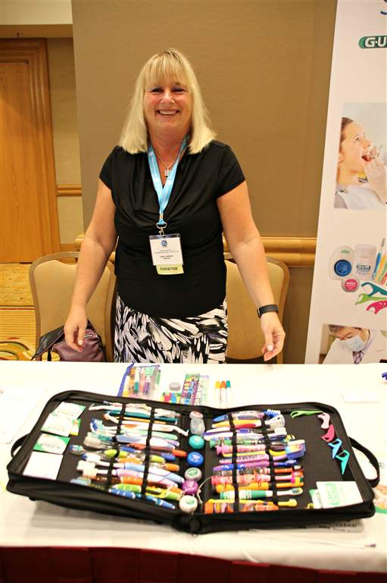
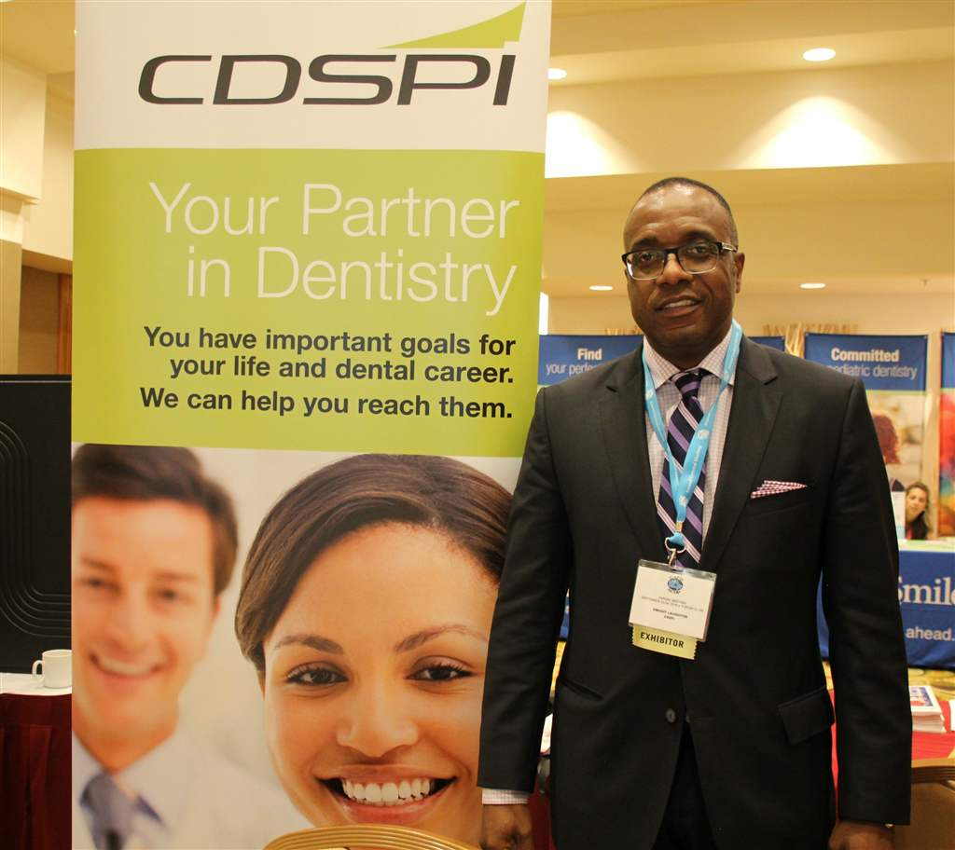
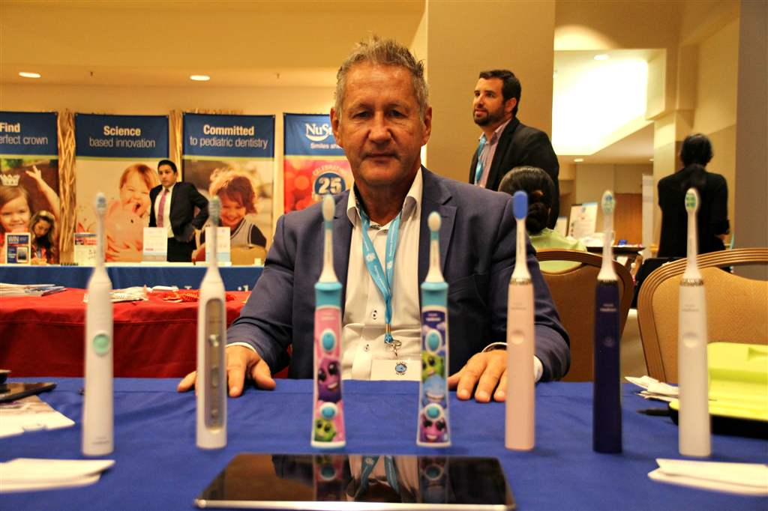

Slide 24
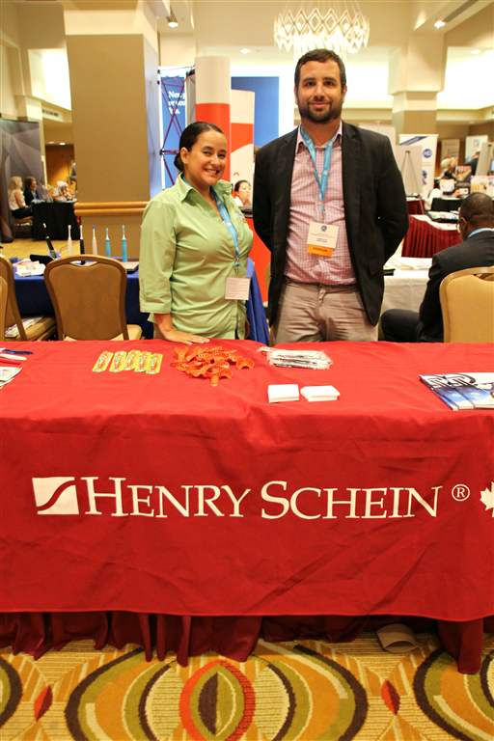
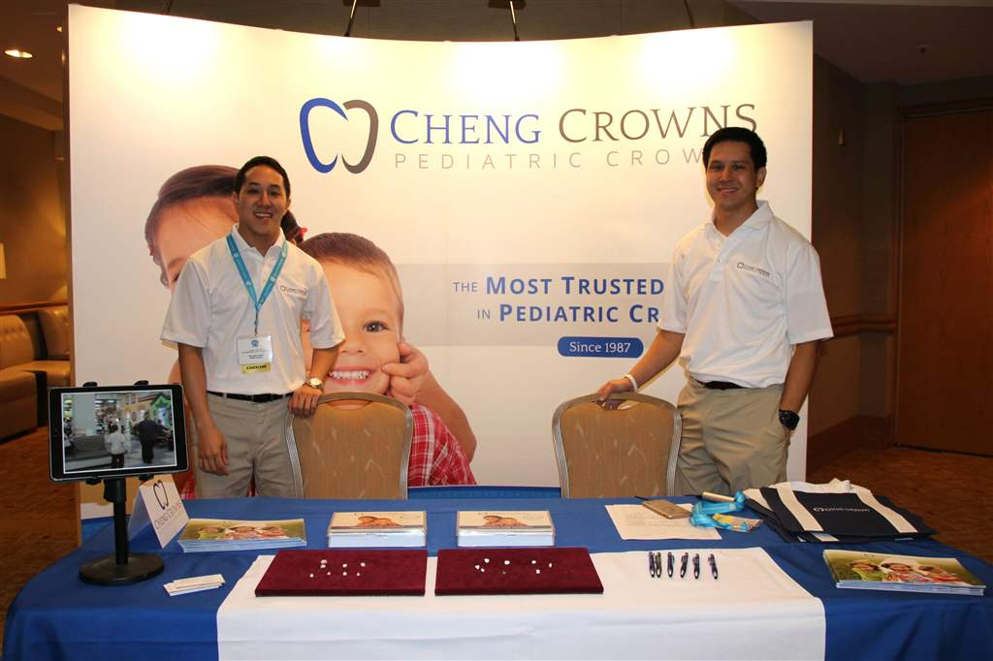
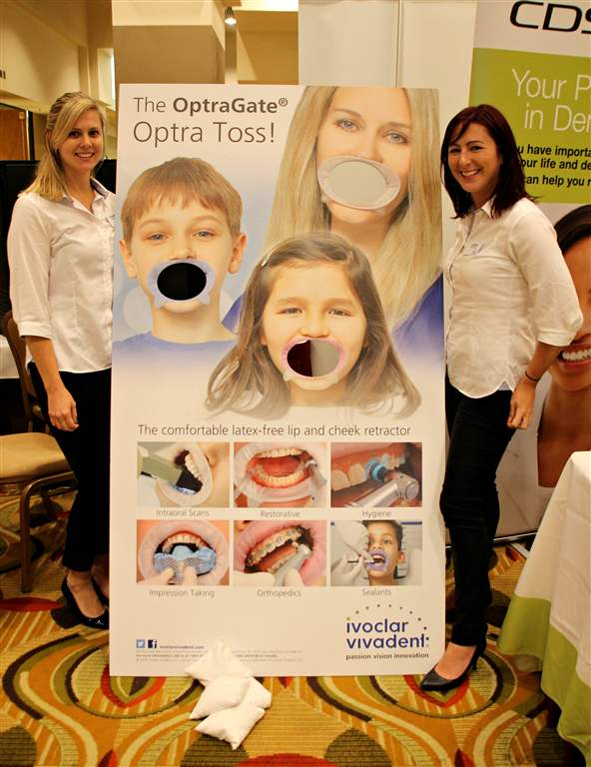
Marisa Salas and Shawn Altro of Henry Schein, one of CAPD/ACDP's Silver Sponsors

Slide 25
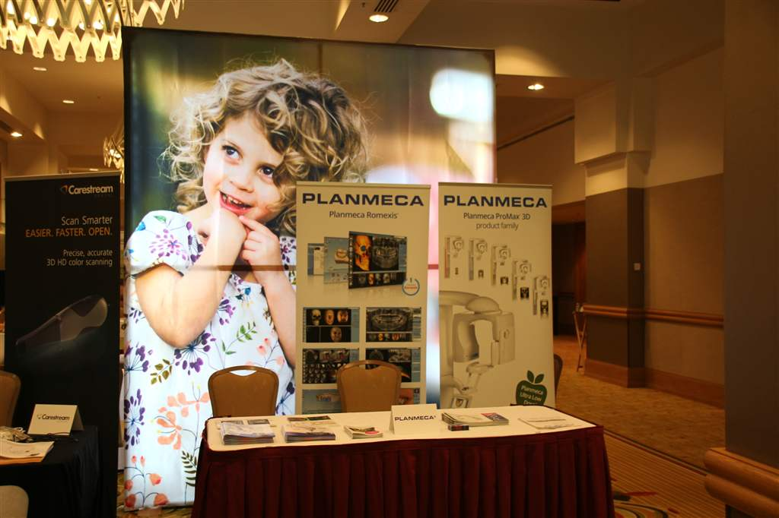

Slide 26
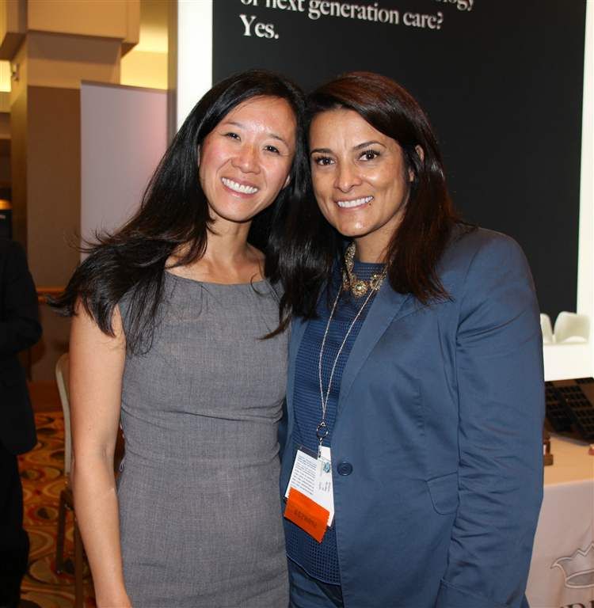

Slide 27
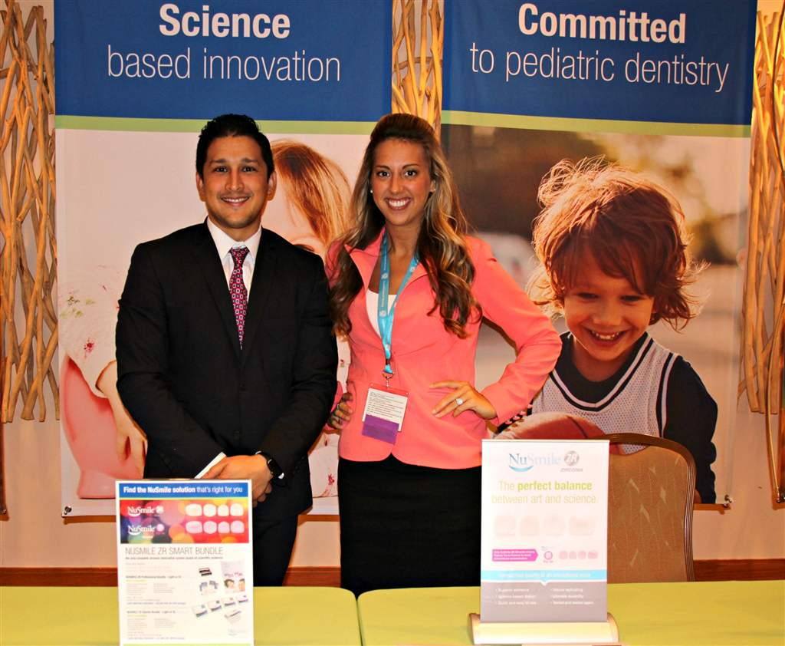

Slide 28
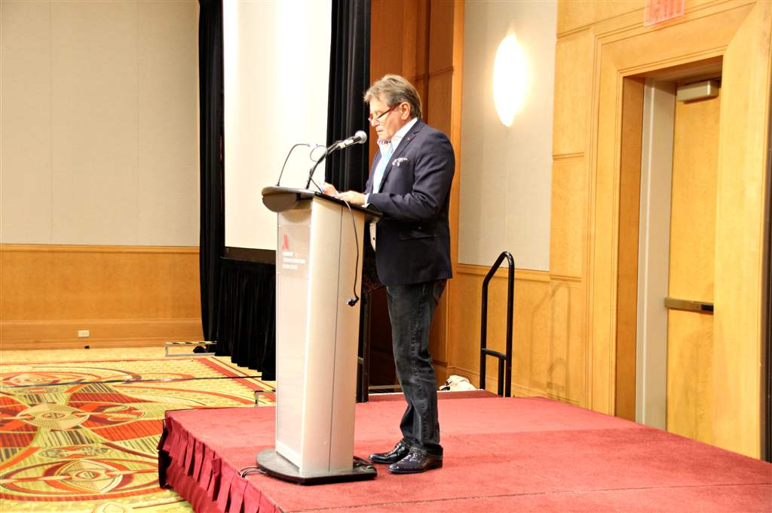
THE ANNUAL GENERAL MEETING

Slide 30
Dr. Victor Legault steps down as CAPD/ACDP's Executive Director

Slide 32
Dr. Elsa Hui-Derkson, Chair of the Scientific Committee, introduces the Graduate Student Presenters.

Slide 33
Dr. Edwin Chan, "Regenerative endodontic treatment of immature necrotic permanent teeth: 30-month follow-up".

Slide 34
Dr. Kunal Chander, "Effects of Aging on Dentin Bonding and Mechanical Properties of Restorative Glass Ionomer Cements"

Slide 35
Dr. Anne-Sophie Fortin Pagé, "Breastfeeding improvement in young infants diagnosed with ankyloglossia after a lingual frenotomy".

Slide 36
Dr. Shuang Liu, "Canadian pediatric residents’ perceptions, training and knowledge of infant oral health".

Slide 37
Dr. Simrit Nijjar. "Comparison of Manitoban general and pediatric dentists behaviour guidance technique usage and preference".

Slide 38
Dr. Becky Olacke, "The Effect of Biophysical Characteristics and Dosing on Pediatric Oral Sedation Outcome".

Slide 39
Double-click to enter text
Friday Evening Welcome Reception at the Hockey Hall of Fame

Slide 40
Dr. Franklin Young and Mimi outside the Hockey Hall of Fame. Franklin served as a member of the Local Organizing Committee

Slide 41
L to R: Brenda Hanson, Executive Director, Vladimir Shcherbak, Operations Manager and Len Epworth, Marketing Manager at EZPEDO, one of CAPD/ACDP's Silver Sponsors.

Slide 47
|10| |44| |45| |47| |2|

Slide 53
Dr. Bob Hustwitt, a member of the Local Organizing Committee, shows us how it's done

Slide 63
A Big Thanks to Daniel & Daniel Catering

Slide 66
Saturday September 24
Morning Schedule:
Breakfast
Trade Show
Dr. Martha Anne Keels, "Eureka Moments in Pediatric Dentistry"
Morning Break, Sponsored by Alexion
Lunch
Dr. Keels' Session Continues
Afternoon Break
Cocktail Reception
President's Gala Dinner and Dance, sponsored by NuSmile.

Slide 67
Saturday morning

Slide 70
Dr. Errol Nezon introduces the Keynote speaker...
Dr. Martha Ann Keels

Slide 75
EZPEDO congratulates Janine Hermine, winner of their Tradeshow draw for an Apple Watch.
L to R: Brenda Hansen, Dr. Brad Krusky, Janine Hermine, Vlad Shcherbak and Len Epworth.

Slide 76
Alex Martinez, NuSmile's Director for Latin America, congratulates Dr. Sabrina Huda on winning the Tradeshow Draw for an ipad Mini

Slide 82
The Cocktail Reception and the President's Gala Dinner and Dance

Slide 88
Ray with Liane Blandford and Sara Chown from Alexion, one of CAPD/ACDP's Silver Sponsors

Slide 89
Dr. Patrick Canonne, Past President, congratulates Dr. Victor Legault, CAPD/ACDP's new Honourary Member.

Slide 90
Dr. Carol Janik: Remembering Dr. Arlington Dungy's contribution to the profession.

Slide 91
Dr. Paul Andrews, President, honours Dr. Patrick Canonne, Past President

Slide 92
Left: Dr. Patrick Canonne....Right: Dr. Paul Andrews

Slide 111
Gigie McGlynn of 3M announces the 2016 Winner of the Graduate Student Presentations

Slide 112
Dr. Edwin Chan of the University of Toronto receives the 3M Award and the $1000.00 prize.

Slide 113
L to R: Steve Gillick, Director of Operations, Claire D'Amour, Executive Secretary and Dr. Raymond Lee, CAPD/ACDP Vice President and Chair of the Local Organizing Committee

Slide 118
Andre Bisson and the JTones were the hit entertainment for the evening.

Slide 119
www. andrebisson.ca

Slide 120
A Huge Thank You to All the CAPD/ACDP Members who were able to attend the 2016 Annual Conference, as well as to the Speakers, student presenters, Sponsors, Exhibitors, the Marriott Hotel, Daniel & Daniel Catering, the Hockey Hall of Fame, Andre Bisson and the JTones and many others who helped behind the scenes.
We look forward to greeting Members, Sponsors and Exhibitors at the Fort Garry Hotel in Winnipeg, Manitoba September 14-15-16, 2017

