Slide 1
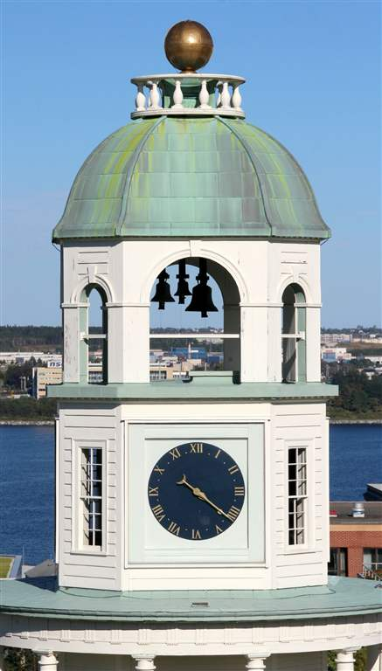
CAPD/ACDP 2015 ANNUAL MEETING
Halifax, Nova Scotia September 25-26

Slide 2
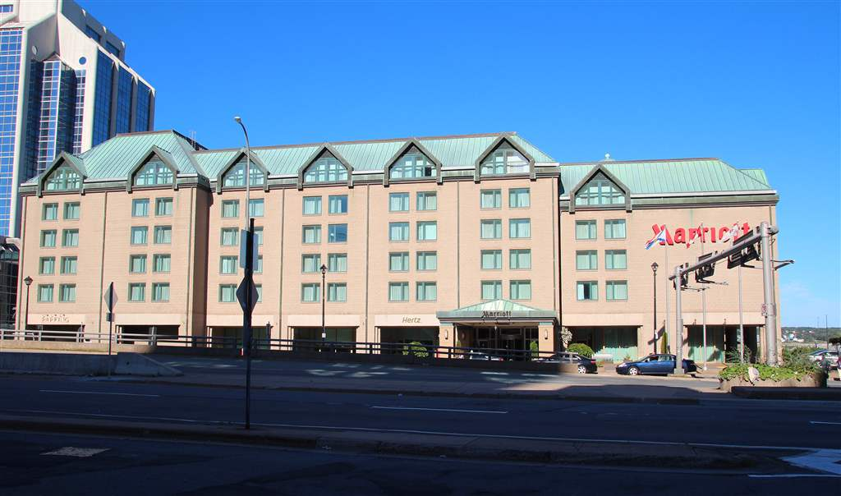
Local Organizing Committee
Dr. Jennifer MacLellan, Chair
Drs. Ross Anderson, Tracy Doyle, Heather Dyment, Anil Joshi
Conference Venue
Halifax Marriott Harbourfront Hotel

Slide 3
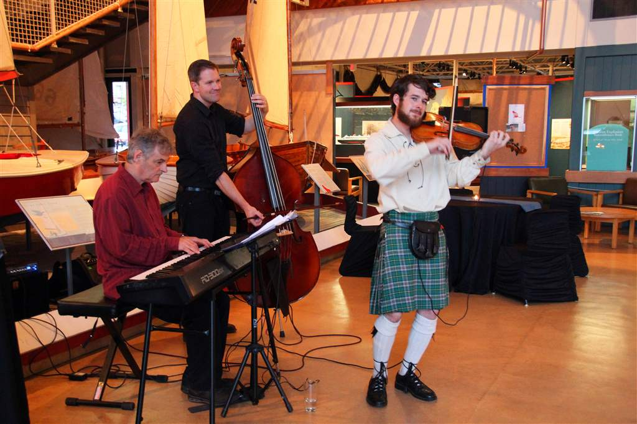
Opening Reception Entertainment by The Fine Tuners
www.thefinetuners.ca

Slide 4
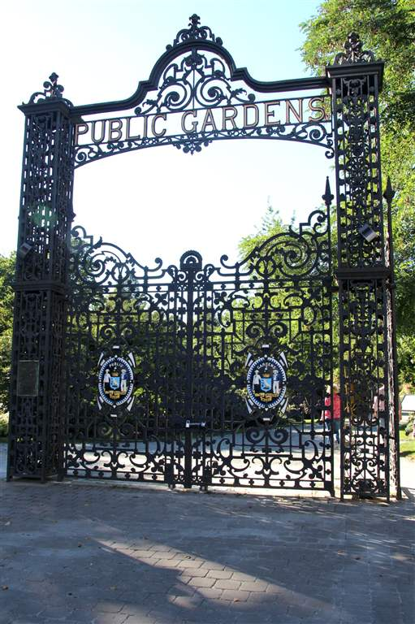
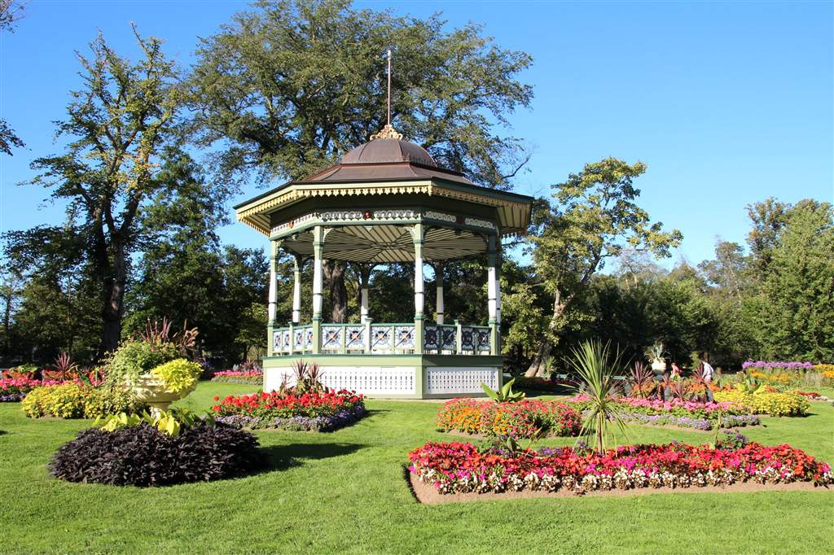
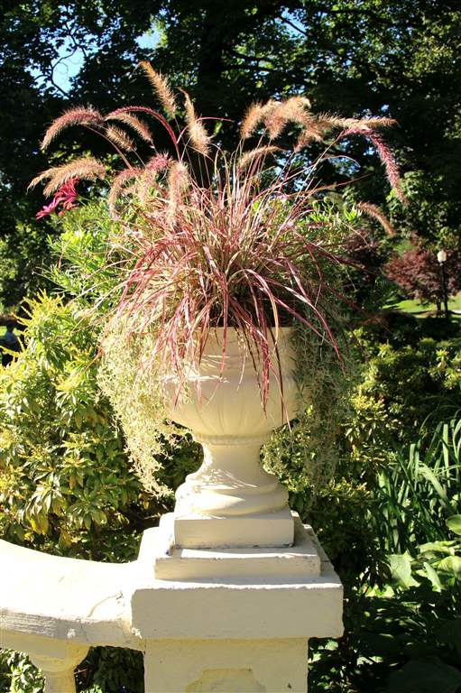
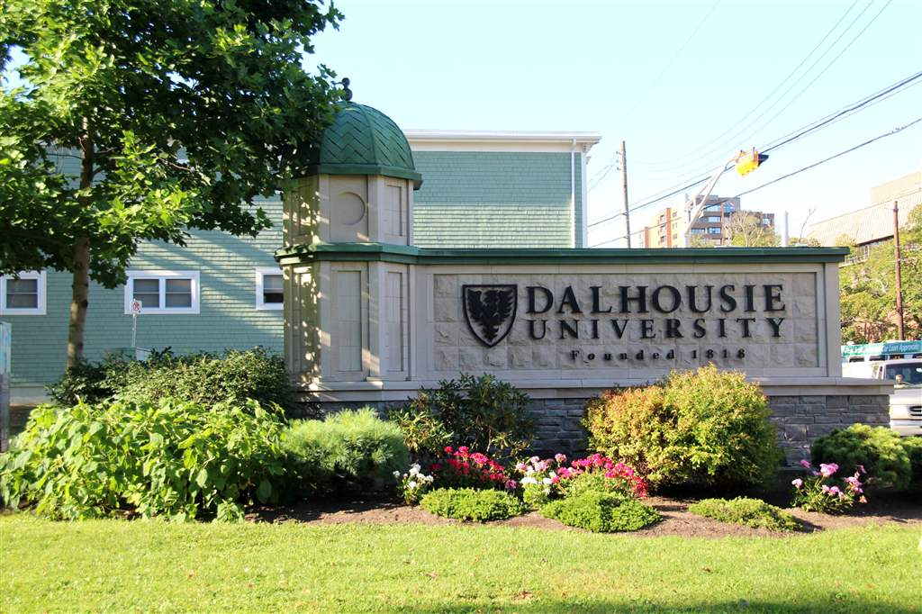
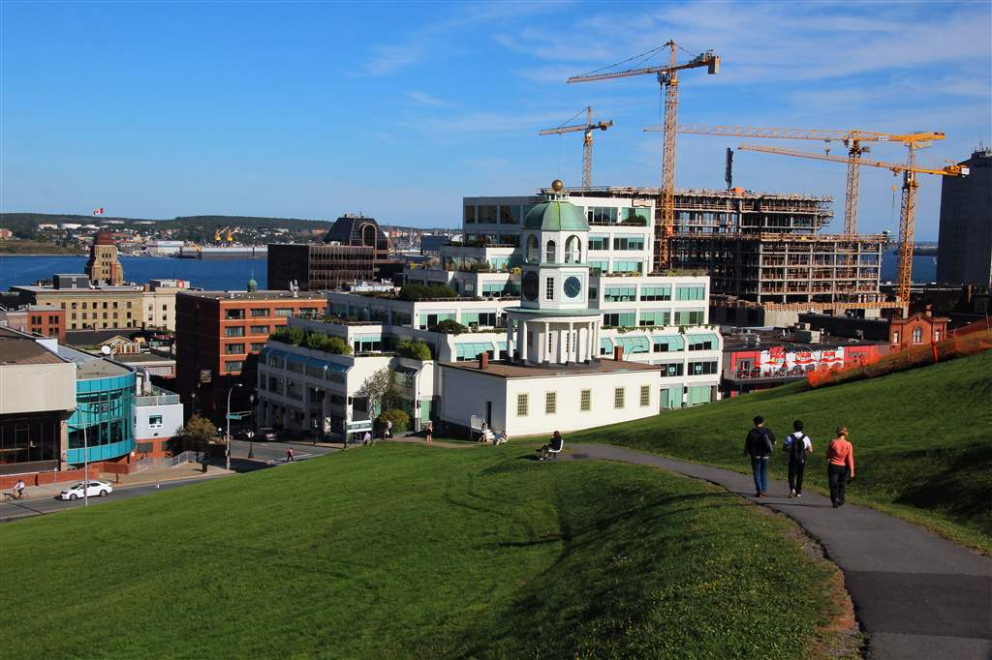
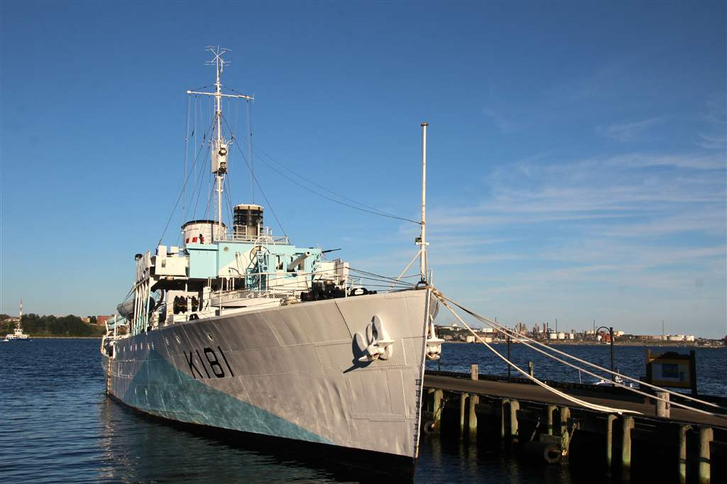
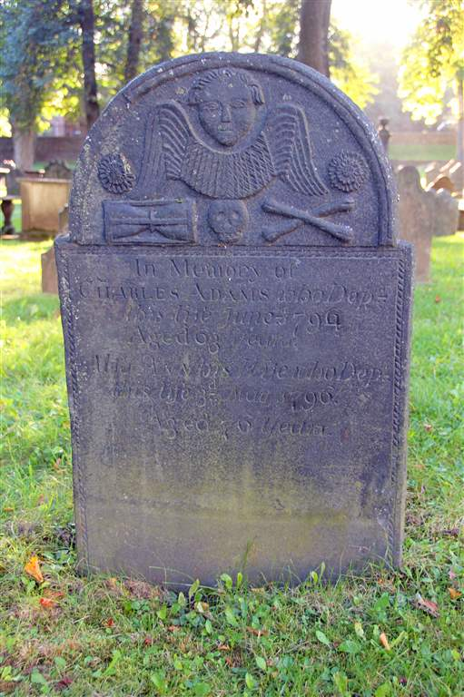
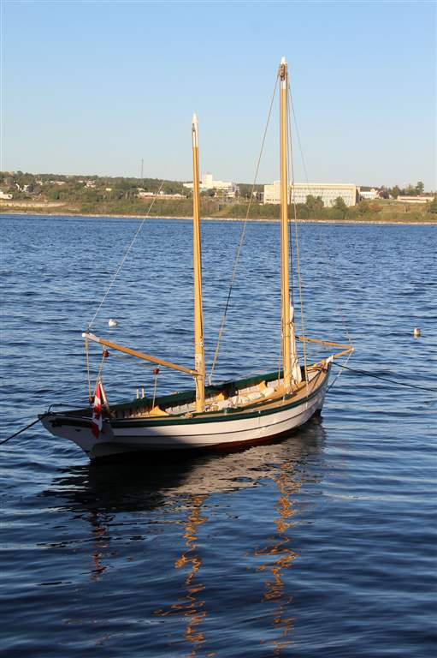
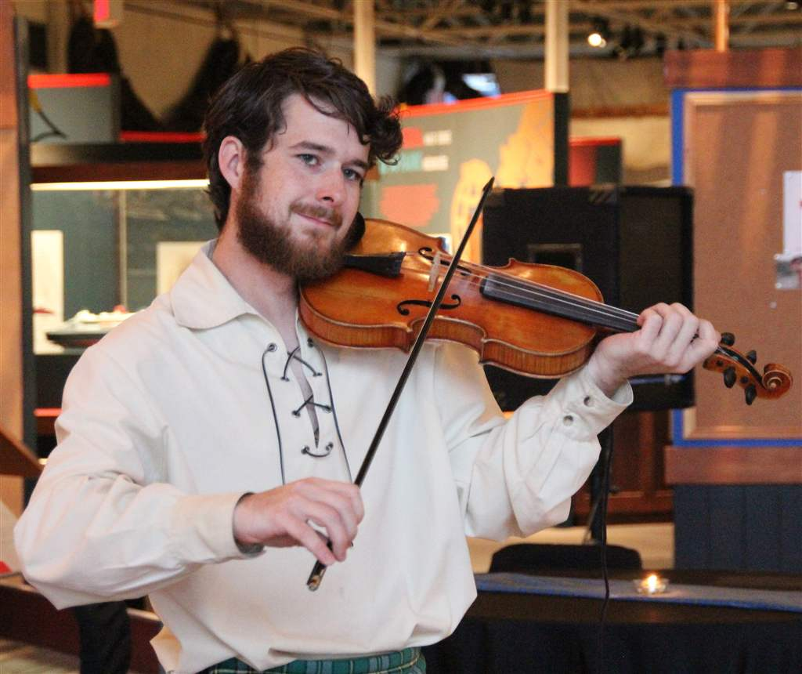
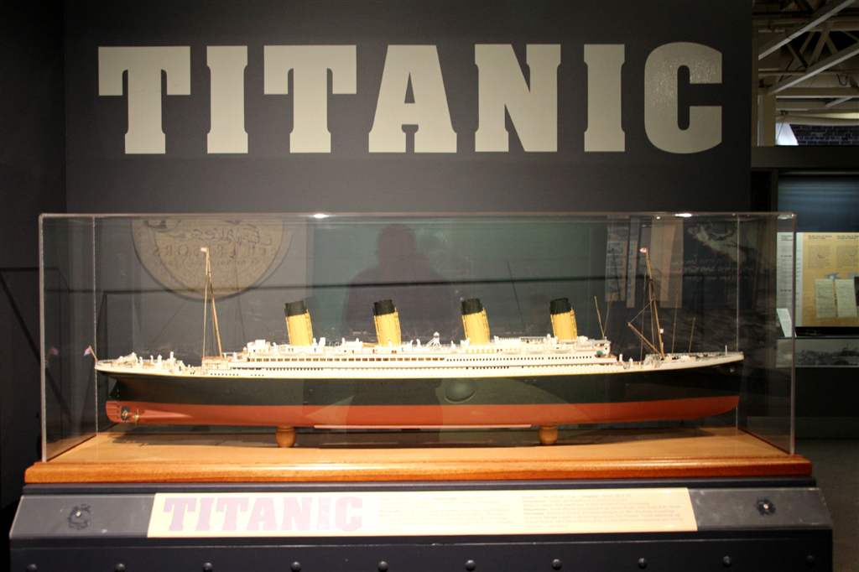
Strolling around Halifax

Slide 5
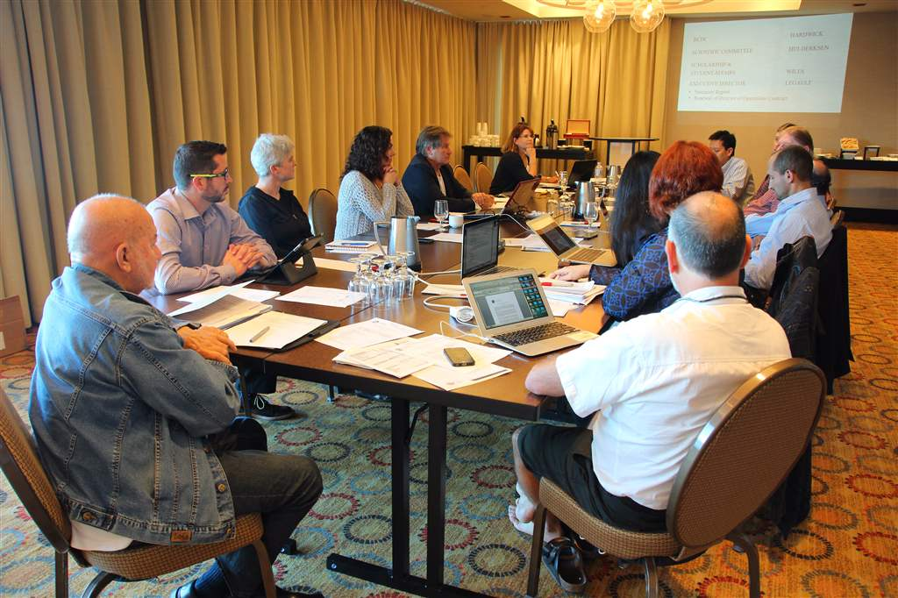
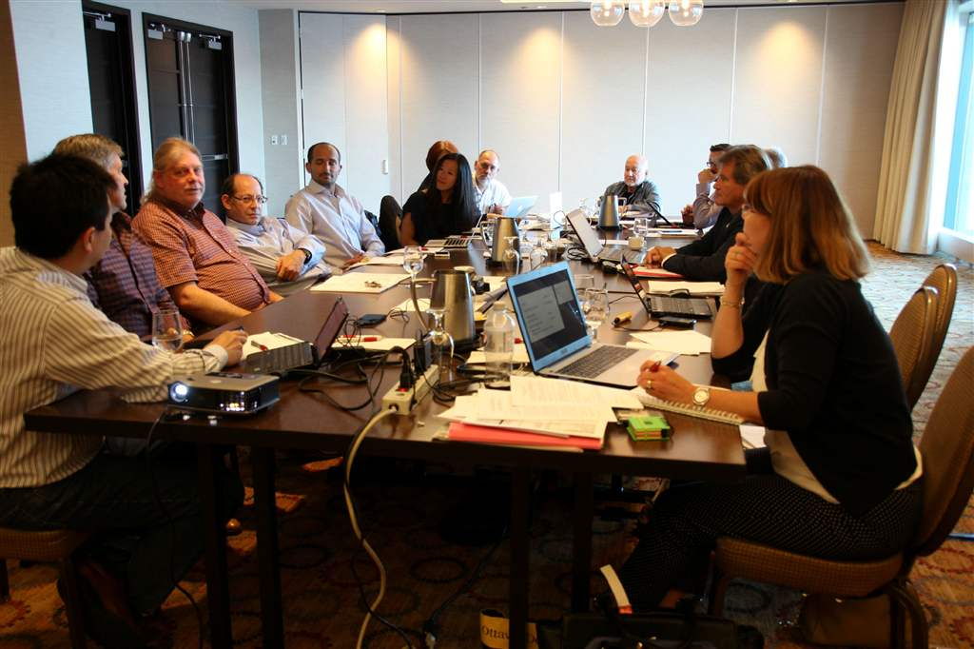
Meeting of the Executive Committee on September 24, 2015

Slide 6
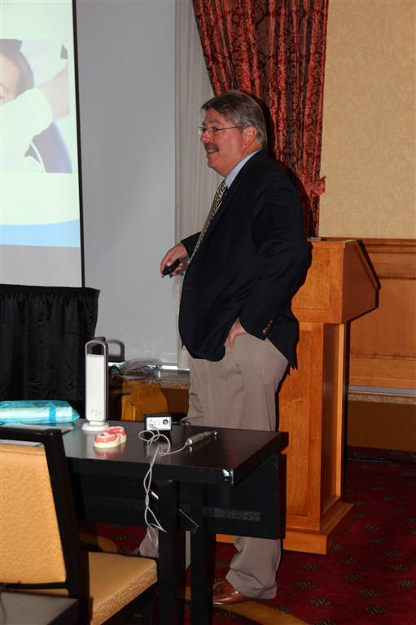
Satellite Symposium, sponsored by NuSmile, featuring Dr. Kevin Donly on "Esthetic Pediatric Crowns In-Depth"

Slide 7
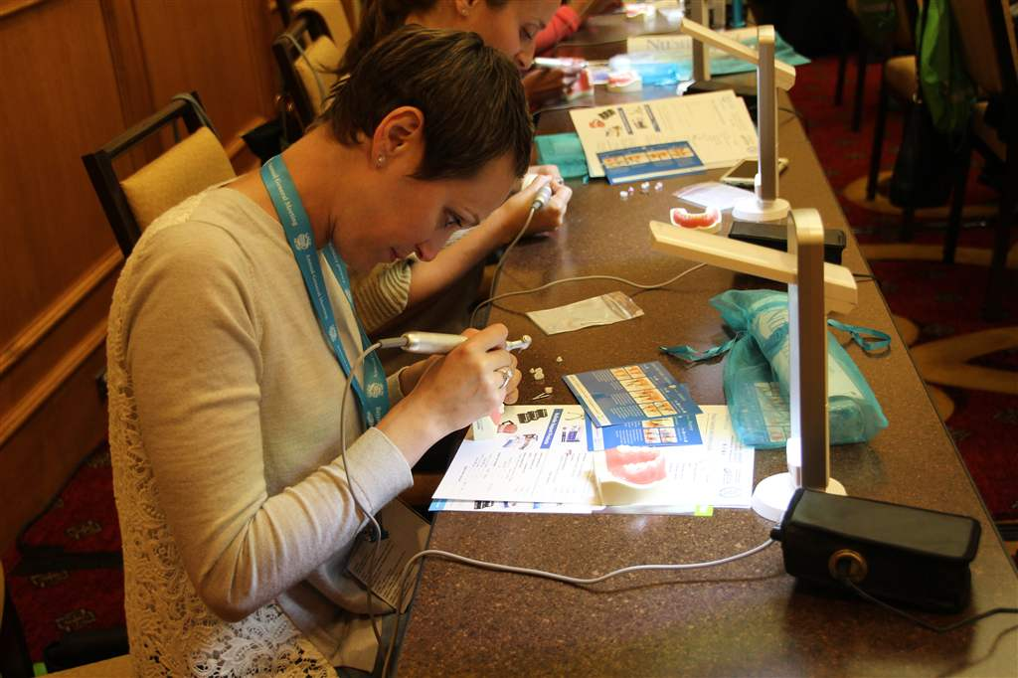

Slide 8
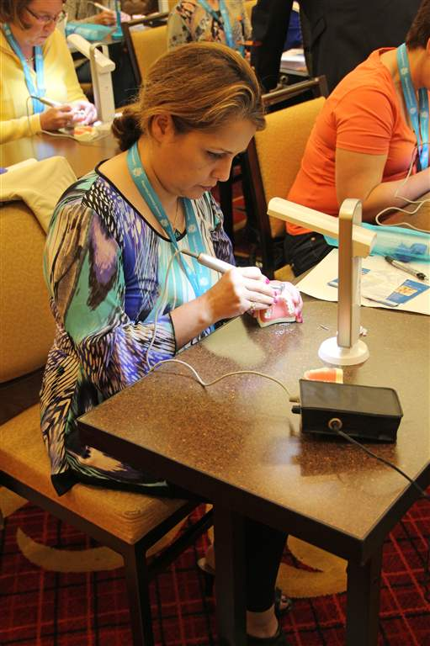
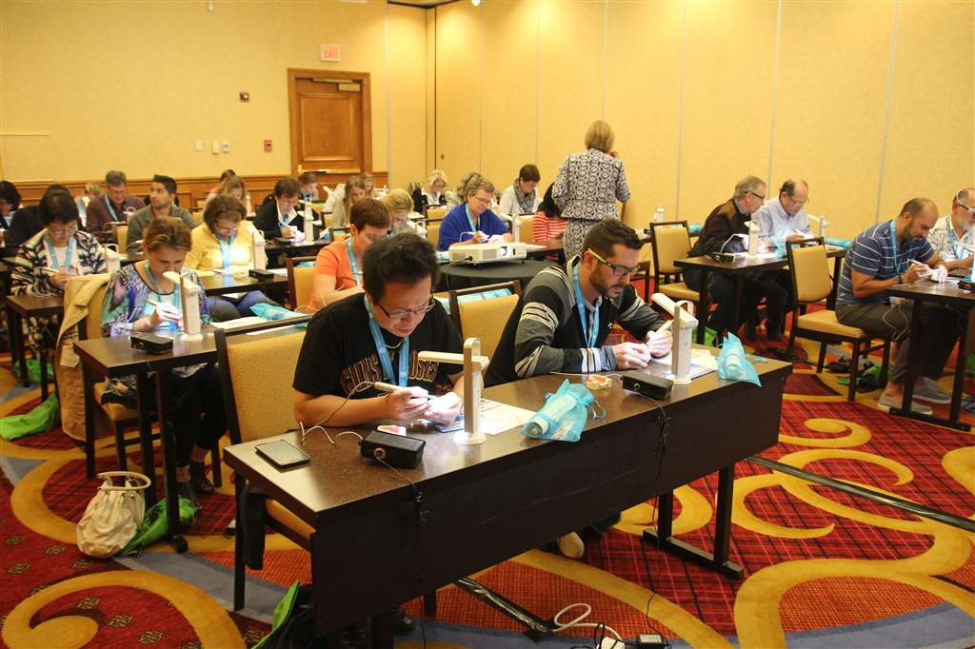
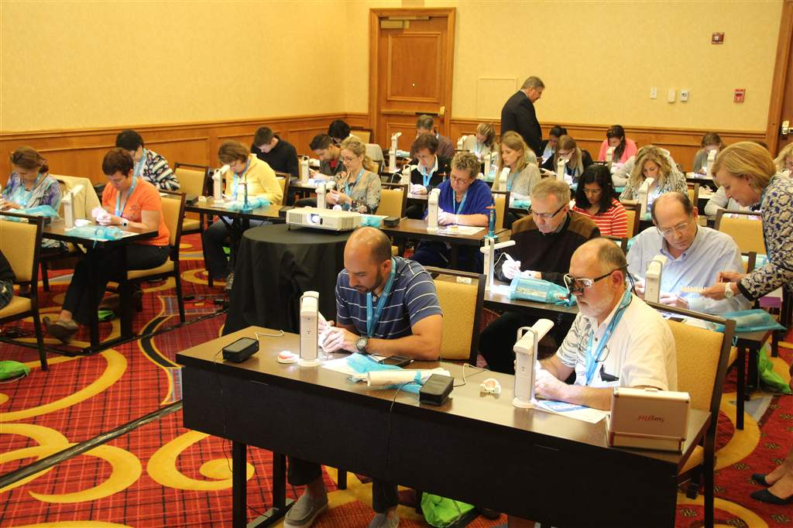

Slide 9
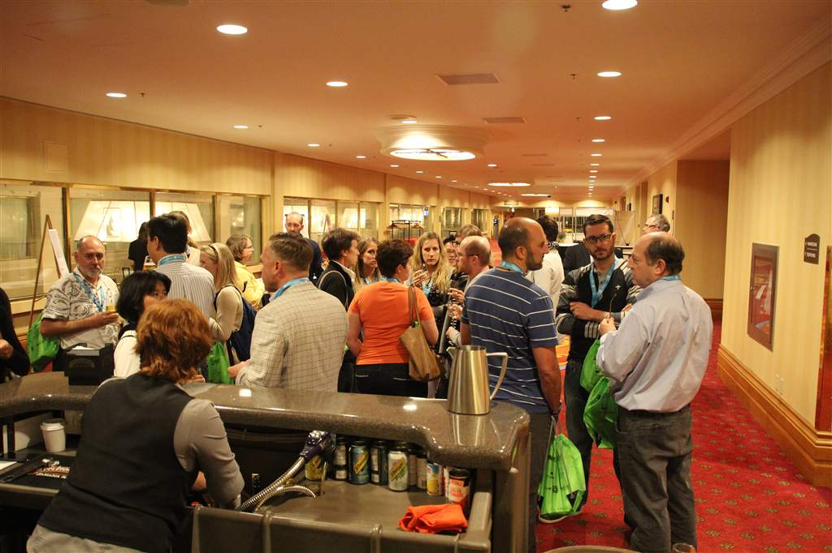
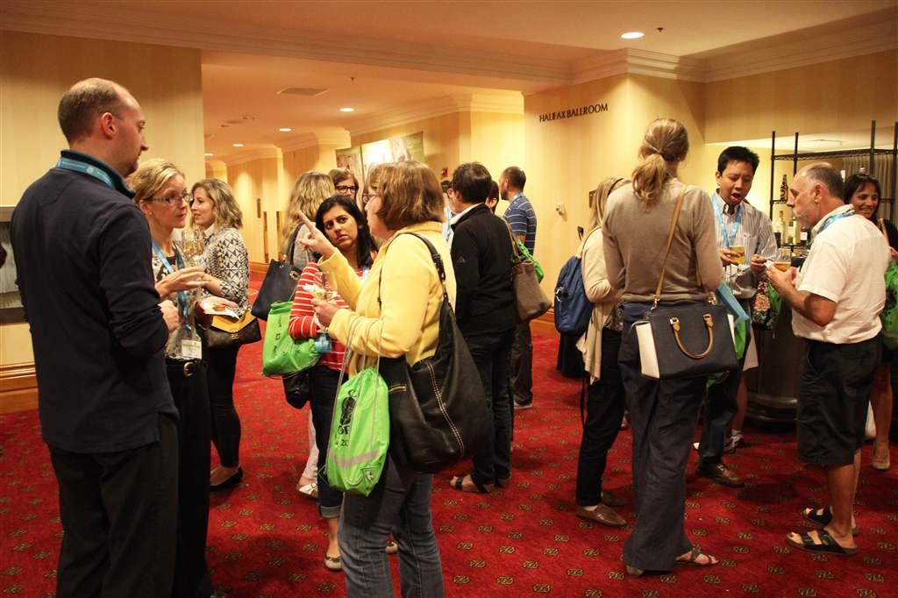
Reception following the NuSmile Satellite Symposium

Slide 10
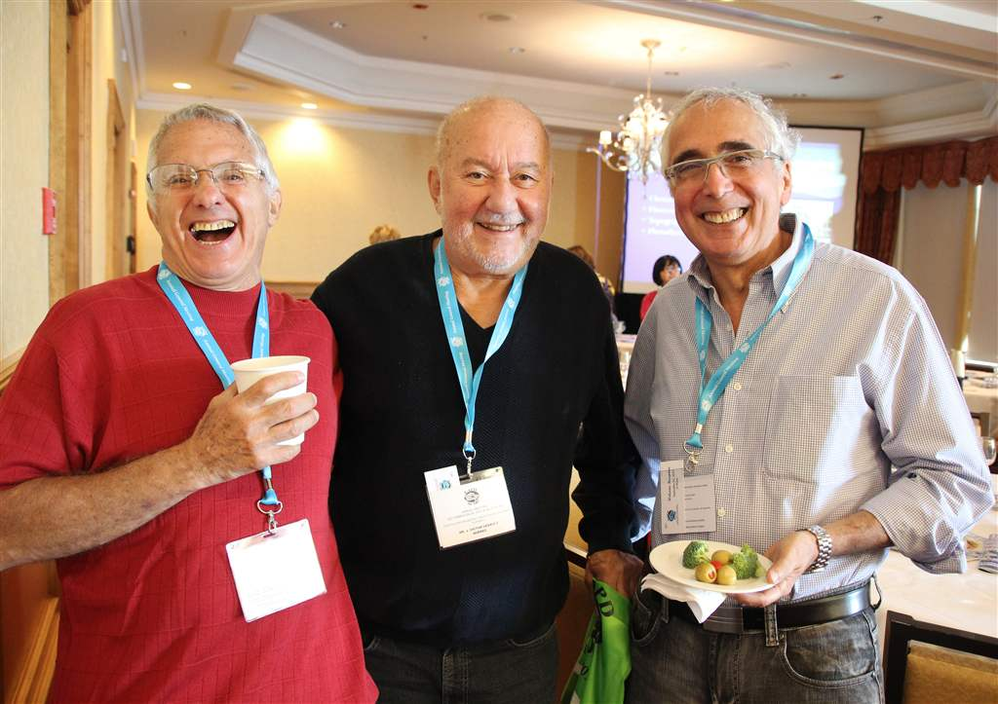

Slide 12
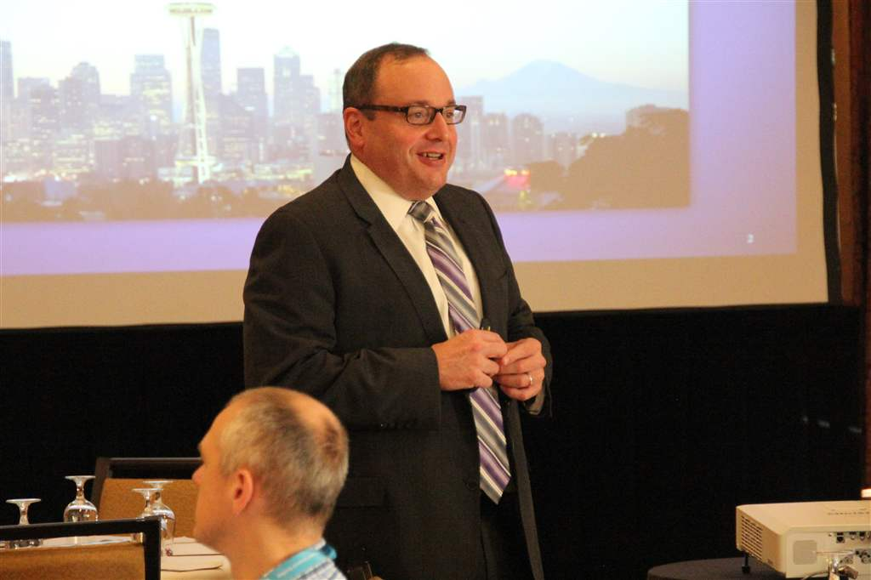
Dr. Joel Berg, the Keynote Speaker, talking on "The Continuum of Caries Management"

Slide 13
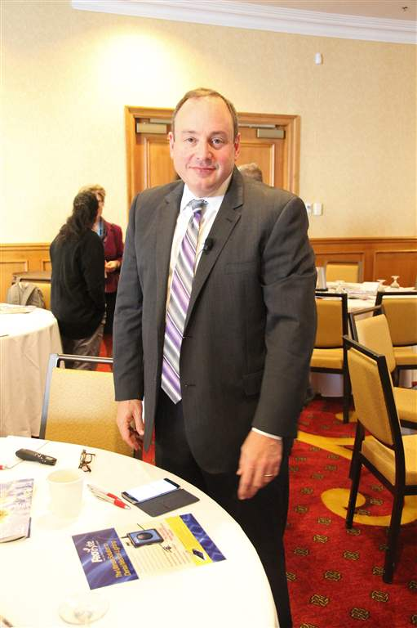

Slide 14
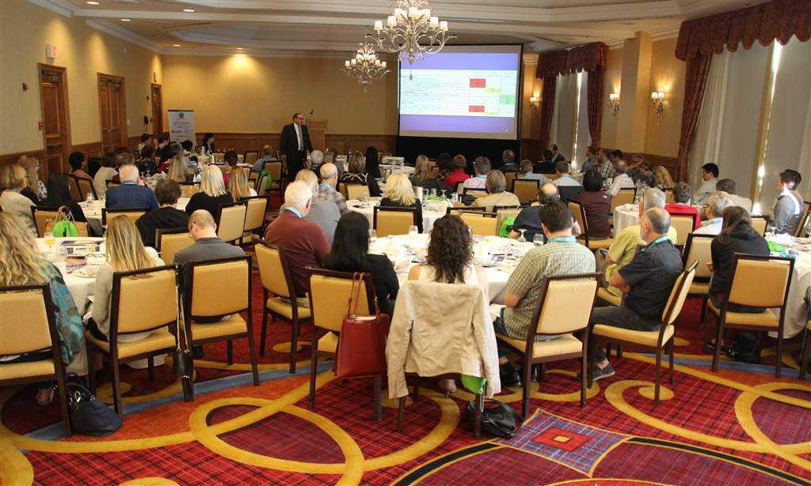

Slide 15
The Trade Show

Slide 16
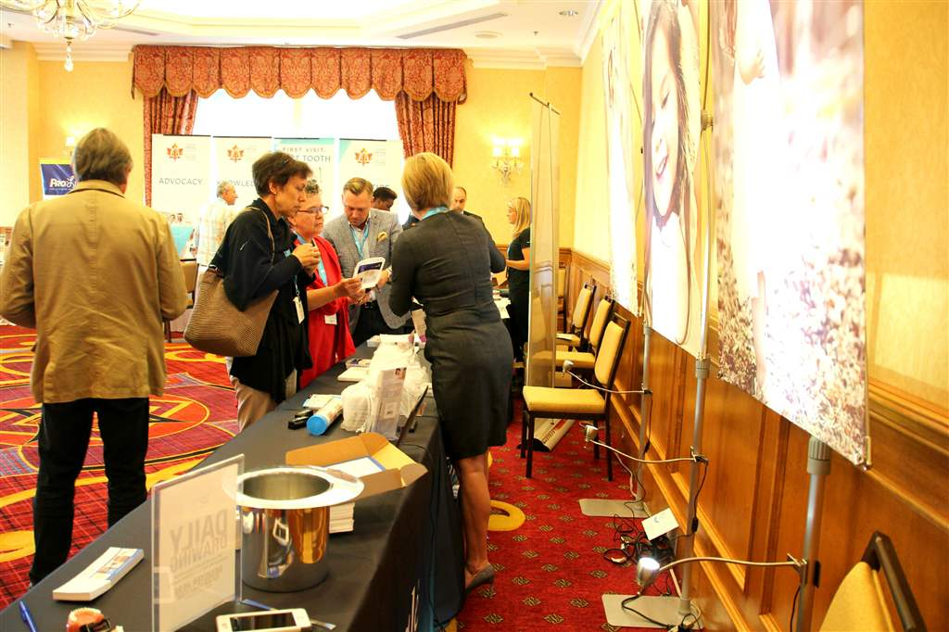

Slide 17
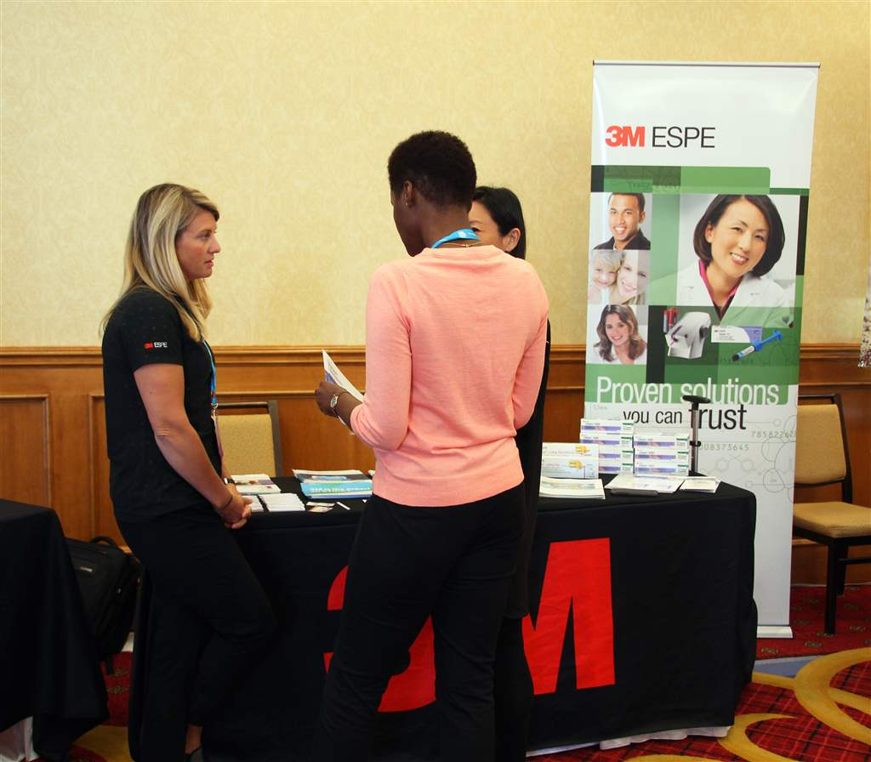

Slide 18
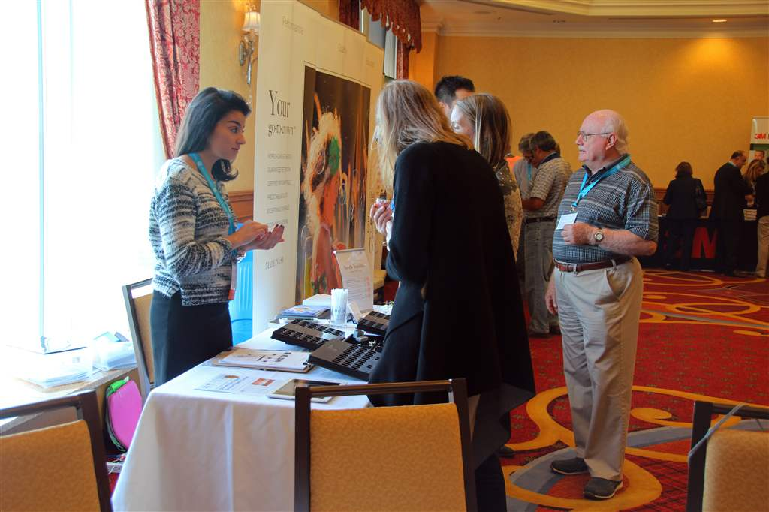

Slide 19
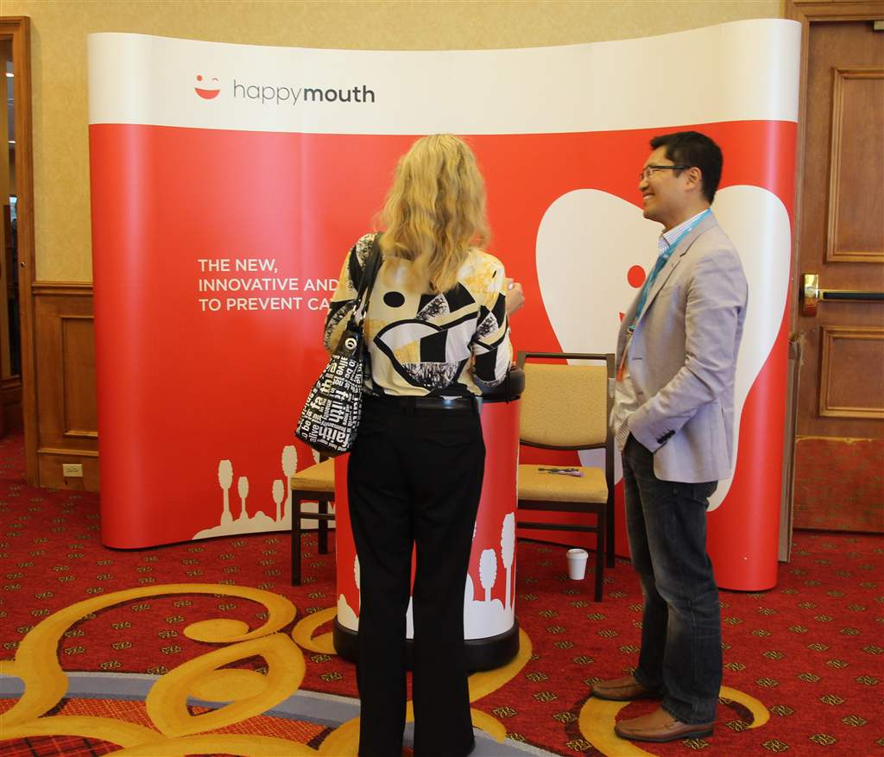

Slide 20
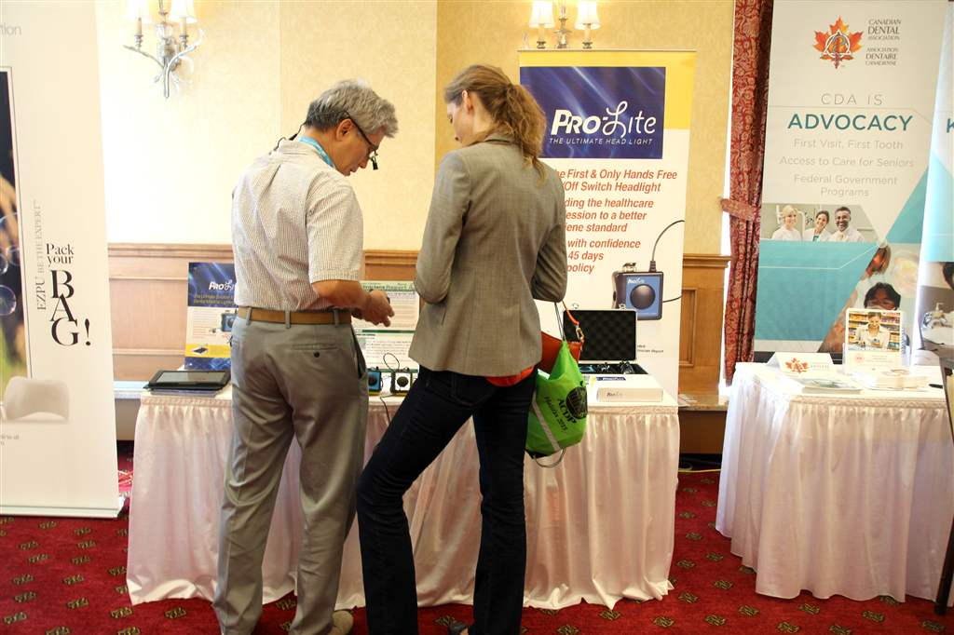

Slide 21
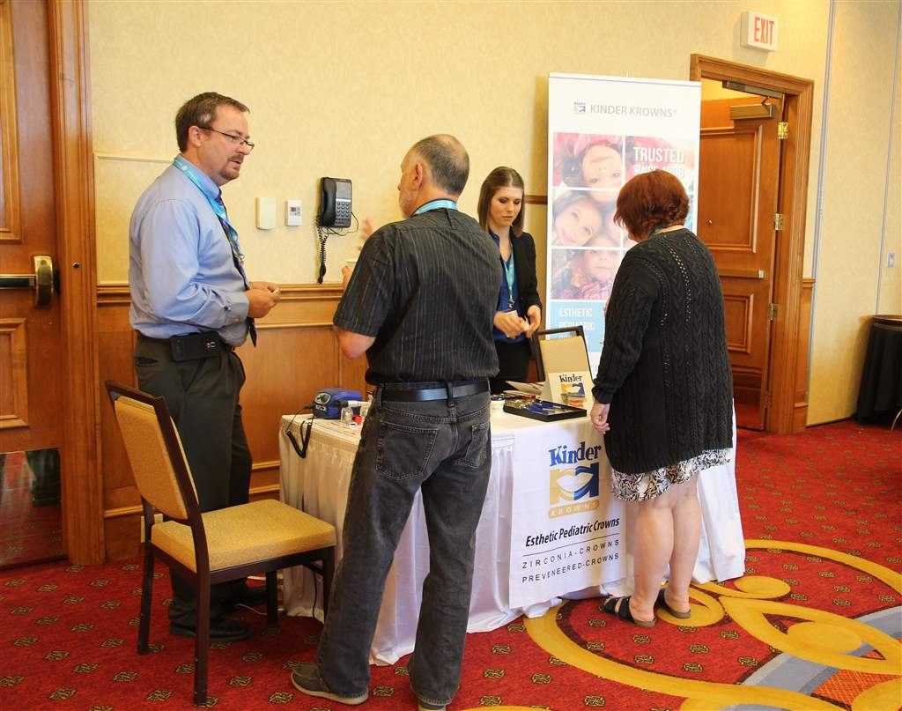

Slide 22
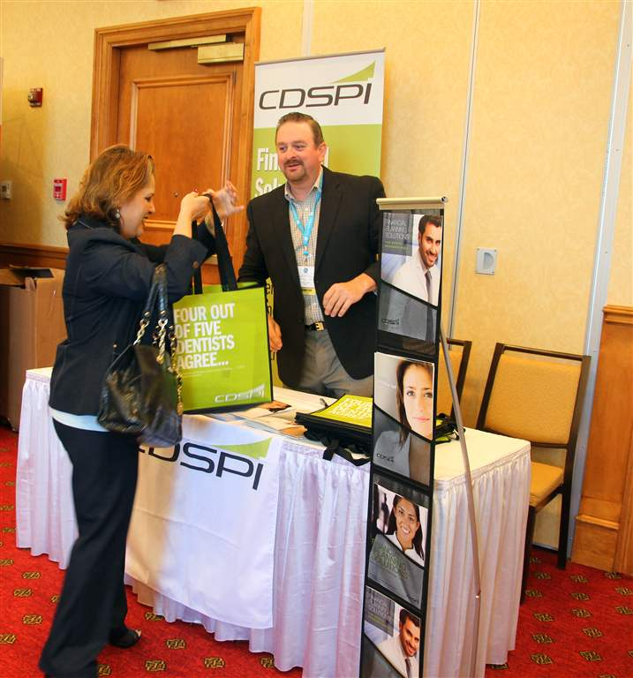

Slide 23
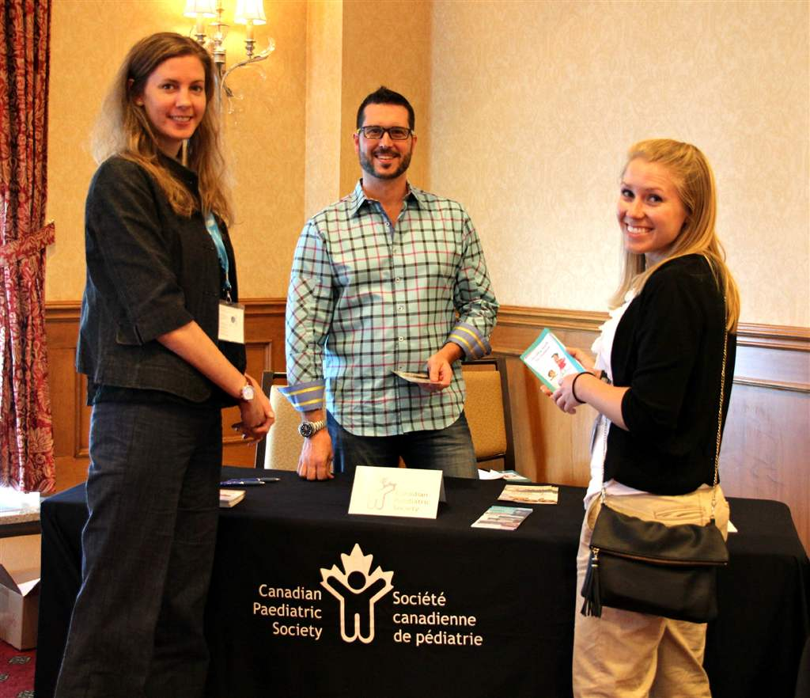

Slide 24
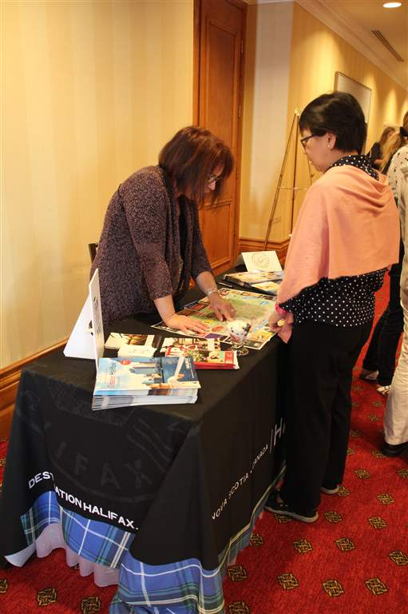

Slide 25
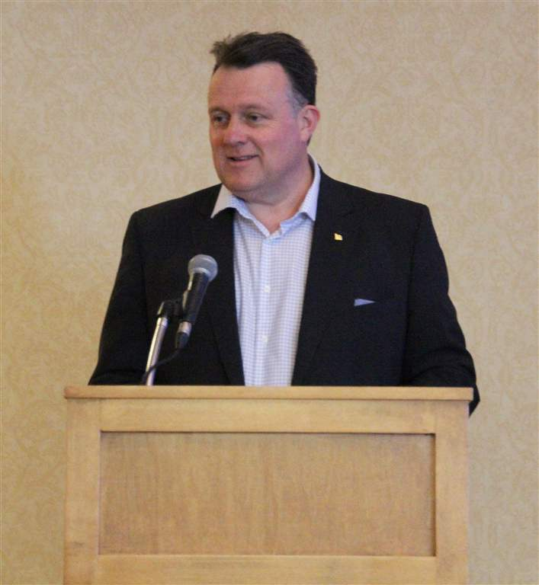
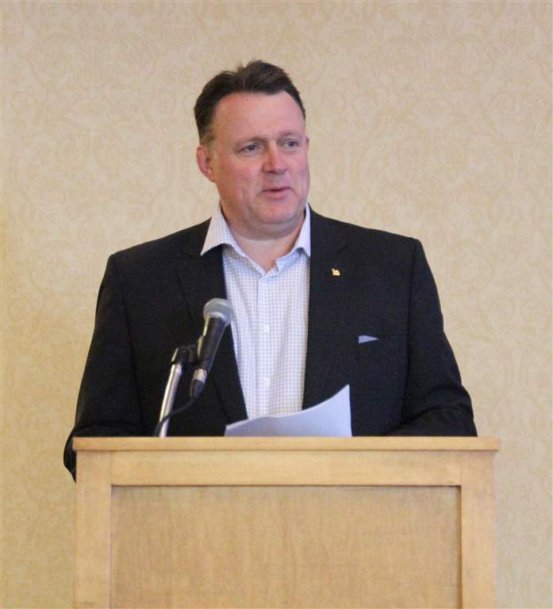
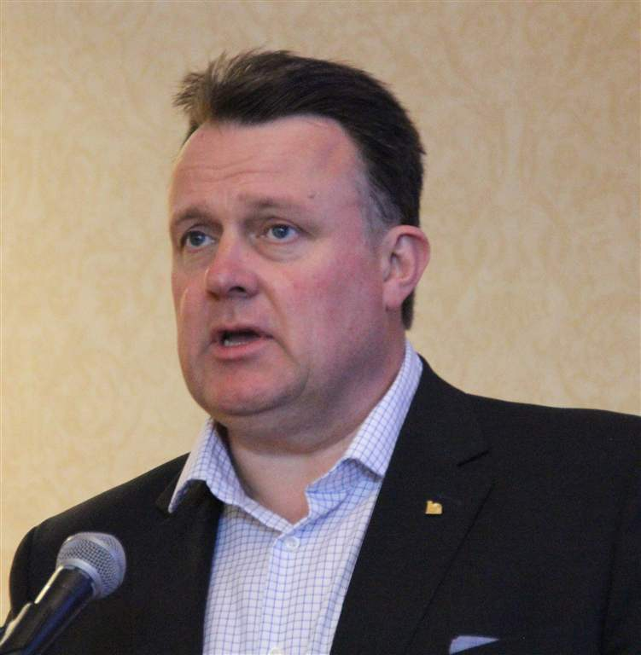
Halifax Mayor Michael Savage formally welcomes the Annual Meeting delegates to Halifax

Slide 26
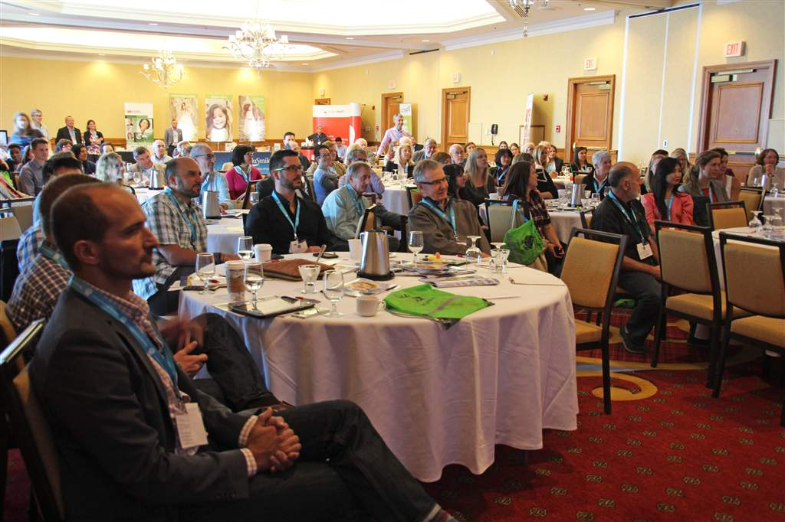
The Mayor's humourous message and serious appreciation for the work of the IWK Health Centre in Halifax, captivated the audience

Slide 27
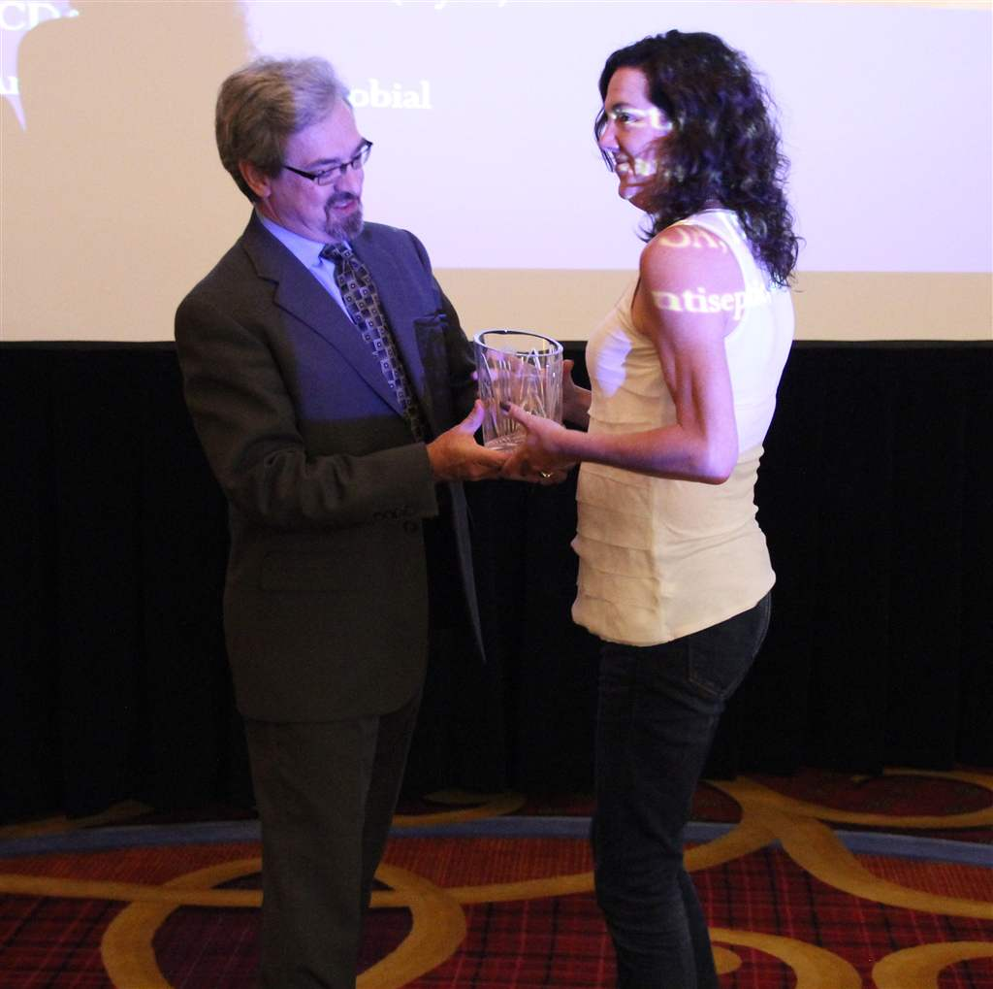
Jeff Turner, the New Business Development Manager at Destination Halifax, presents Dr. Jennifer MacLellan, Chair of the Halifax Local Organizing Commiittee, with the Halifax Ambassador Award for her work in promoting the city.

Slide 28
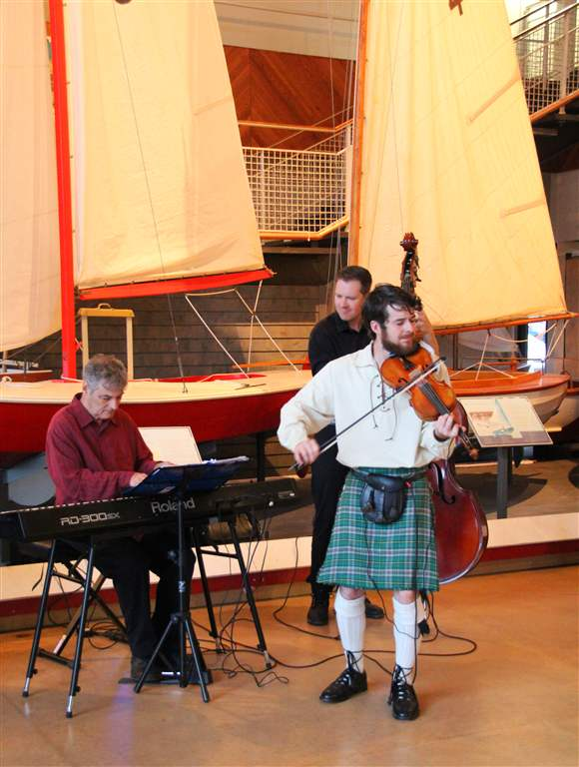
Friday Night Welcome Reception at the Maritime Museum of the Atlantic, with music by The Fine Tuners

Slide 29
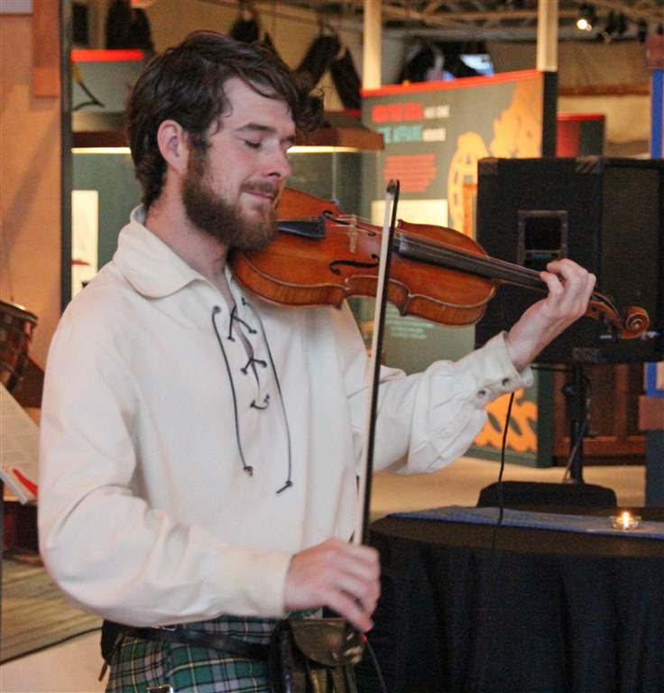

Slide 30
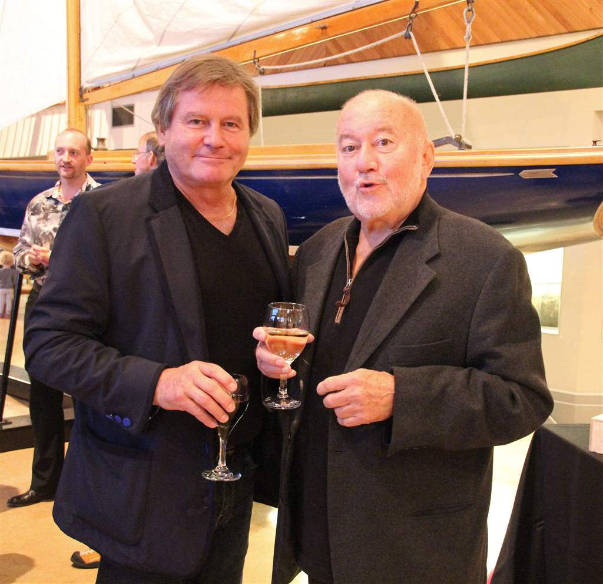

Slide 31
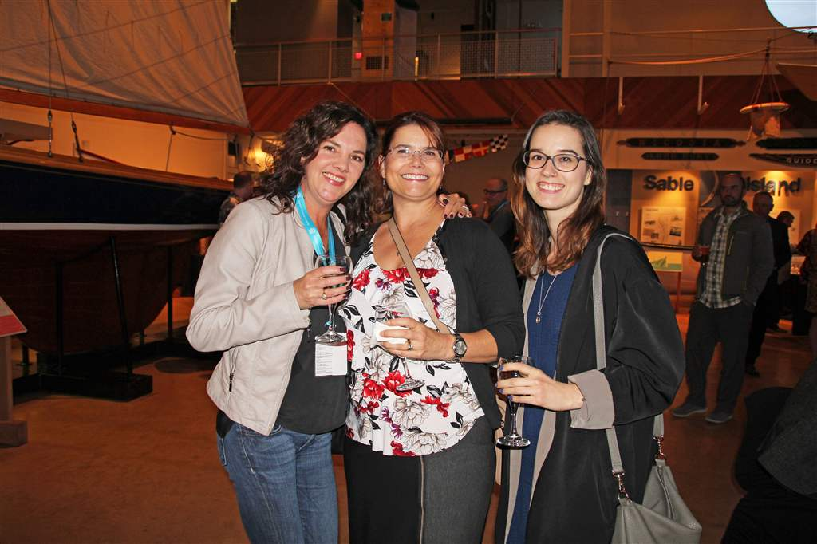

Slide 32
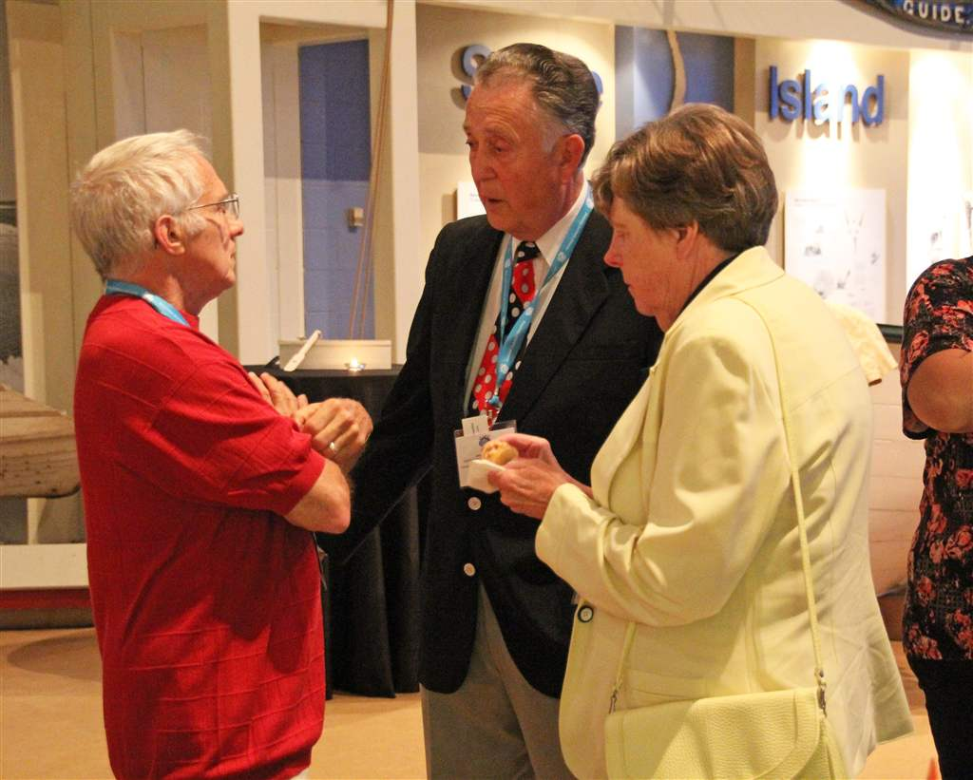

Slide 33
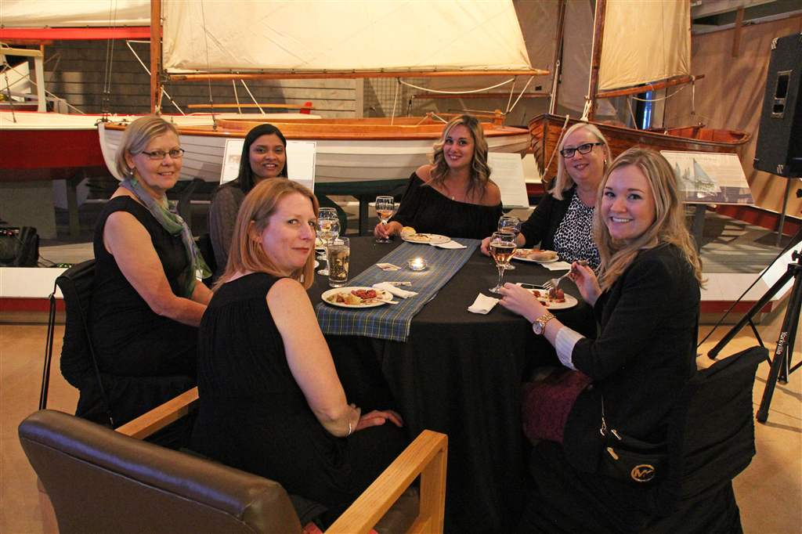

Slide 34
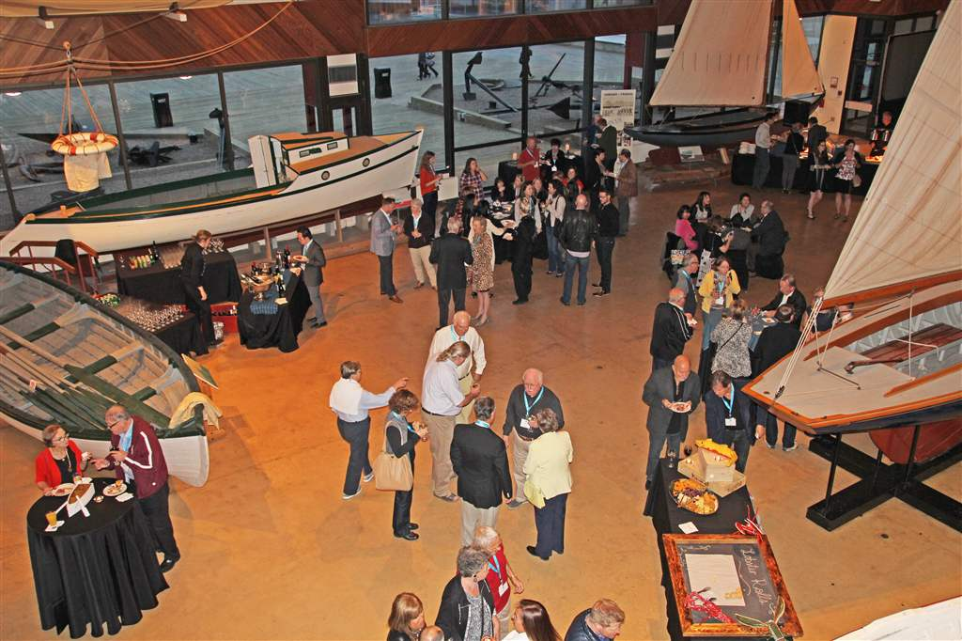
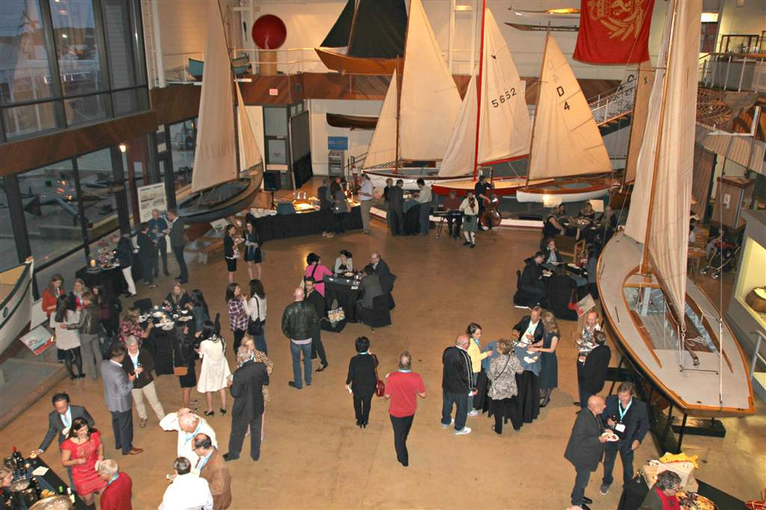
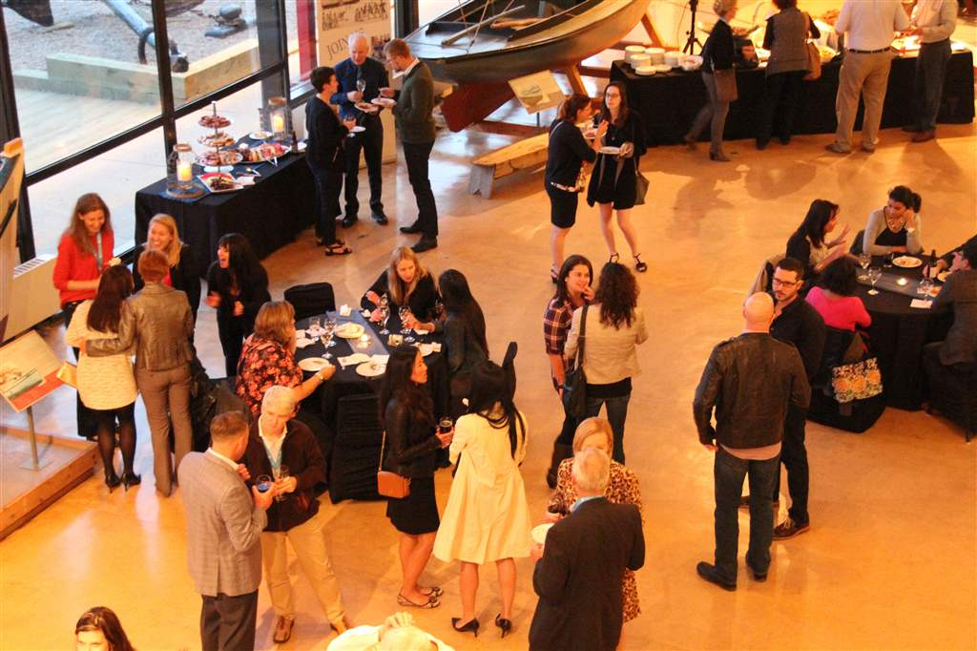
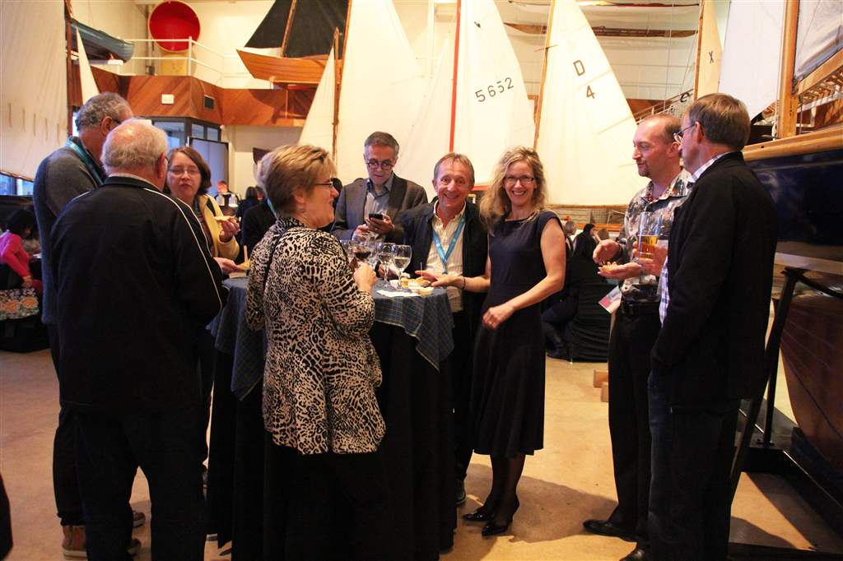

Slide 37
Saturday September 25

Slide 38
Dr. Ross Anderson introduces Keynote Speaker, Dr. Richard Price on the topic of "Fast Curing with High Power Curing LIghts: Is this a good idea?"

Slide 39
Dr. Richard Price

Slide 40
Annual General Meeting

Slide 41
Dr. Mitch Taillon, a member of the CDA Board of Directors, addresses the AGM on the First Tooth Initiative

Slide 42
Dr. Terry Farquhar, Chair of the CPS Oral Health Section andCAPD/ACDP Liaison to CPS delivers his report to the AGM.

Slide 43
Dr. Patrick Canonne, President of CAPD/ACDP

Slide 44
Dr. Paul Andrews, Vice President of CAPD/ACDP

Slide 45
Dr. Raymond Lee, Secretary-Treasurer of CAPD/ACDP

Slide 46
FIRST TOOTH INITIATIVE
Group photo of CAPD/ACDP members who expressed an interest in spreading the word about the First Tooth program in partnership with the CDA

Slide 47
Claire D'Amour, CAPD/ACDP Executive Secretary and Judith, one of the most cheerful and customer service oriented Marriott Hotel staff that we have ever met.

Slide 48
Dr. Elsa Hui-Derksen, Chair of the CAPD/ACDP Scientific Committee, introduces the Graduate Student Abstract Presentations

Slide 50
Dr. Molly Ehrlich, University of Toronto

Slide 51
Dr. Mark Berscheid, University of Manitoba

Slide 52
Dr. Leena Chohan,
University of Toronto

Slide 53
Dr. Jennifer Park, University of British Columbia

Slide 54
Dr. Alison Sigal, University of Toronto

Slide 55
Dr. Shan Sun, University of British Columbia

Slide 56
Dr. Victor Legault, Executive Director and Andrée Legault at the cocktail reception

Slide 57
Dr. Jennifer MacLellan and Claire D'Amour

Slide 58
Harry Bentham serenaded the members during the cocktail reception

Slide 60
The President's Gala Dinner and Dance

Slide 61
Dr. Jennifer MacLellan, Chair of the Halifax LOC introduces two special guests

Slide 62
Left: Dr. Jade Miller, President-Elect of the AAPD
Right: Dr. John O'Keefe, Director of Knowledge Networks with the CDA

Slide 63
The President's Dinner featured a number of meal choices including Seafood Chowder and Atlantic Hard Shell Lobster

Slide 64
Lobster Socks
L to R: Dr. Charles Lekic, Dr. Brad Klus, Dr. Mohammed Omar and Dr. Mark Berscheid

Slide 68
Dr. Elsa Hui-Derksen, Chair of the CAPD/ACDP Scientific Committee (Left) and Andrea Bowie, Sales Account Executive for 3M ESPE get ready to announce the winner of the Graduate Student Abstract Presentations.

Slide 69
The winner was Dr. Molly Ehrlich (see inset) of the University of Toronto. As Molly was unable to attend the President's Gala, Drs. Gabriella Garisto and Marie-Lyne Gosselin accepted the award on her behalf.

Slide 70
Dr. Jennifer MacLellan presented Steve Gillick, Director of Operations and Claire D'Amour, Executive Secretary with gifts for assisting the LOC in organizing the Halifax Annual Meeting.

Slide 71
Big Fish entertained until the wee hours of the morning

Slide 72
See you in 2016
September 22-23-24
The Toronto Marriott Downtown Eaton Centre Hotel

