Slide 1
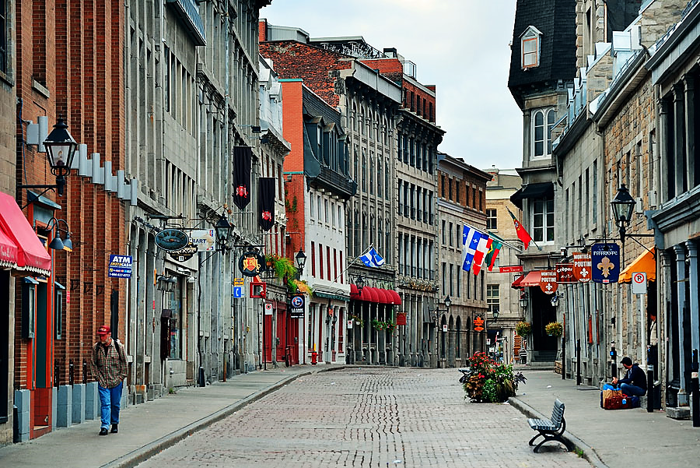
CAPD/ACDP 2014 ANNUAL MEETING
Marriott Chateau Champlain Hotel, Montreal, Quebec
Old Montreal

Slide 2
September 11th Executive Council Meeting, Conference Set Up and Welcome Reception

Slide 3
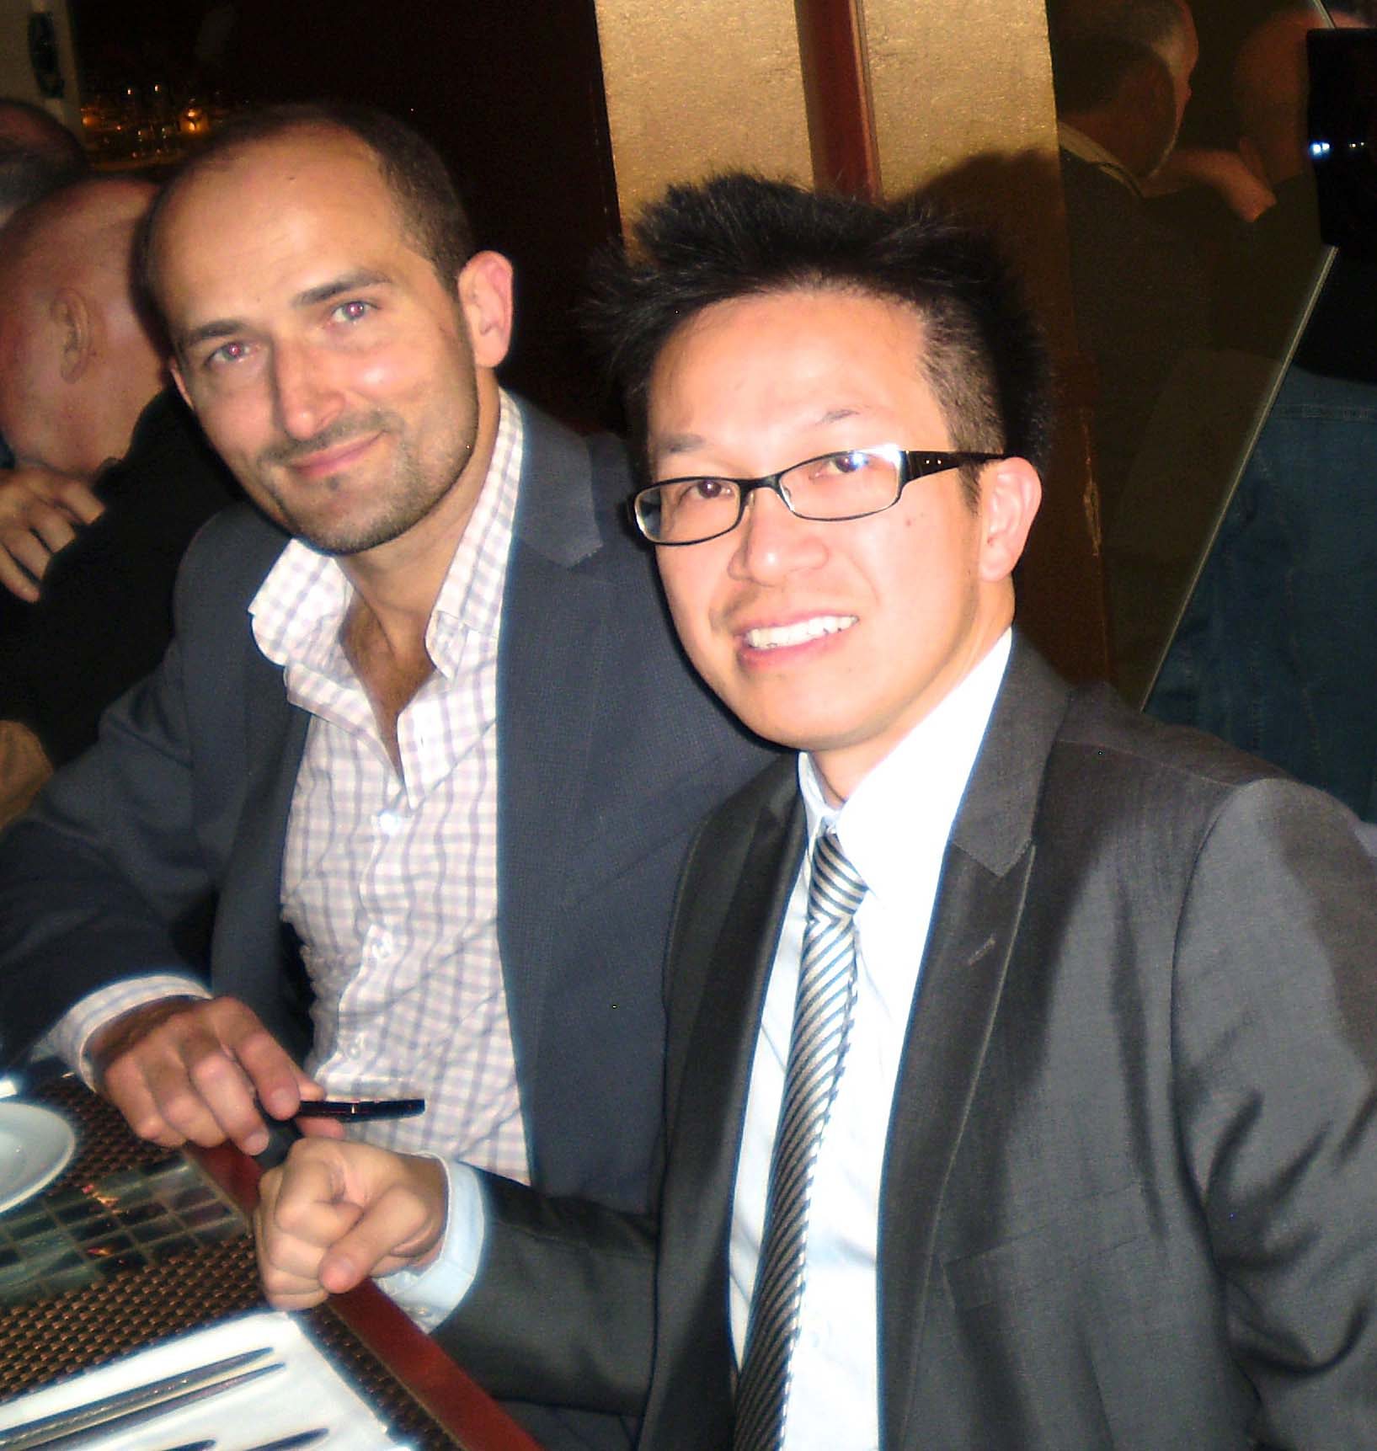
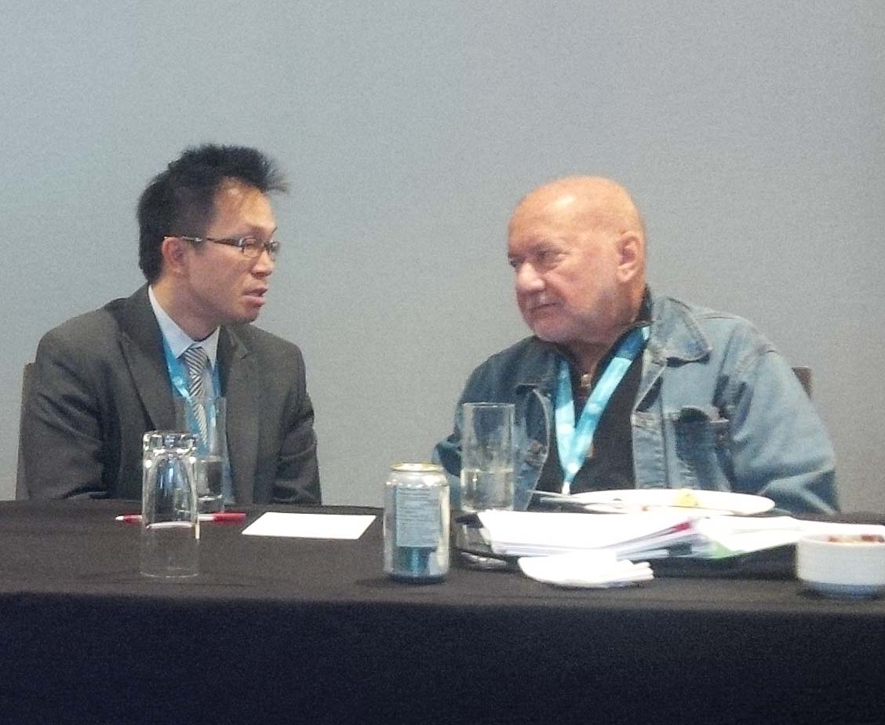
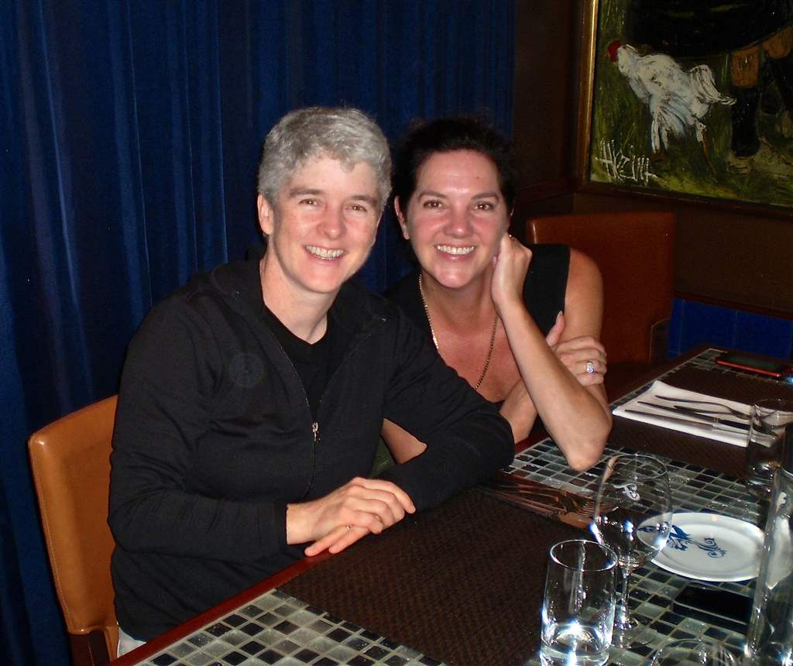
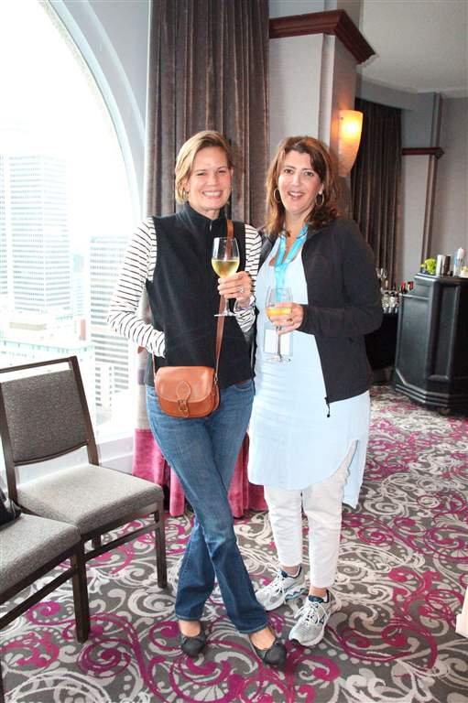
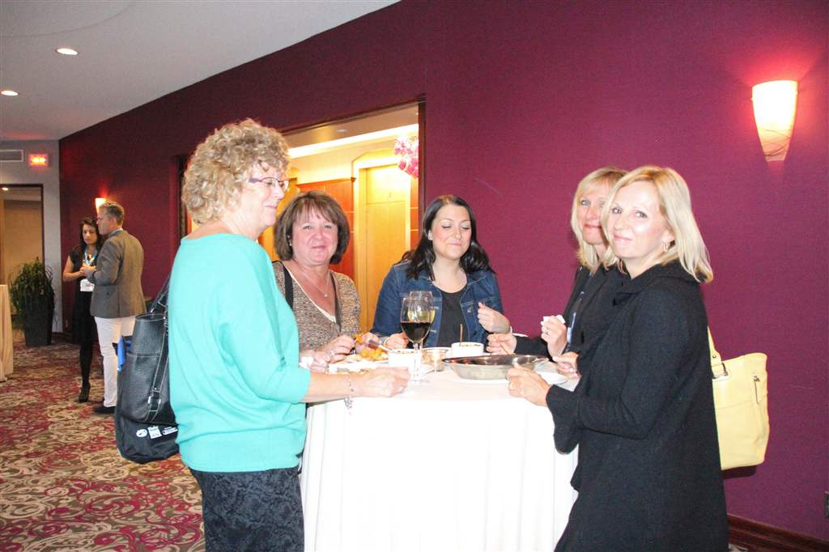
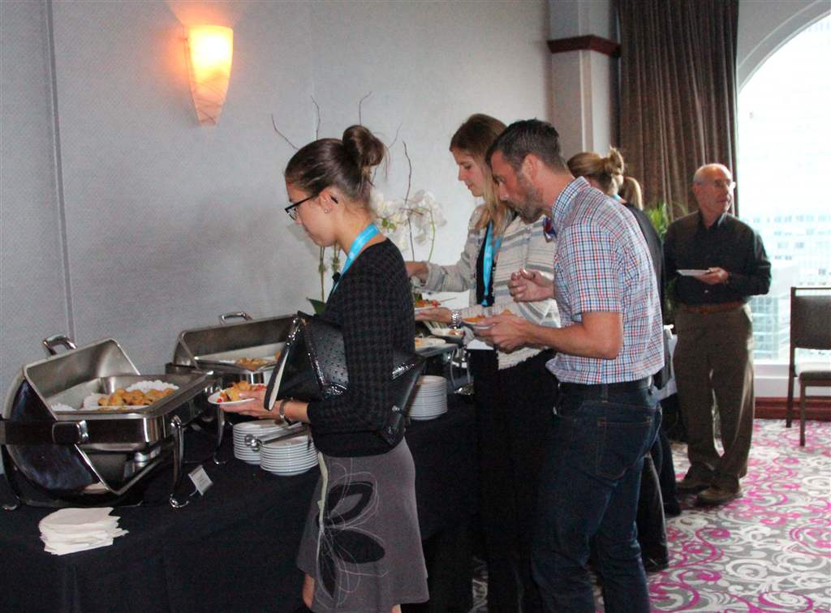

Slide 5
3M ESPE
CAPD/ACDP's Sustaining Sponsor

Slide 6
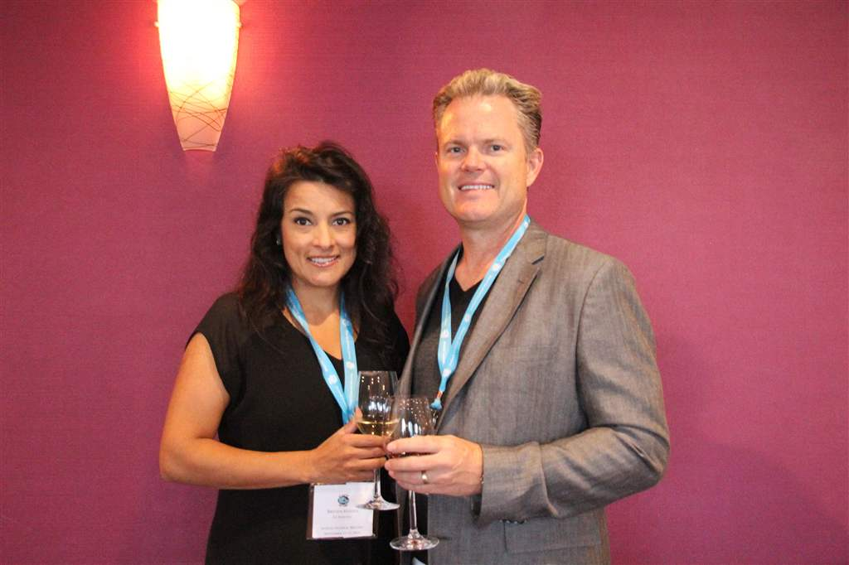
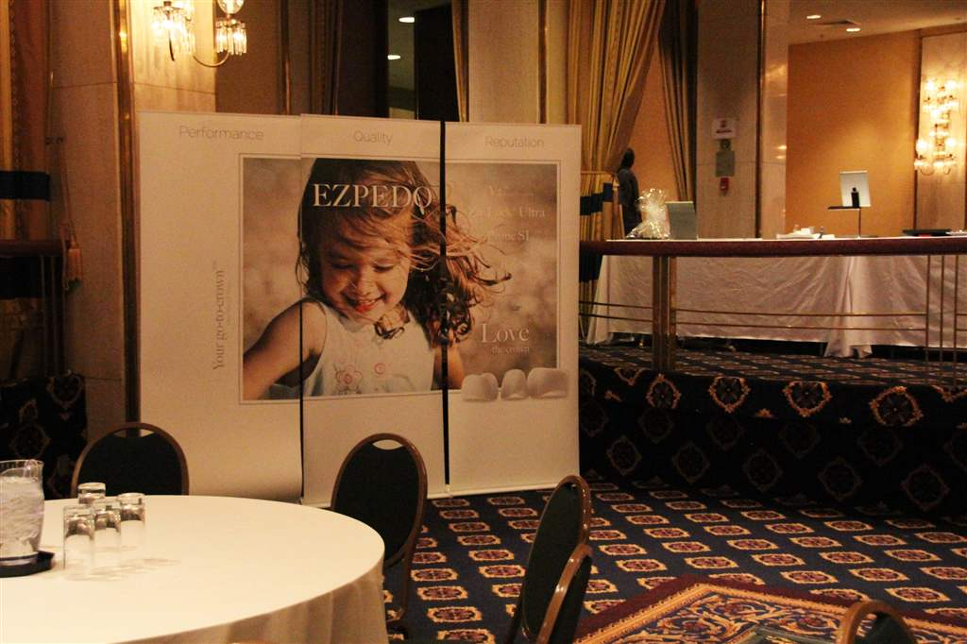
EZ Pedo was our Gold Sponsor.
Brenda and Dr. John Hansen attended the Reception and manned the EZ Pedo Booth

Slide 7
Nu Smile Pediatric Crowns was one of our Silver Sponsors with Diane Johnson Kreuger at the booth

Slide 8
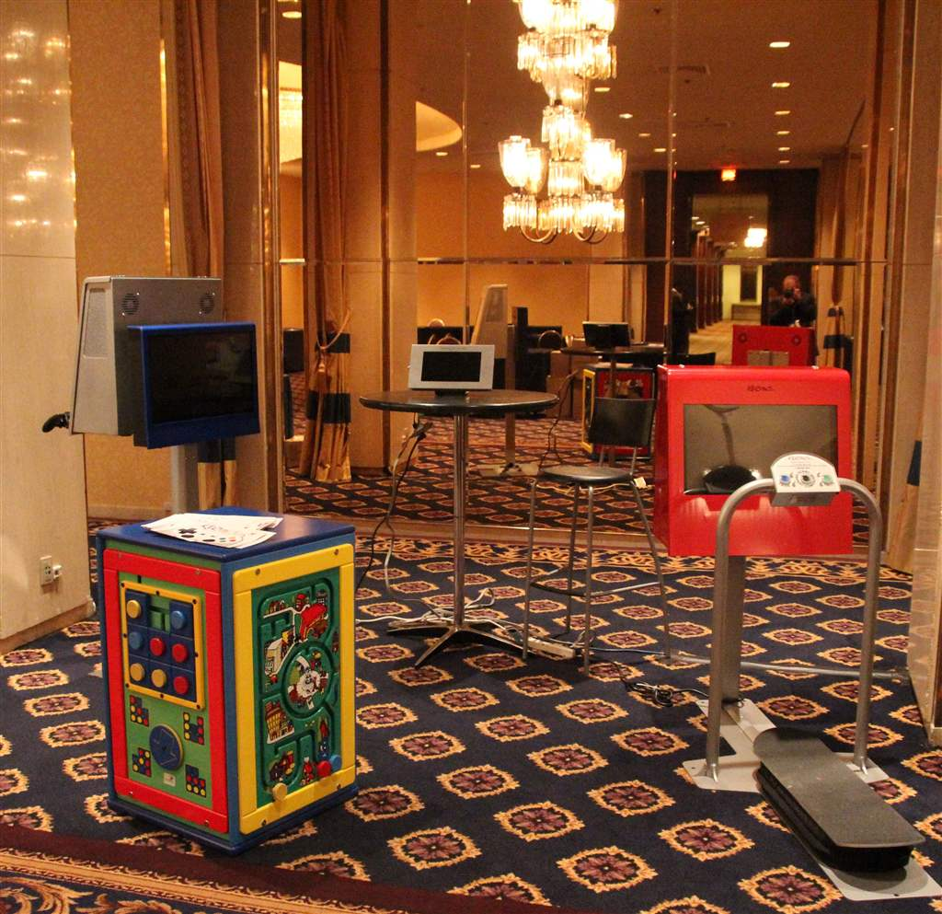
Kidzpace Interactive, one of our Bronze Sponsors, set up an interactive display

Slide 9
Planmeca was one of our Bronze Sponsors

Slide 10
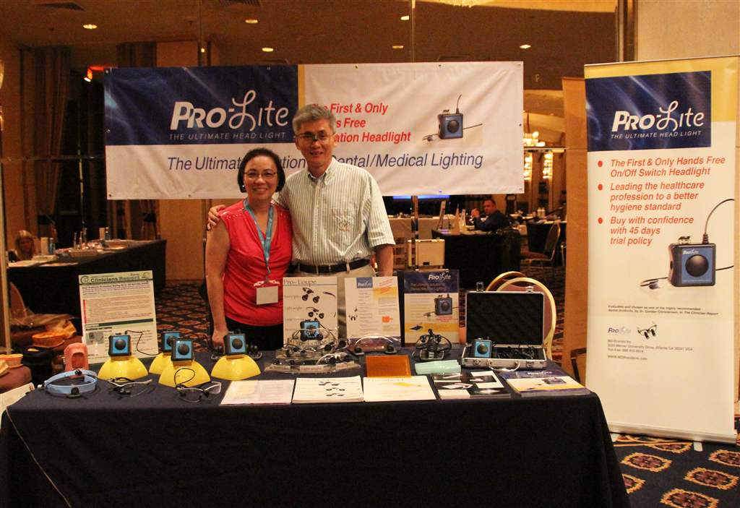
Cecilia Lu and Dr. Joseph Lau at the Pro-Lite Booth, one of our Bronze Sponsors

Slide 11
Brian Shea of Prophy Magic, one of our Bronze Sponsors

Slide 12
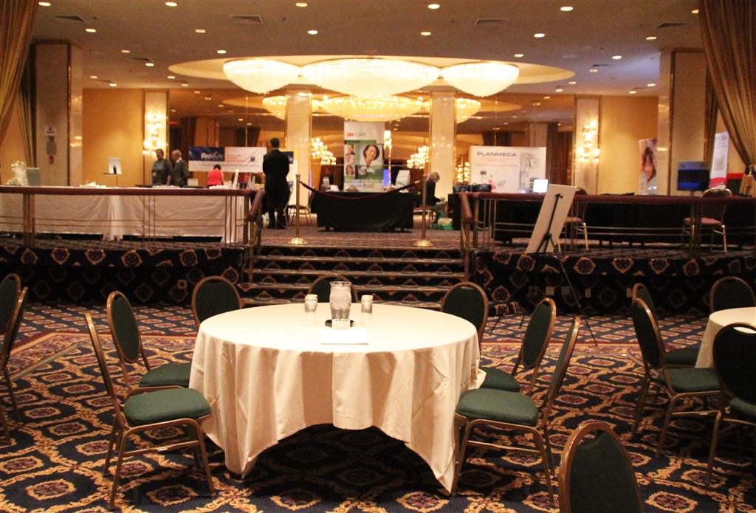
The Exhibit Displays, as seen from the room where the general sessions were held

Slide 13
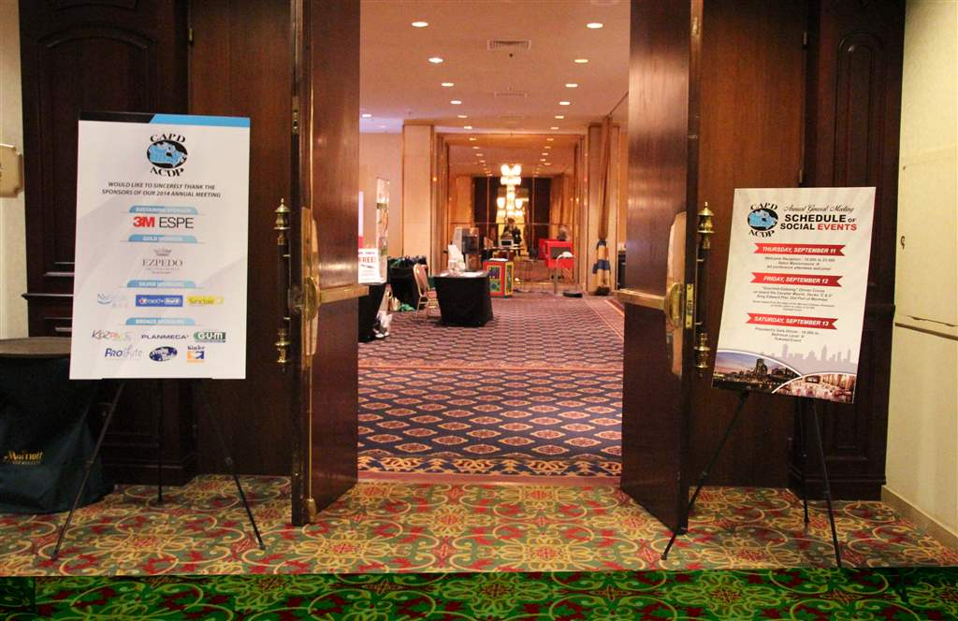
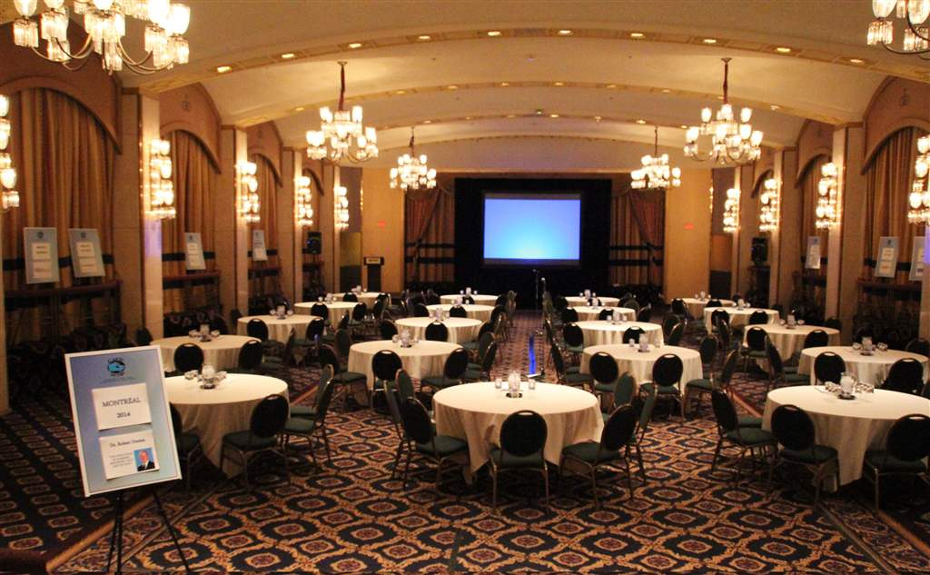
The entrance to the General Session and Display area
Sponsor signs are set up...and we are ready to go!

Slide 14
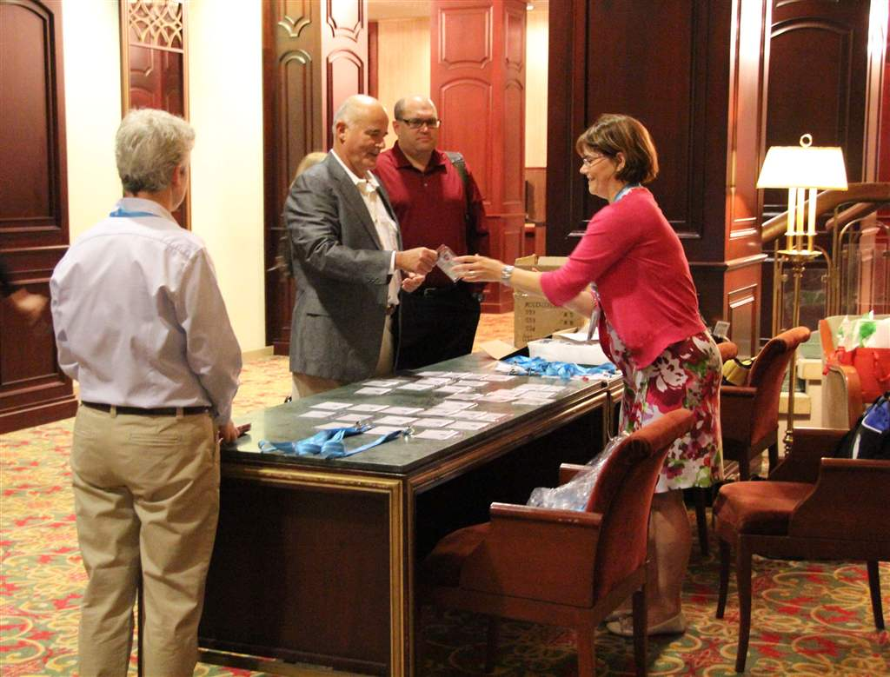
Claire D'Amour, the Executive Secretary, at the Registration Table

Slide 15
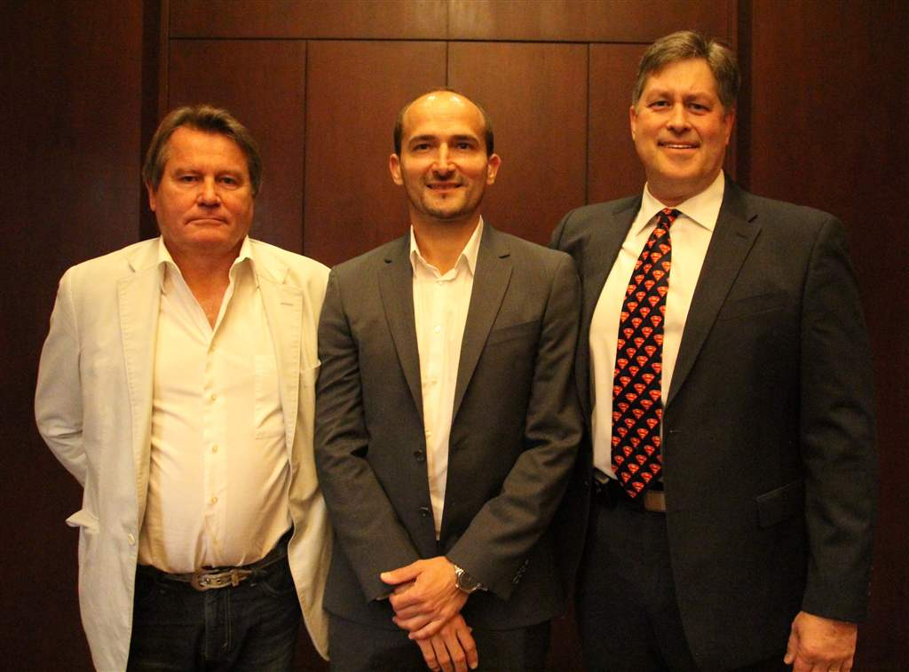
2014-2015 Executive Council Members: Dr. Patrick Canonne-President, Dr. Michal Goralski-Past President, Dr. Paul Andrews, Vice President

Slide 16
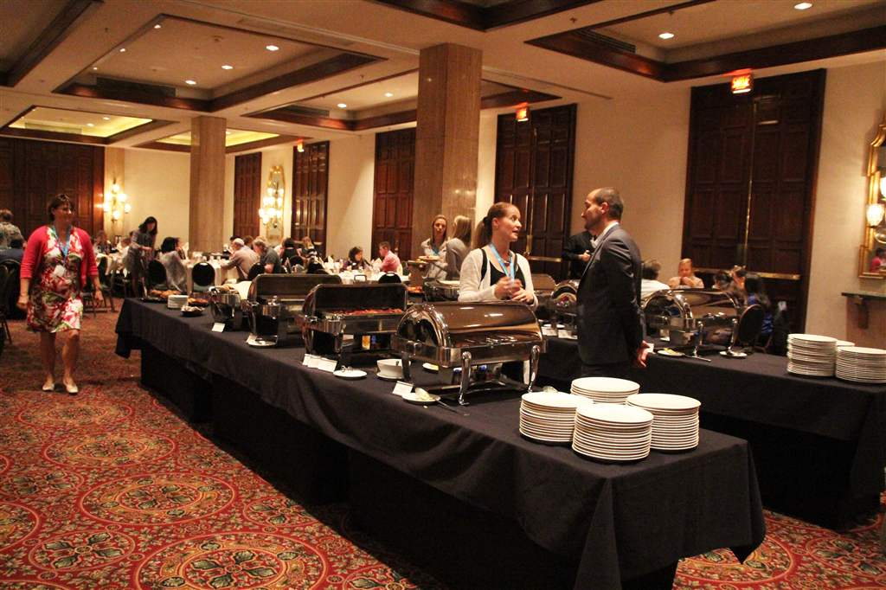
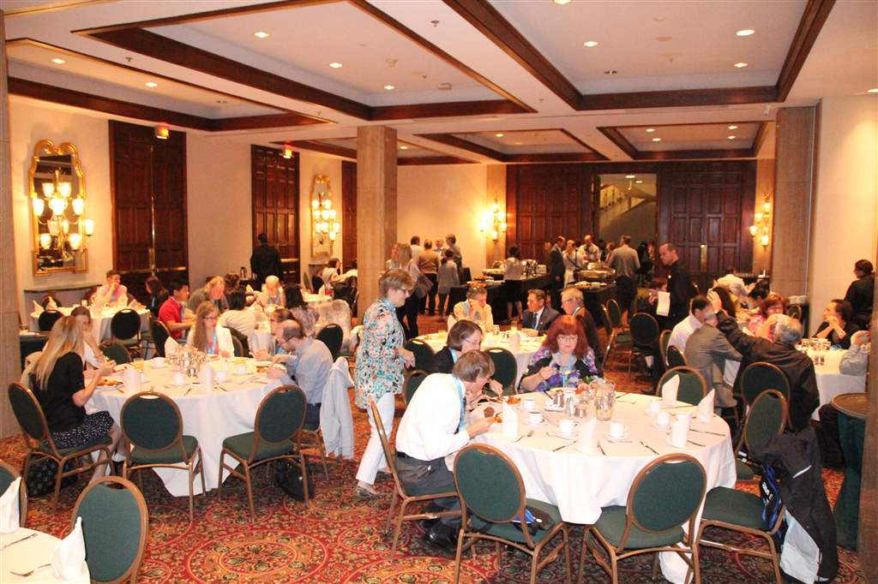
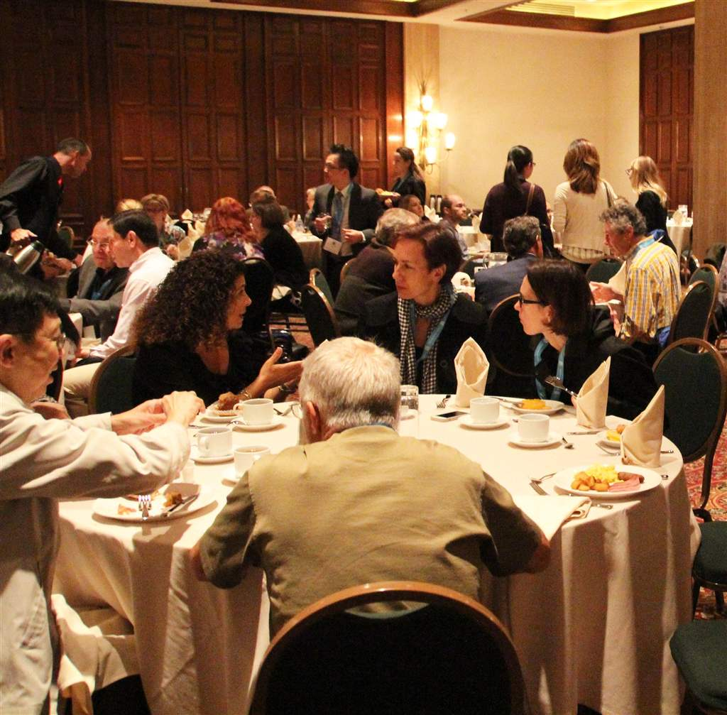
September 12th Breakfast

Slide 17
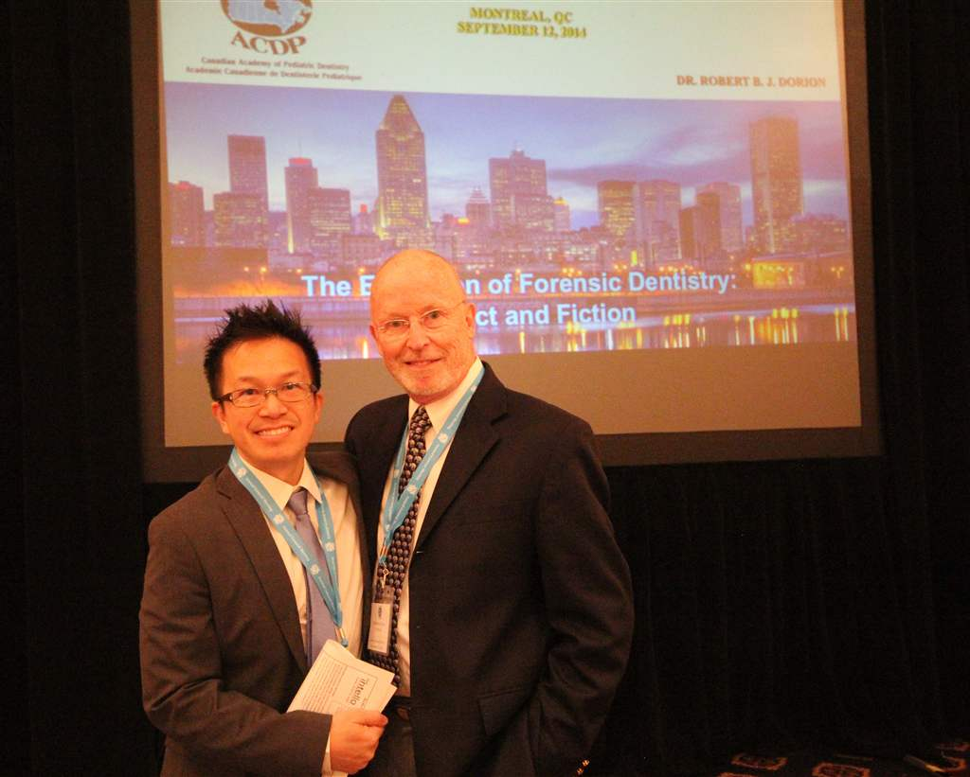
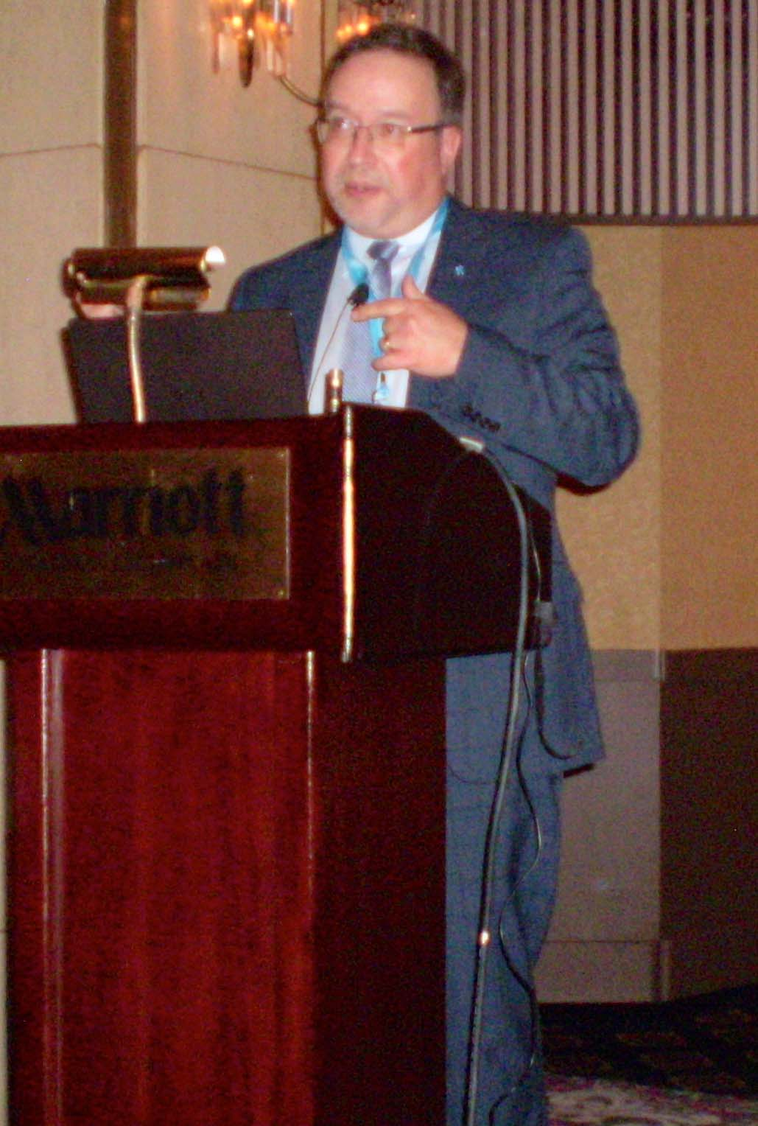
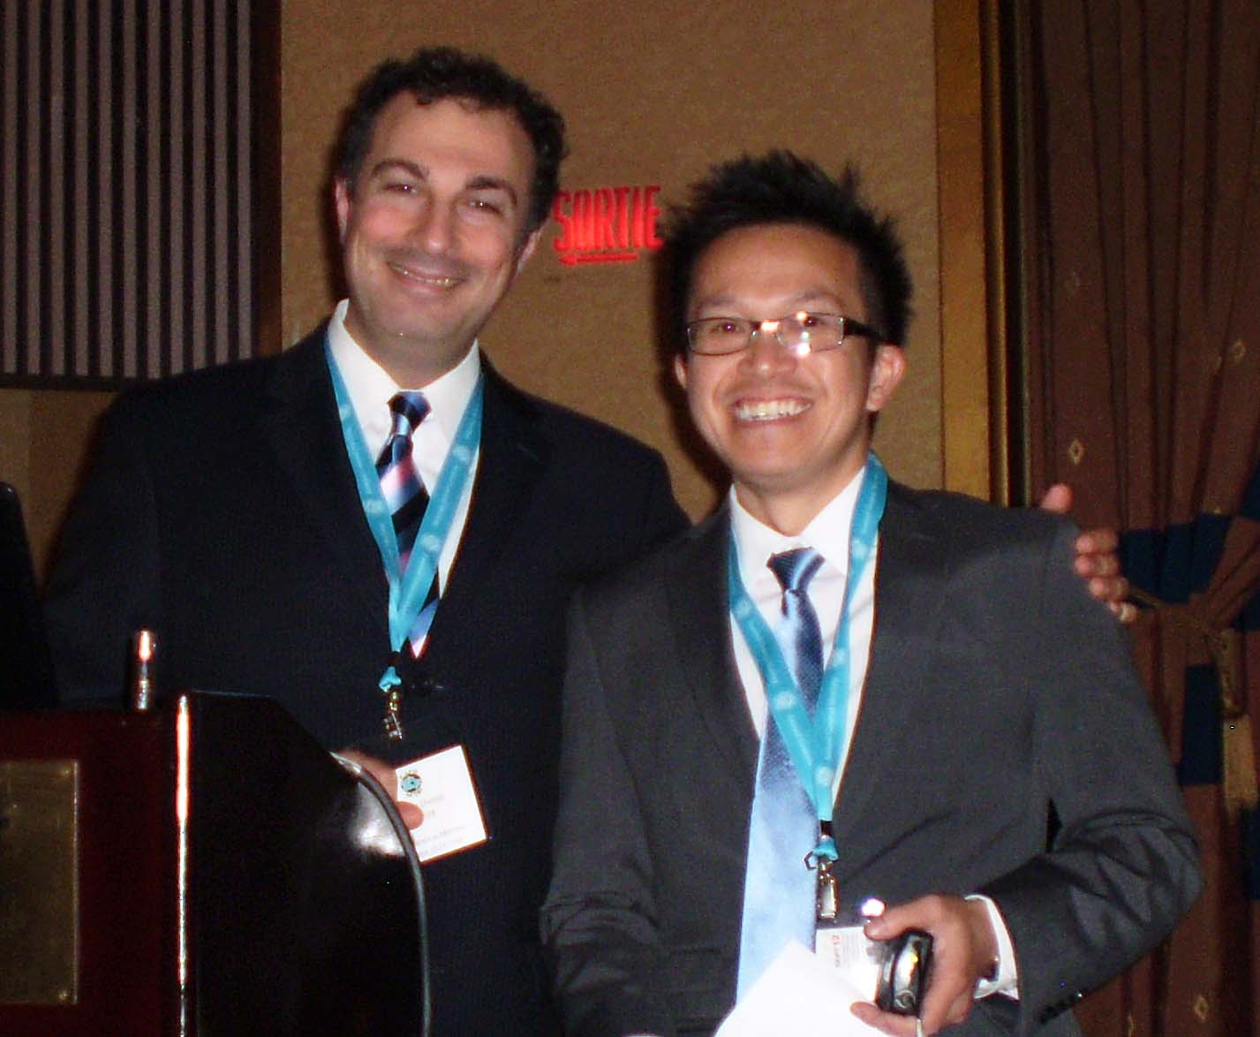
Some of the excellent Friday session leaders included Top Left: Dr. Roberrt Dorion (here pictured with Dr. Duy-Dat Vu, the LOC Chair); Bottom Left: Dr. Sam Daniel (with Dr. Vu) and Right: Dr. Alain Moreau.

Slide 18
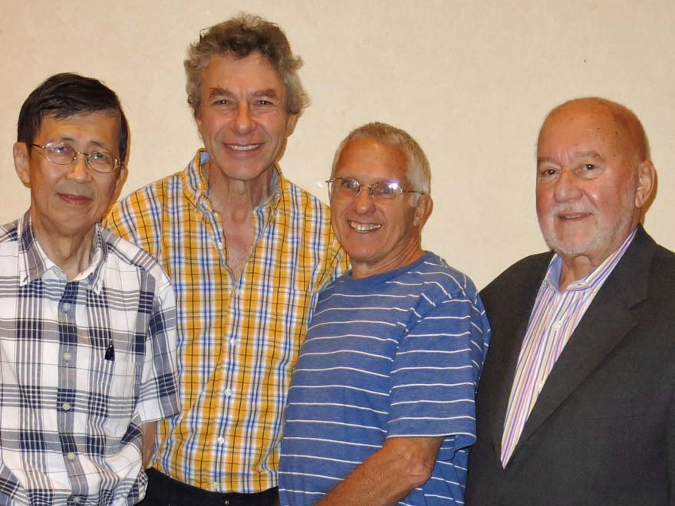
A meeting of old friends at one of the breaks: L to R: Dr. Wa Sham Cheung, Dr. Lawrence Yanover, Dr. Murray Diner and Dr. Victor Legault

Slide 19
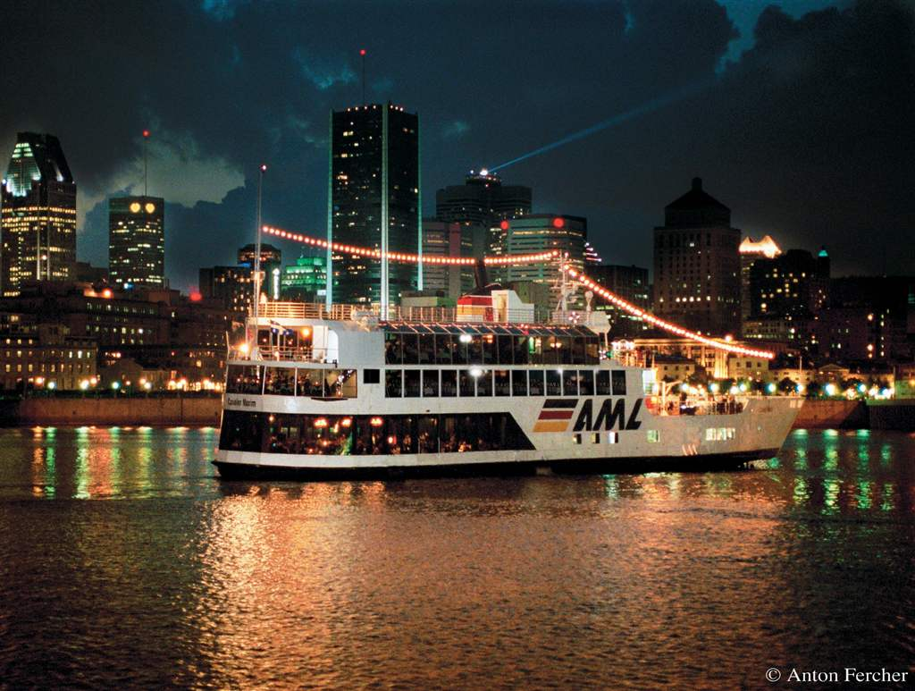
Friday Night Gourmet Dinner Cruise on the St. Lawrence River

Slide 20
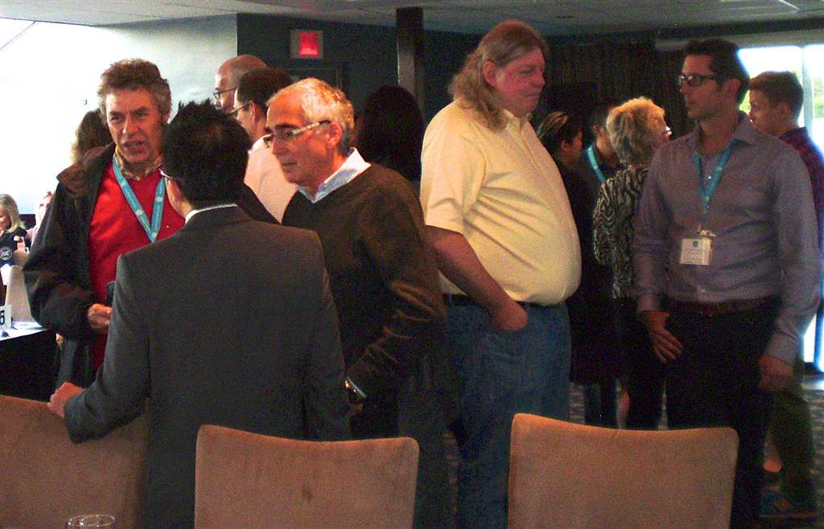
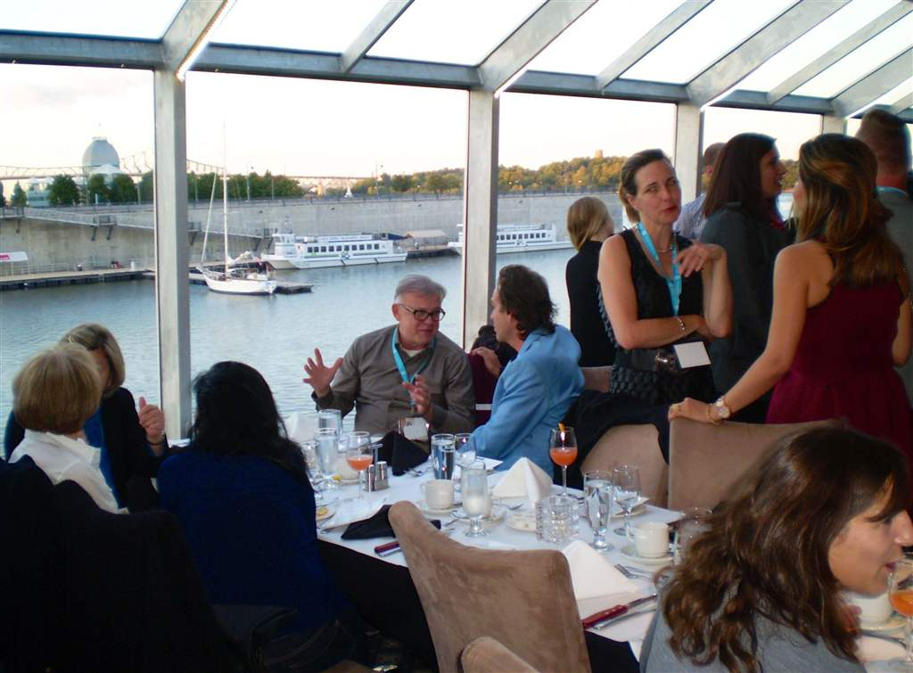
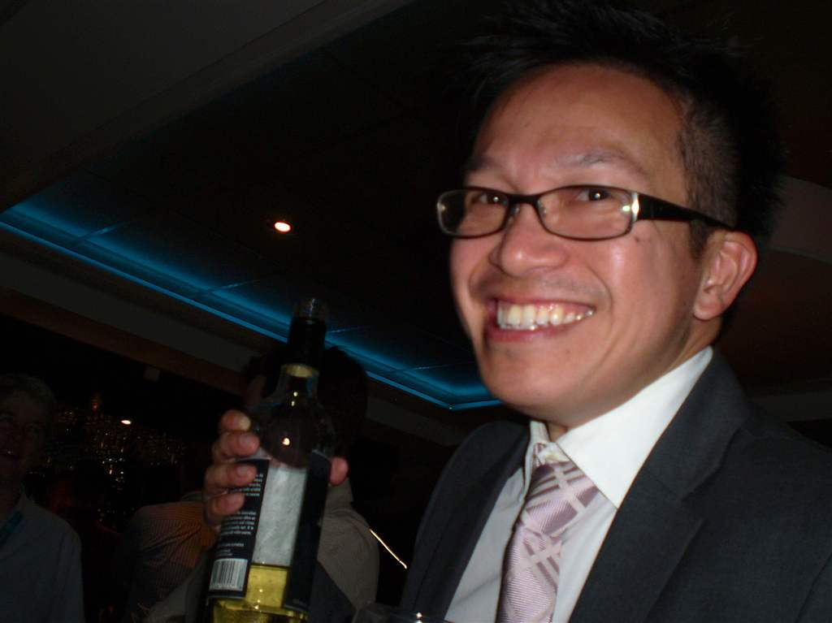
Cruising and Dining on Friday evening

Slide 21
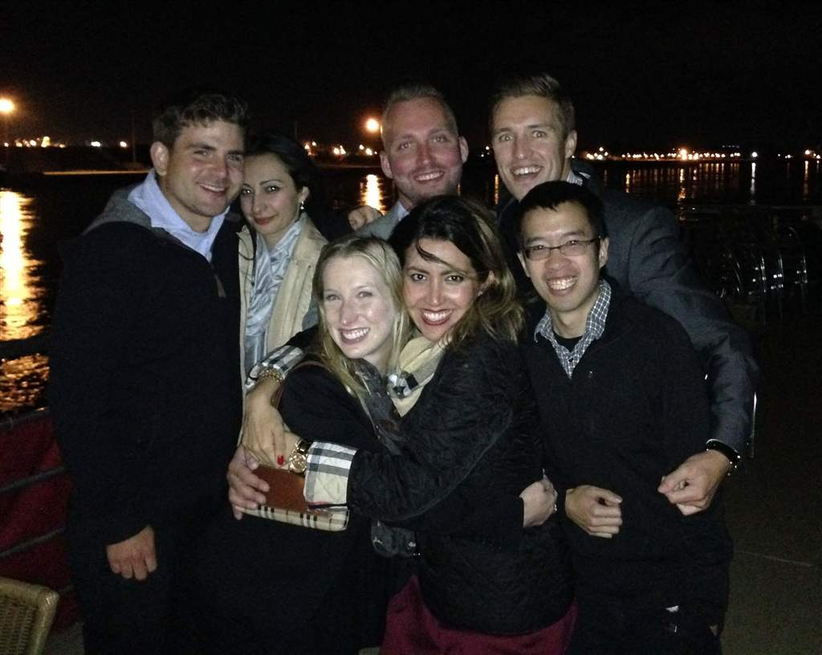
The Graduate Student Research Presenters get together on the Upper Deck during the dinner cruise

Slide 22
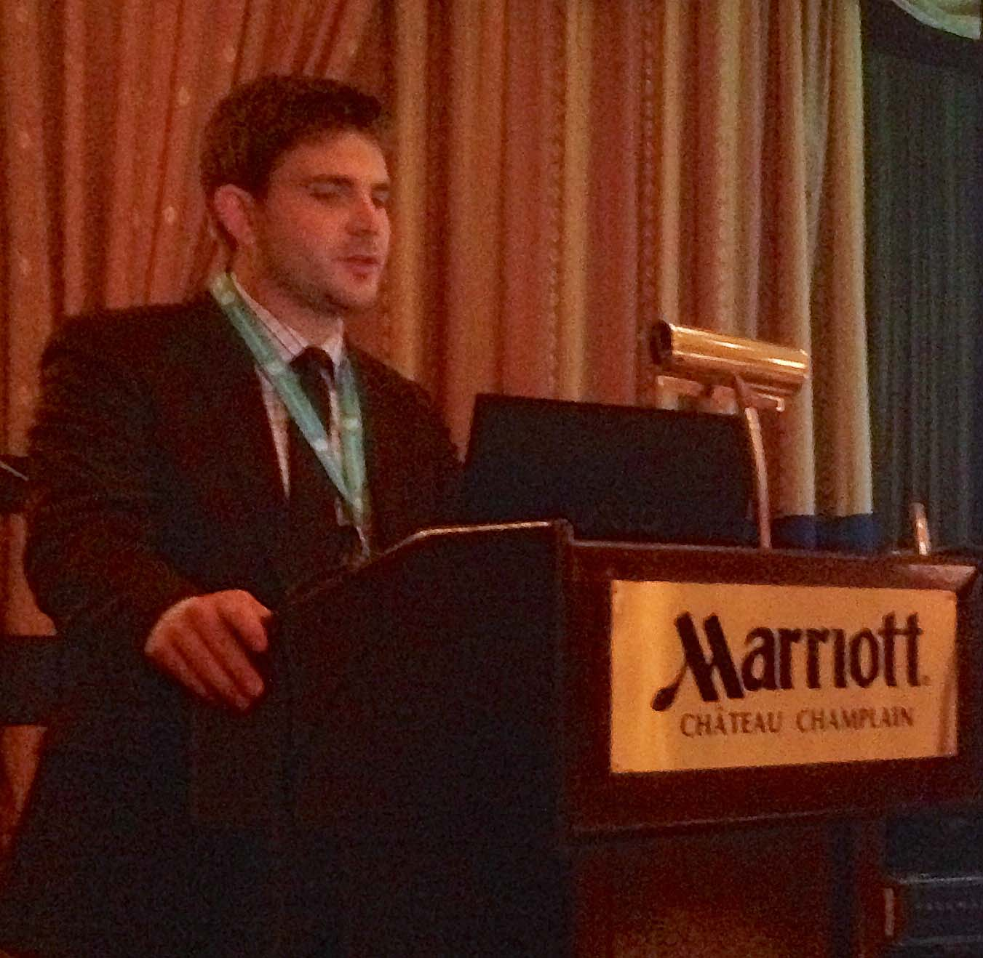
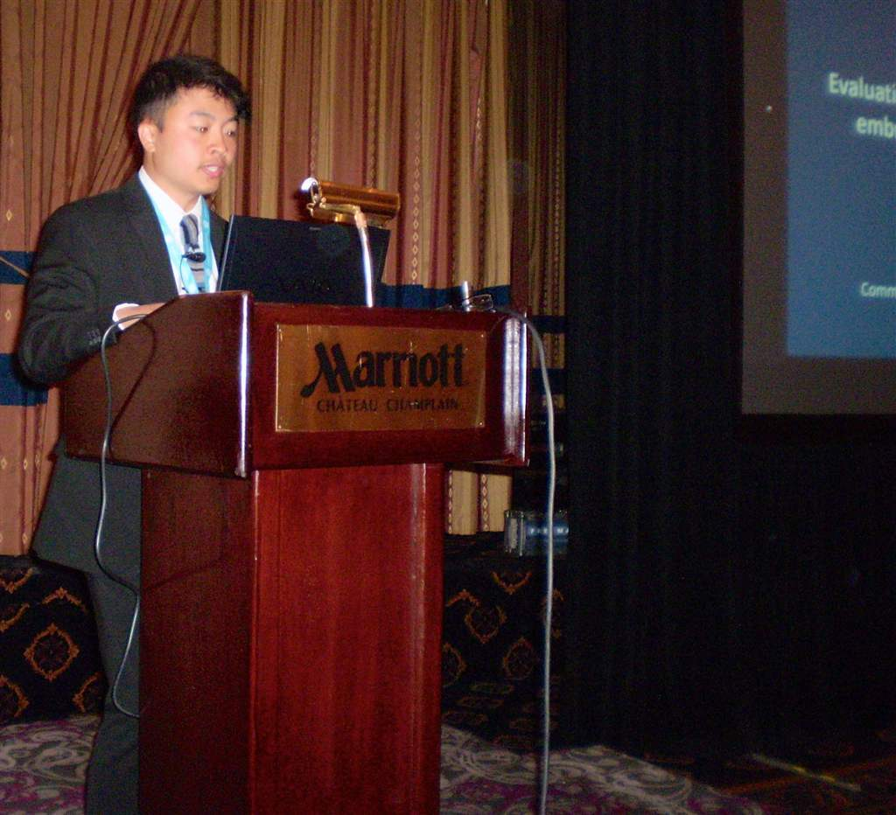
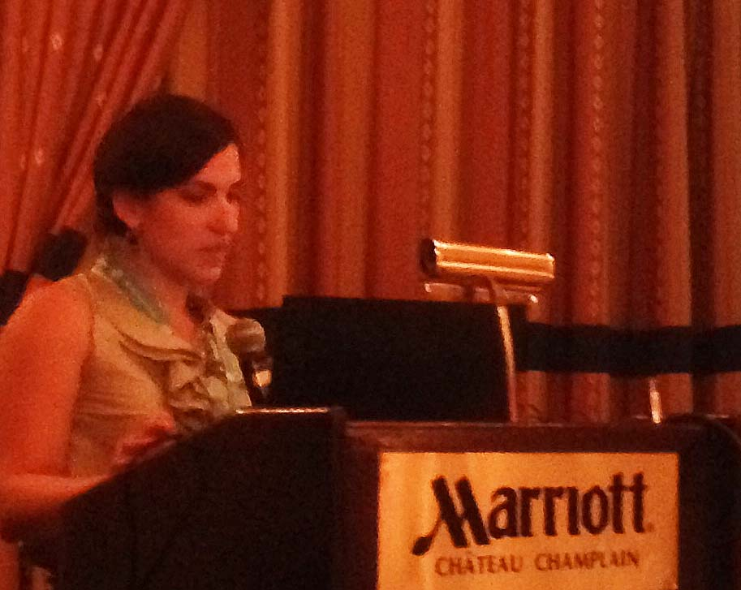
Graduate Student Reseach Presentations:
Left-Johnathan Woo; Top Right: Bradford Scheideman; Bottom Right: Marie-Lyne Gosselin

Slide 23
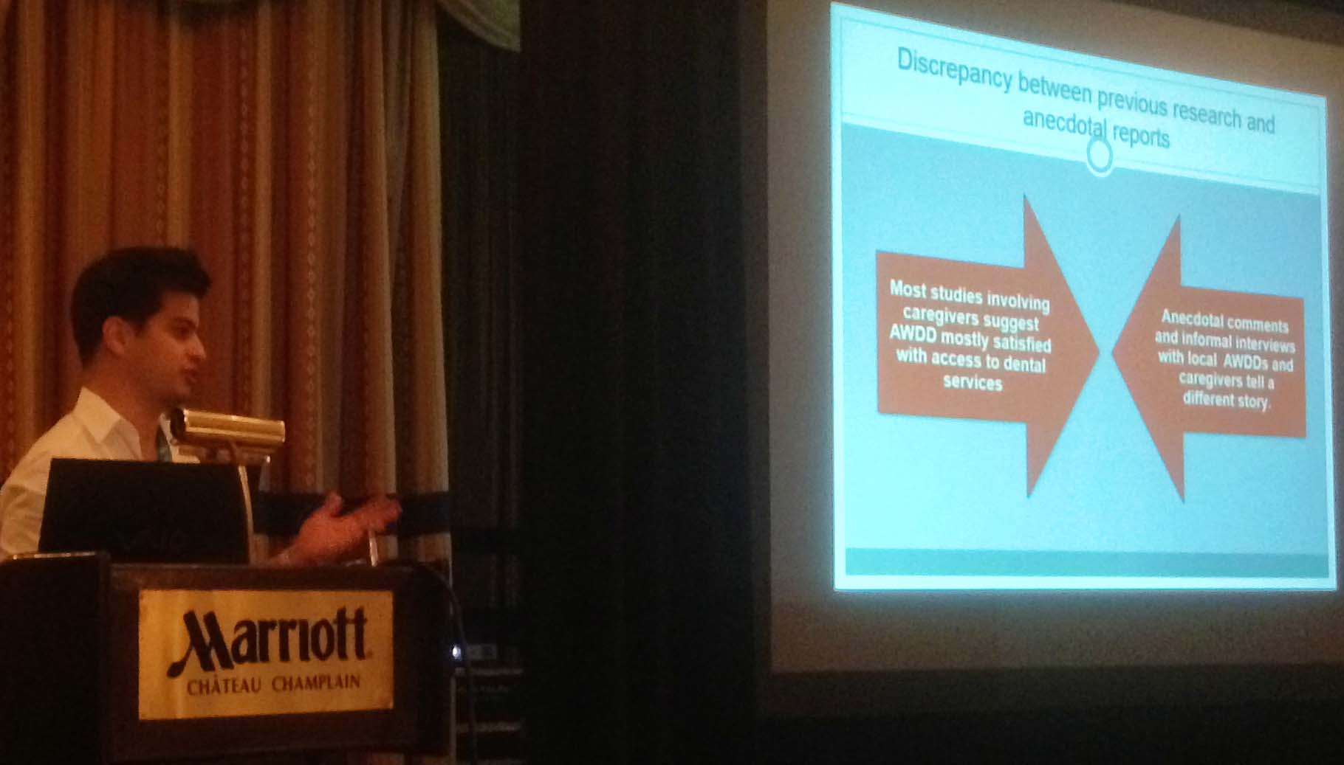
Graduate Student Research Presentations: Amin Salmasi

Slide 24
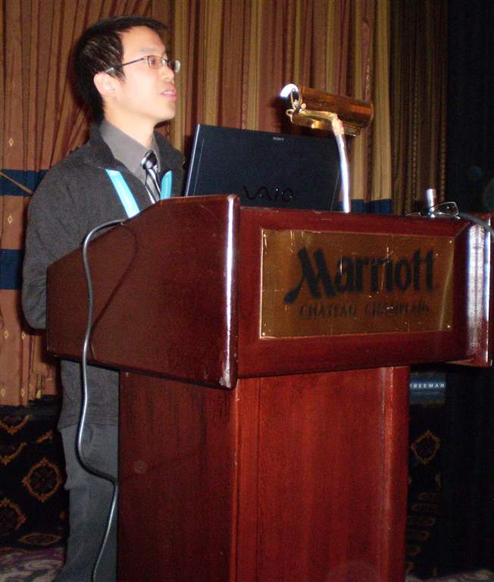
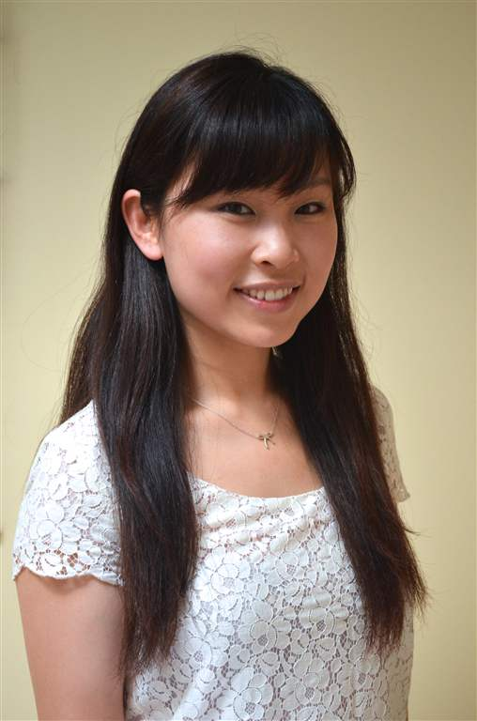
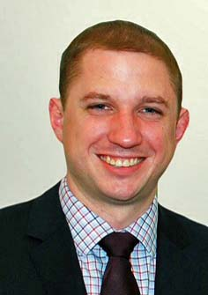
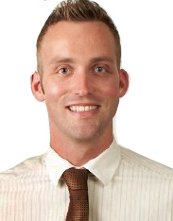
Graduate Student Research Presenters: Left: Andrew Wong
Top Right: Emily Lin Jun Chen Bottom Left- Nick Lekic and Right- Brad Klus

Slide 25
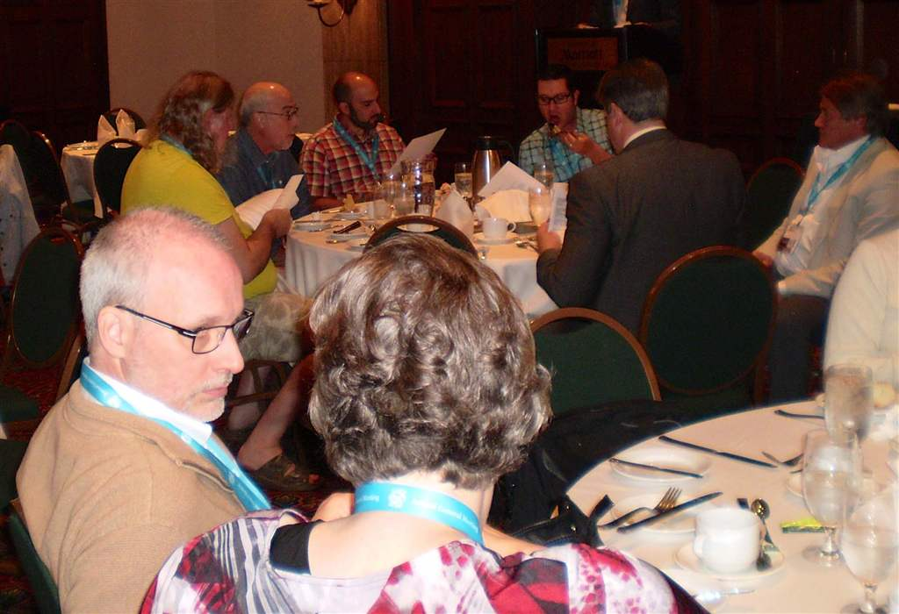
Saturday's AGM Lunch

Slide 26
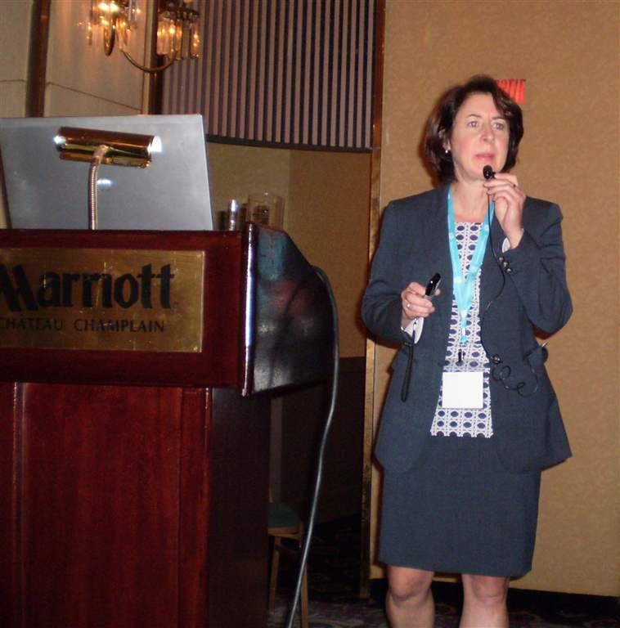
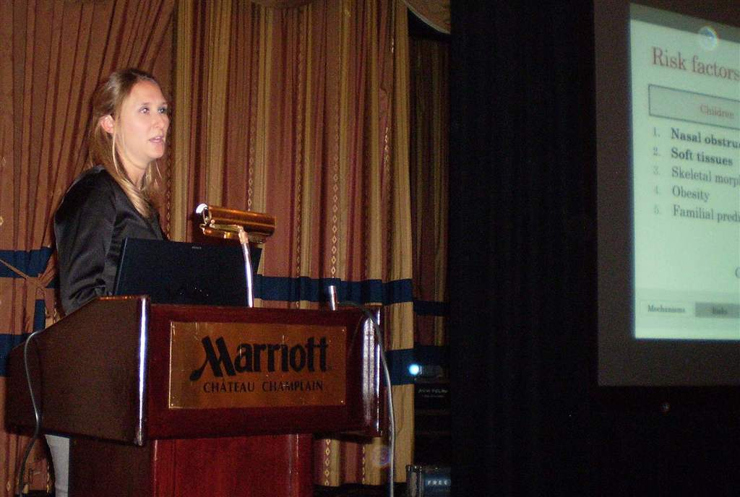
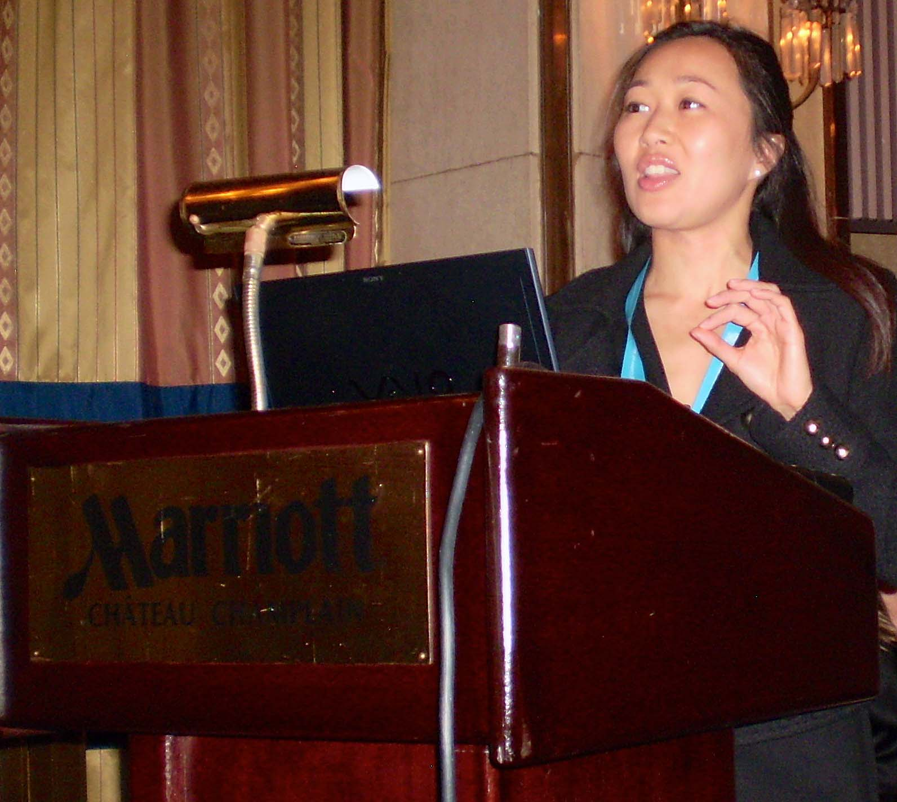
Saturday Educational Speakers included L: Marie-Josee Tessier Top Right: Dr. Andree Montpetit and Bottom Right: Dr. Nelly Huynh

Slide 27
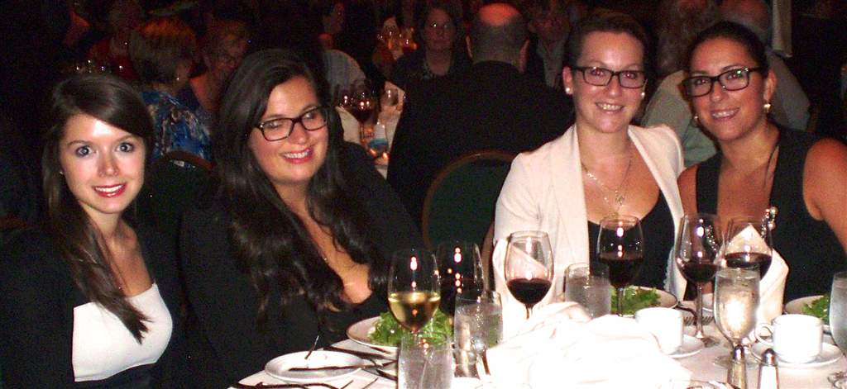
The President's Gala Dinner

Slide 28
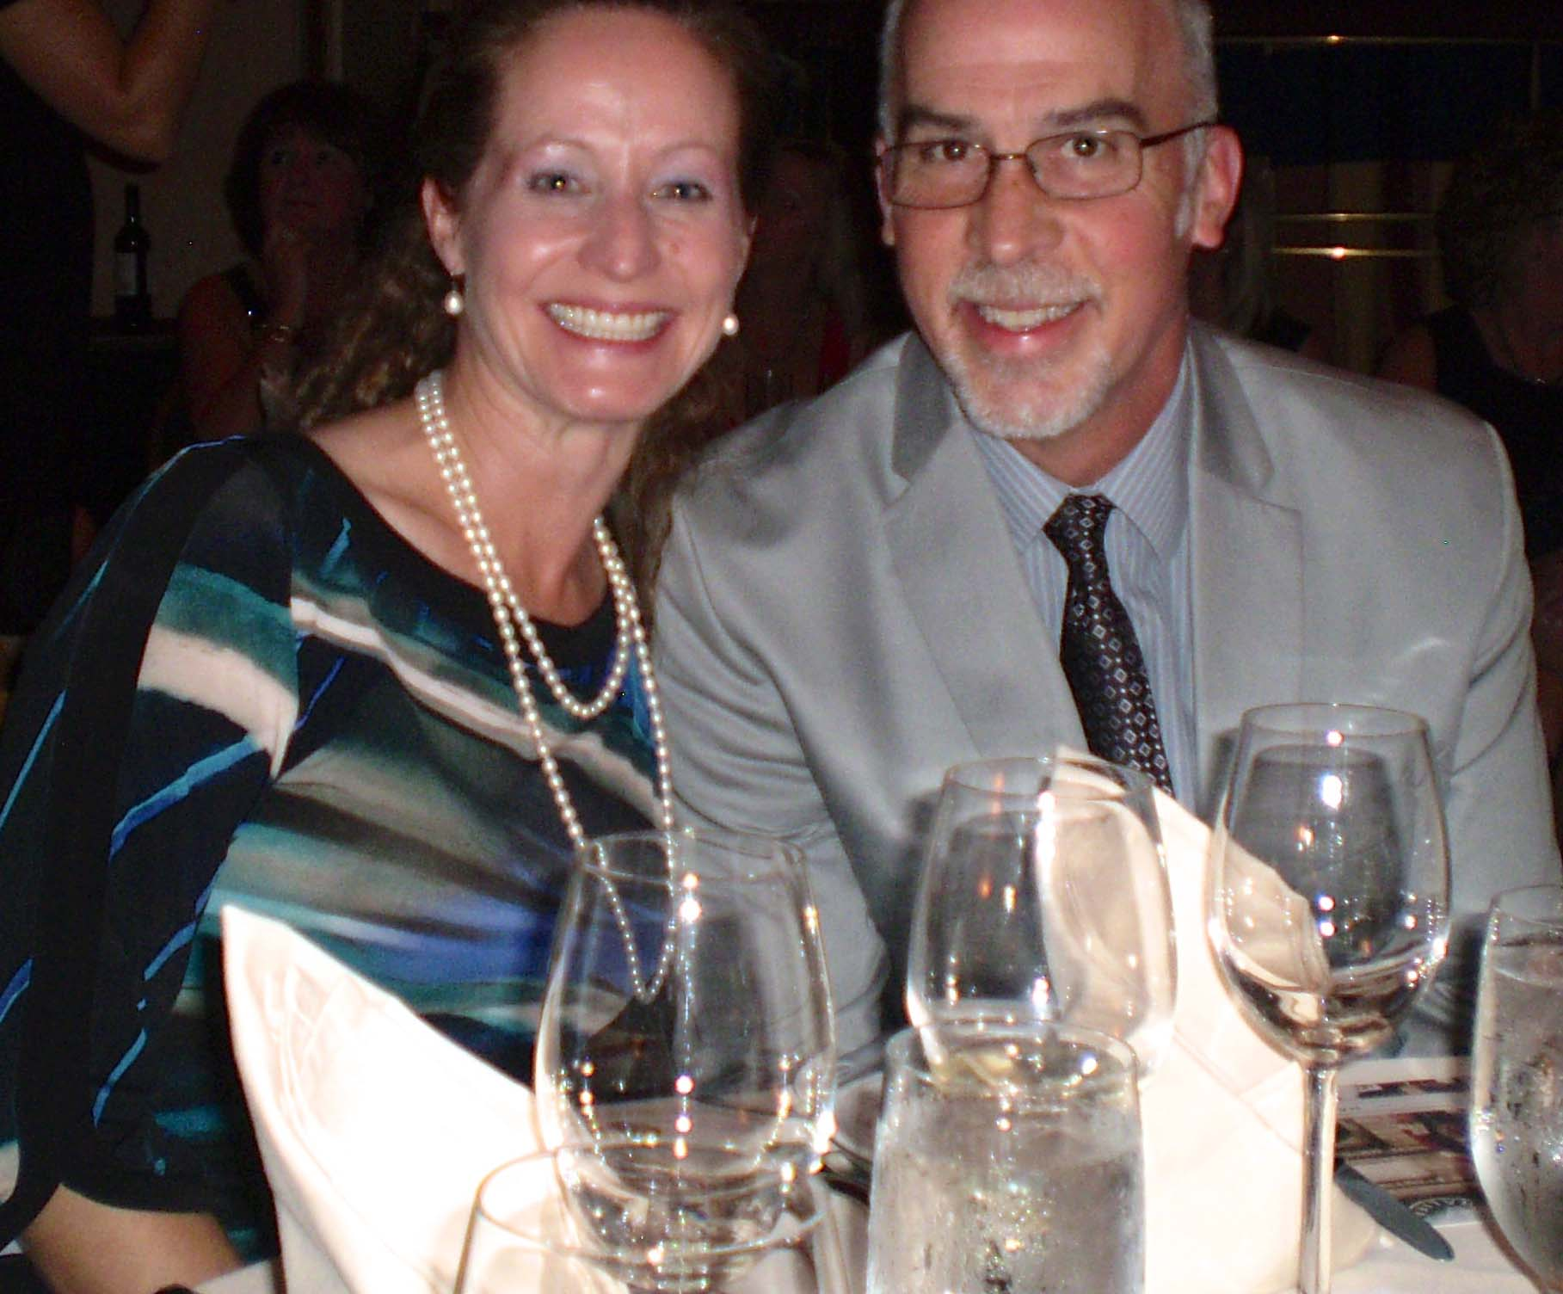
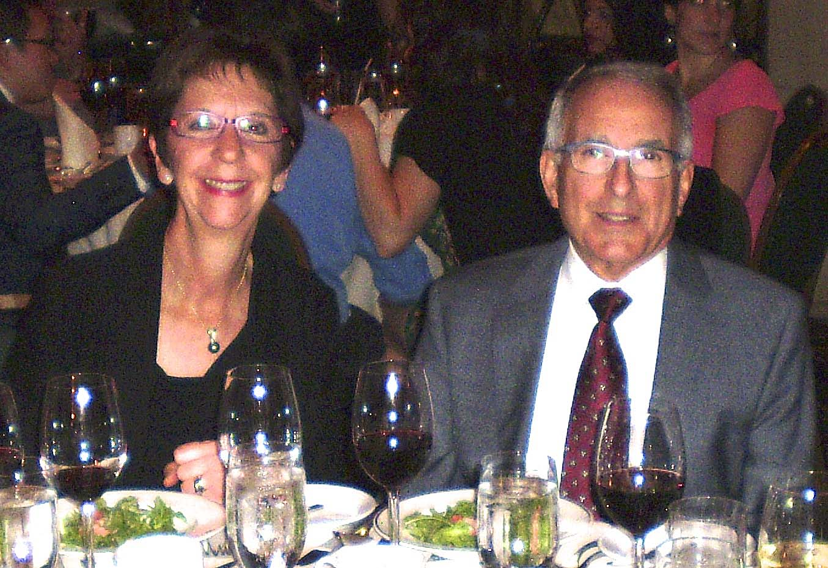
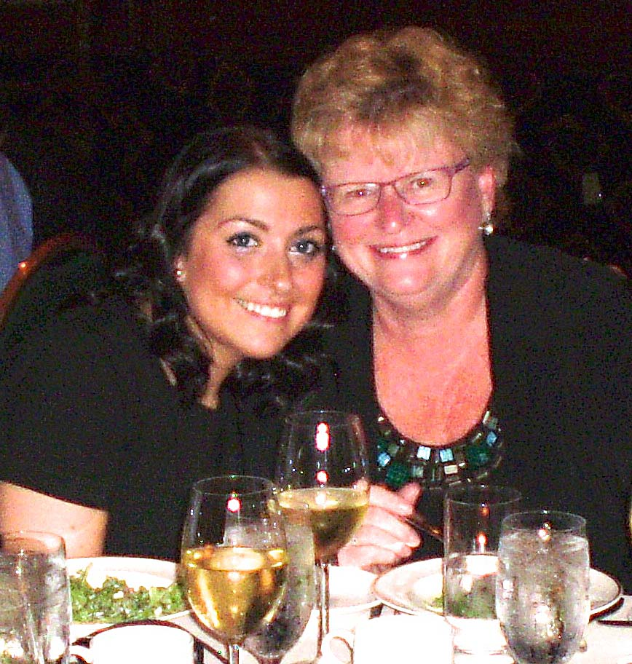
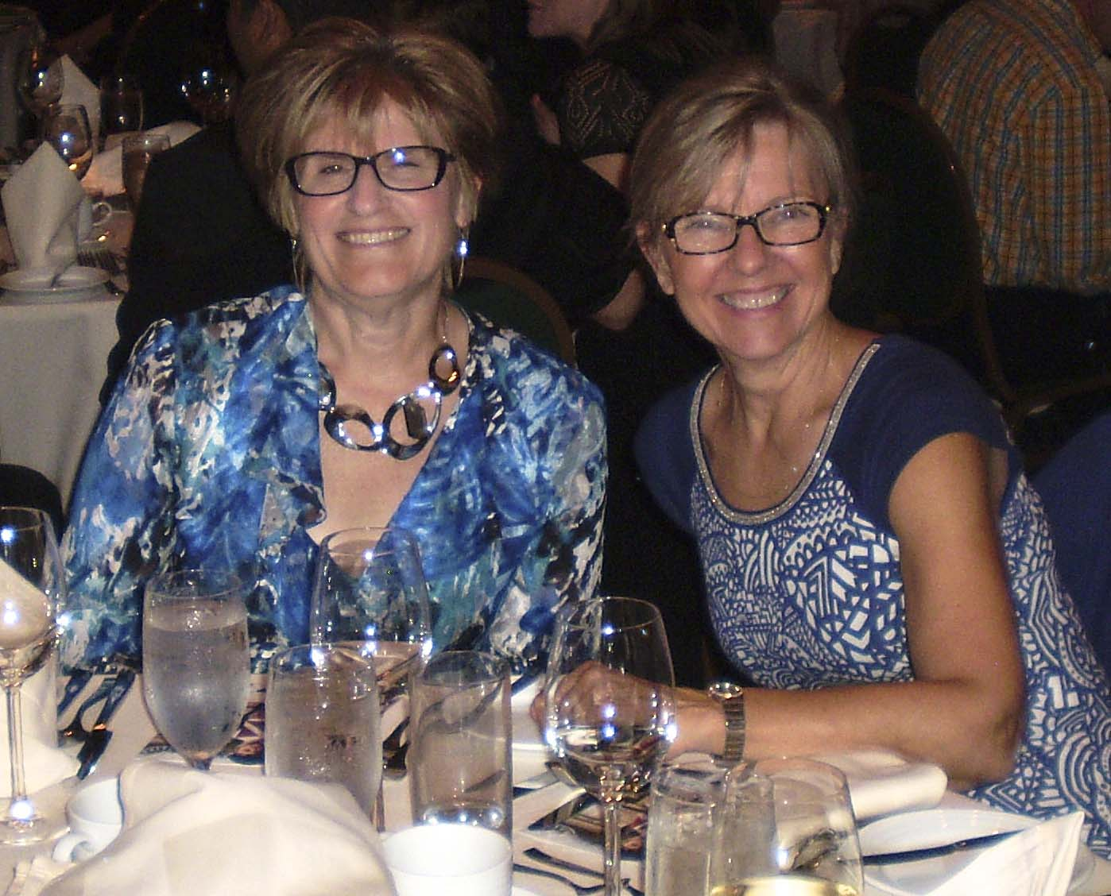

Slide 29
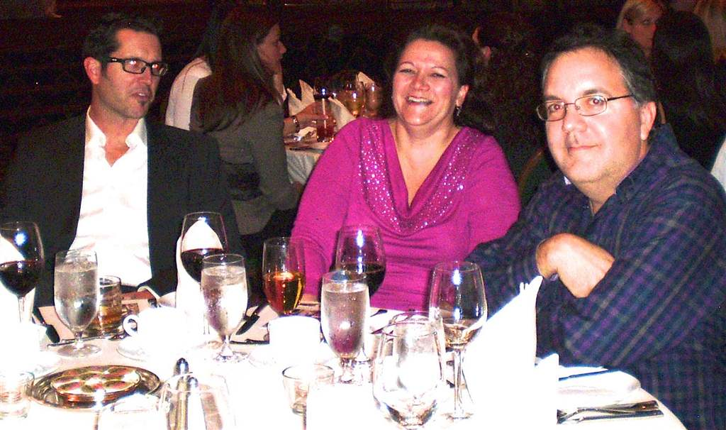
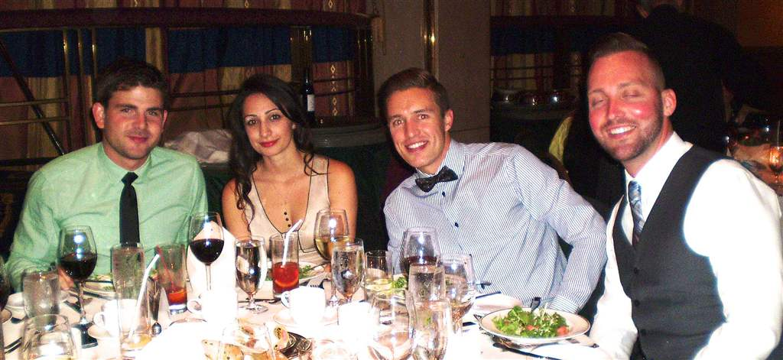

Slide 30
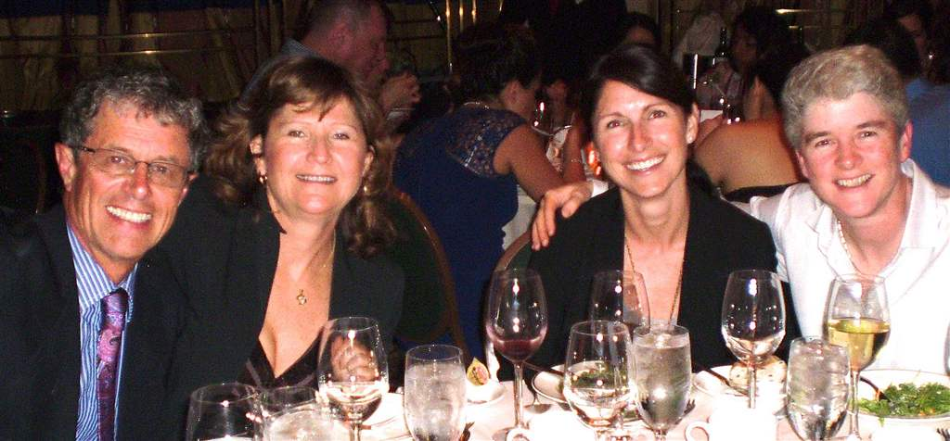
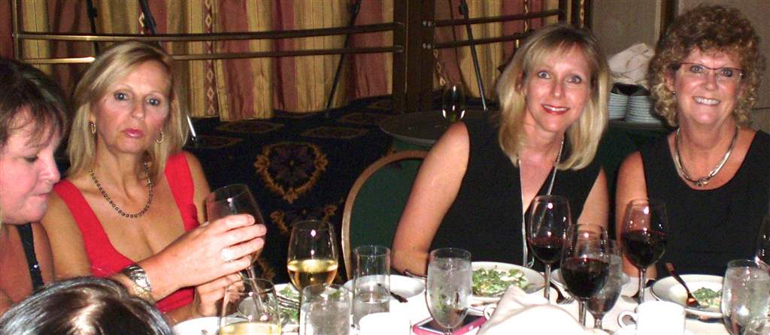

Slide 31
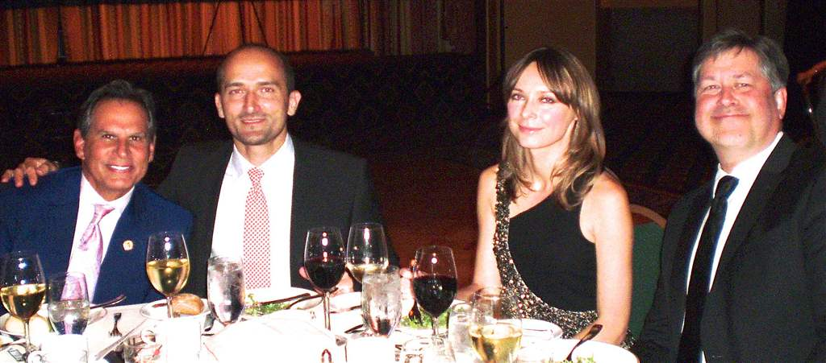
L to R: Dr. Robert Delarosa, AAPD President-Elect; Dr. Michal Goralski, CAPD Past President; Agnes Mazur, Dr. Paul Andrews, CAPD Vice-President

Slide 32
The acapella group QU4RTZ

Slide 33
The 3M ESPE Award Presentation L to R: Dr. Zahra Kurji, Laura Brown (3M Rep), Dr. Johnathan Woo (joint winner with Dr. Brad Klus), Dr. Michal Goralski

Slide 35
SEE YOU NEXT YEAR
HALIFAX, NOVA SCOTIA
SEPTEMBER 24-25-26, 2015

