Slide 1
The CAPD-ACDP
2013 ANNUAL GENERAL MEETING
Vancouver, British Columbia

Slide 2
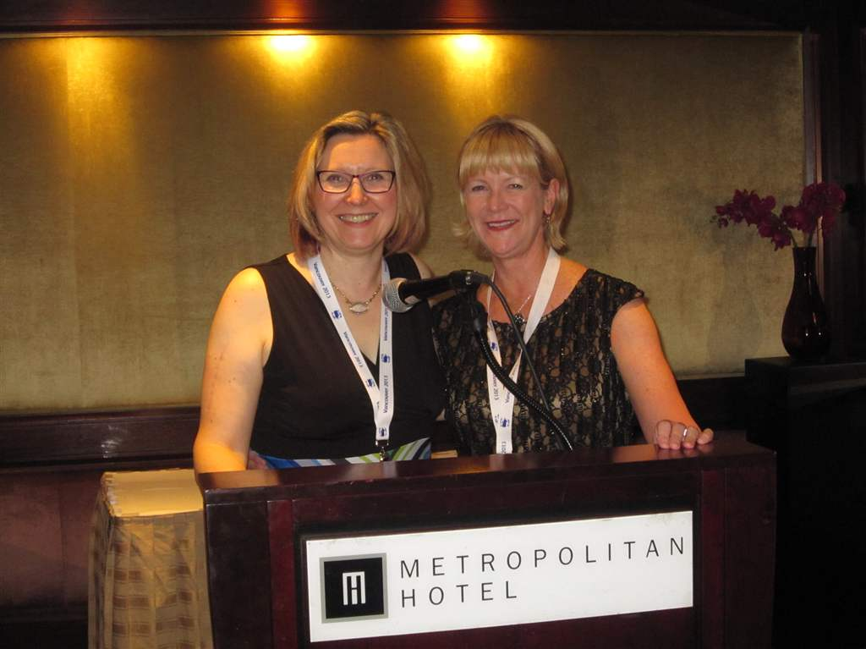
Anita Gartner and Felicity Hardwick, the organizers of the 2013 Annual Meeting

Slide 3
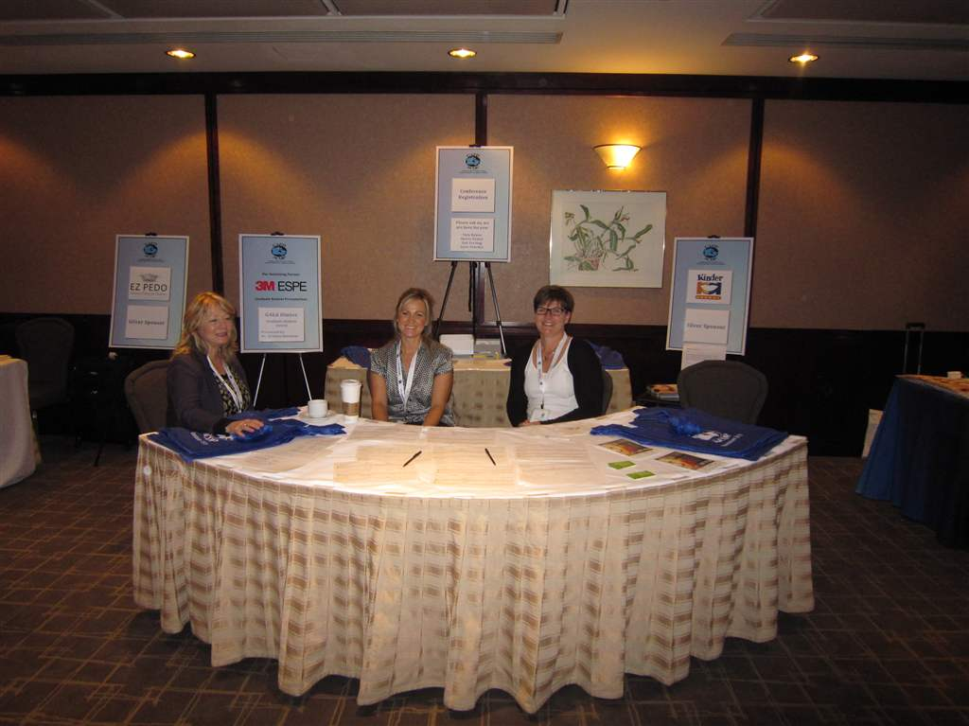
Registration Desk

Slide 4
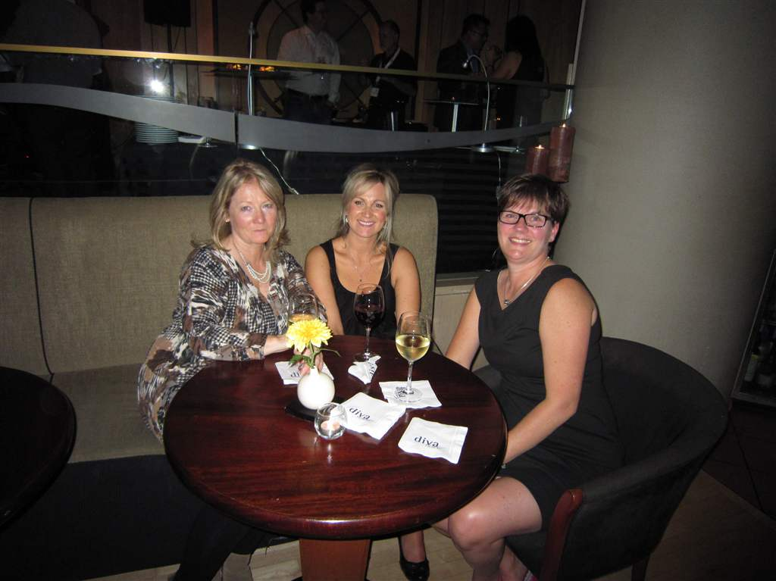
Sherri, Tara and Anita
Volunteers at our Registration Desk

Slide 5
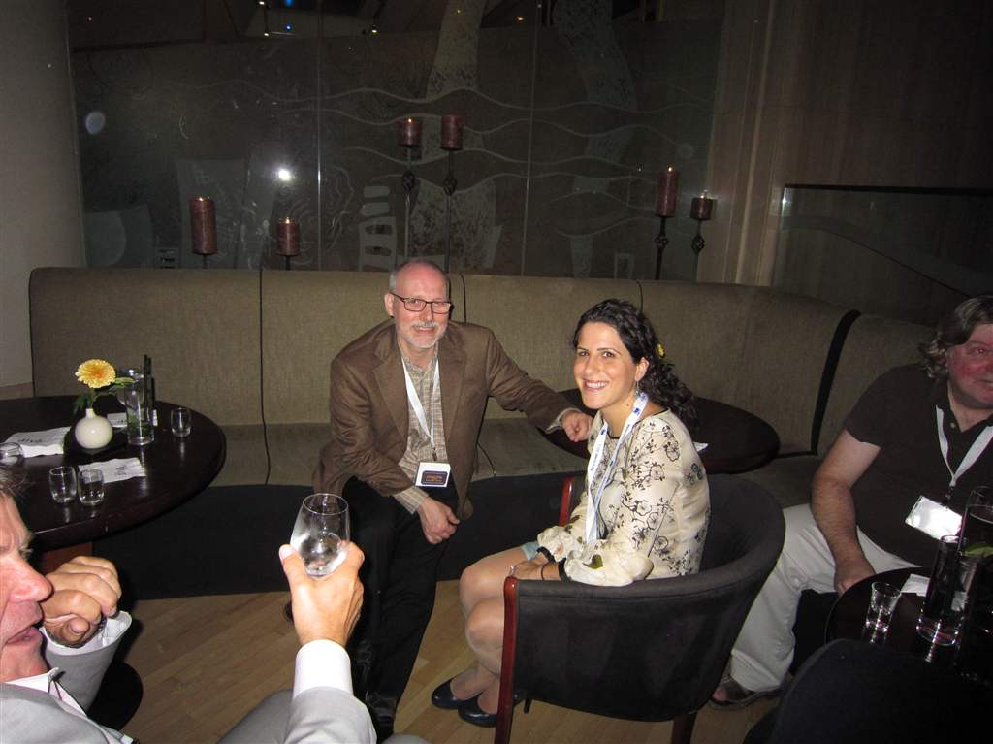
Diva Night

Slide 6
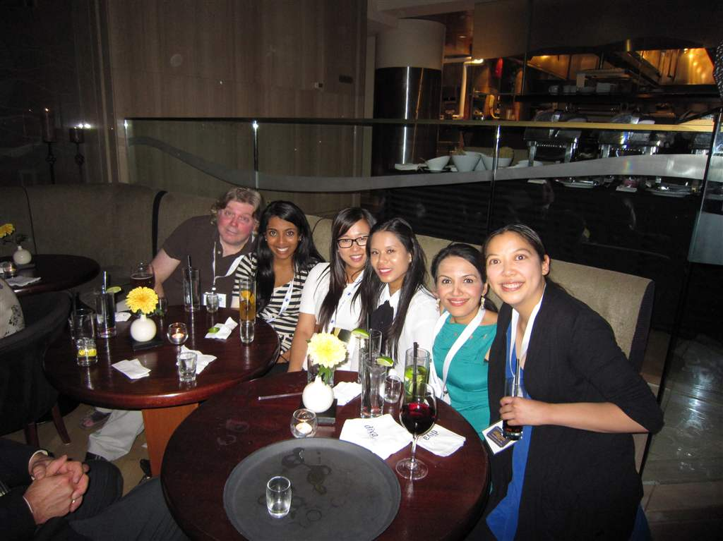
Diva Night

Slide 7
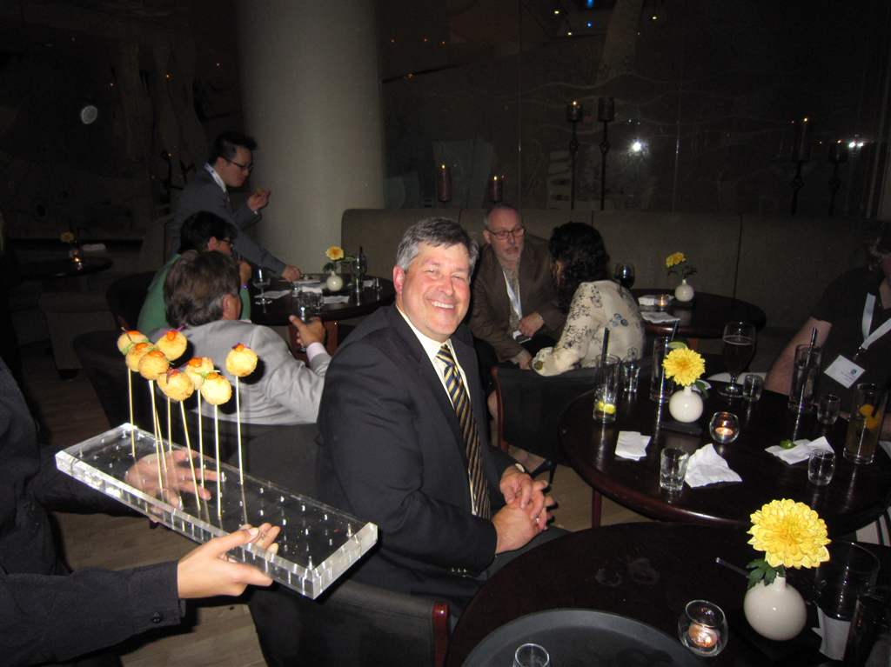
Diva Night

Slide 8
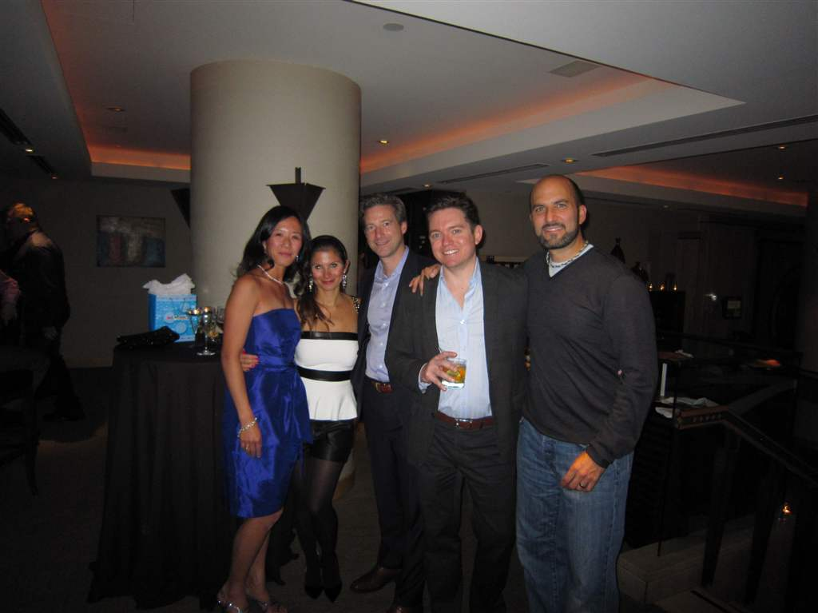
Diva Night

Slide 9
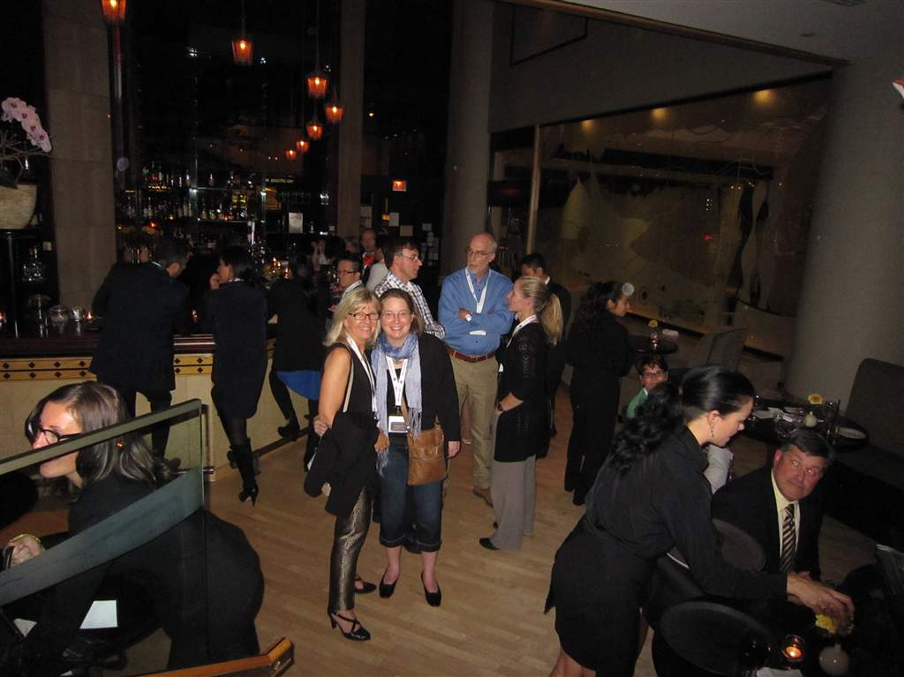
Diva Night

Slide 10
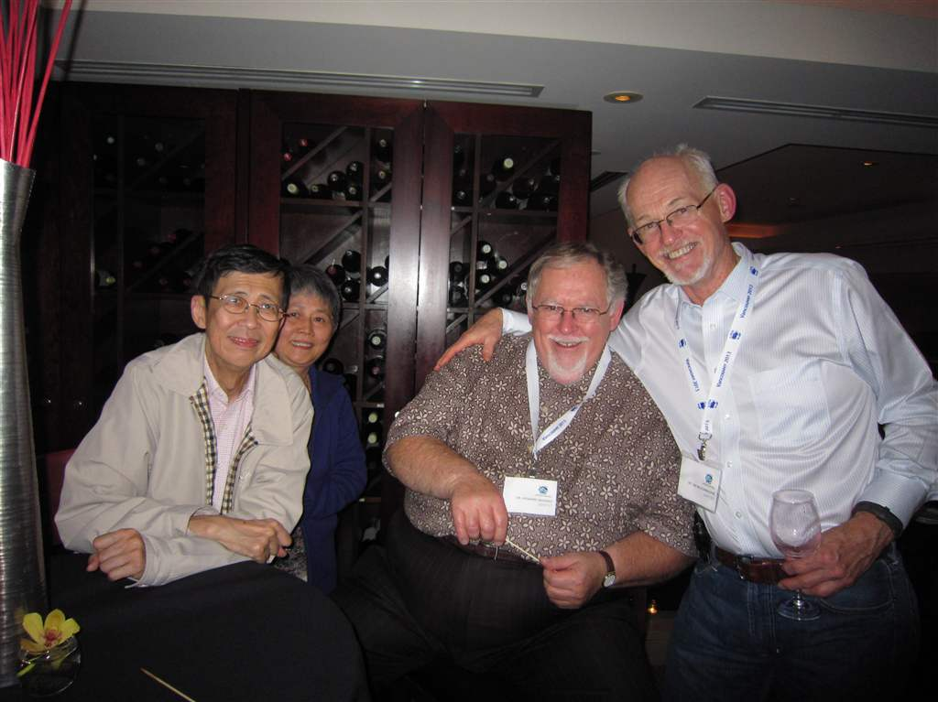
Diva night - Dr & Mrs Cheung with Drs McIsaac and McConnachie

Slide 11
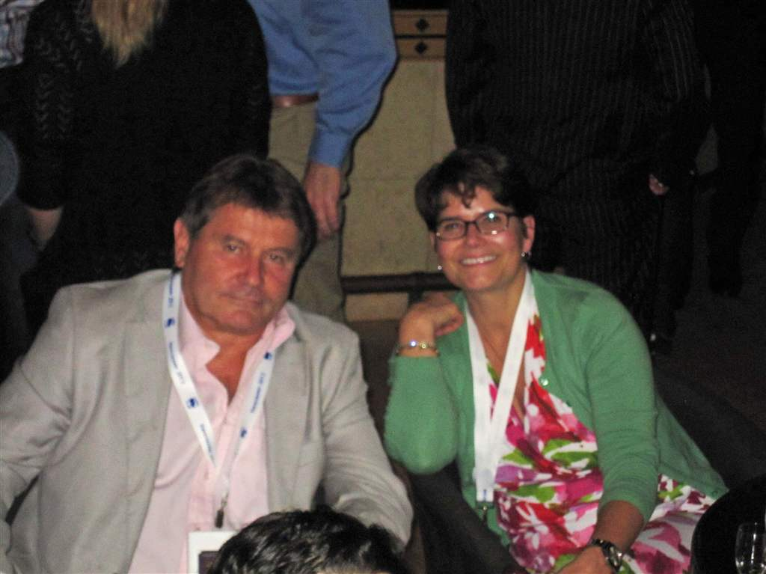
Diva night - Dr Canonne & Mrs Claire D'Amour

Slide 12
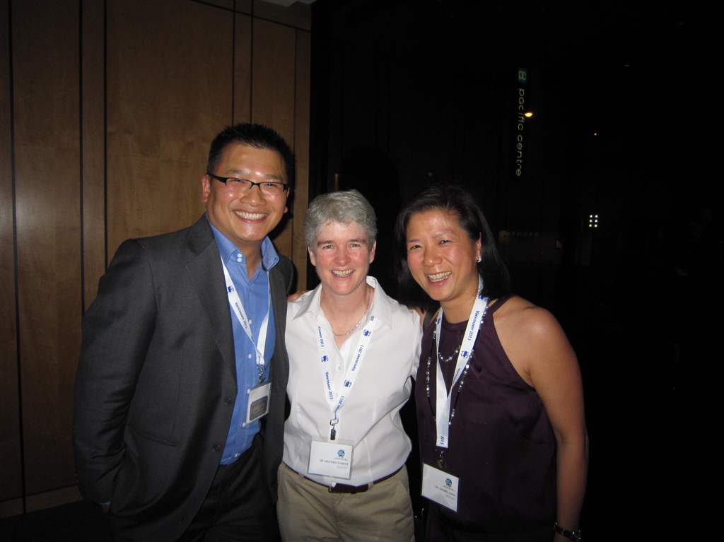
Diva night - Drs Kuah, Dyment & Chan

Slide 13
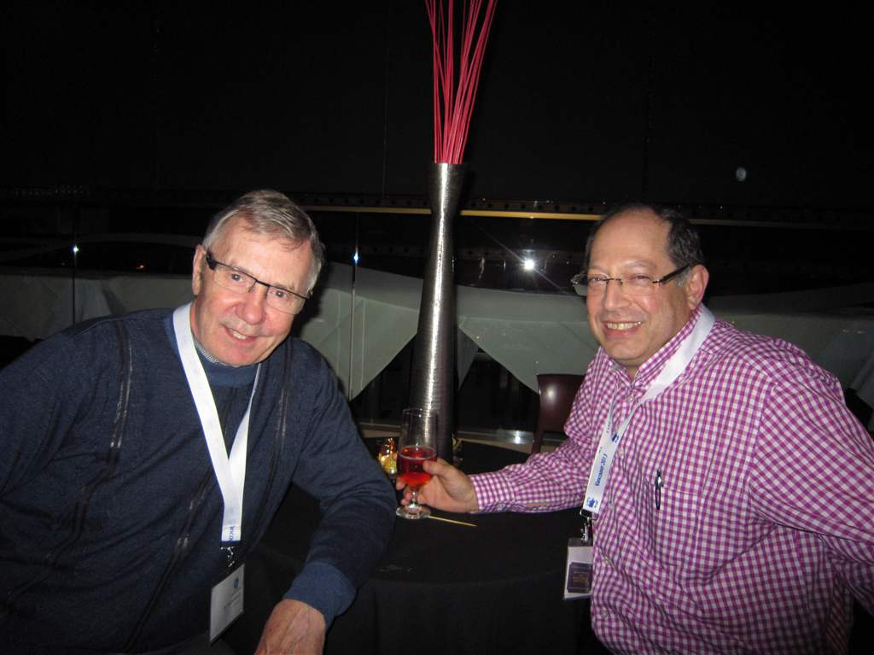
Diva night - Drs Morley & Barsky

Slide 14
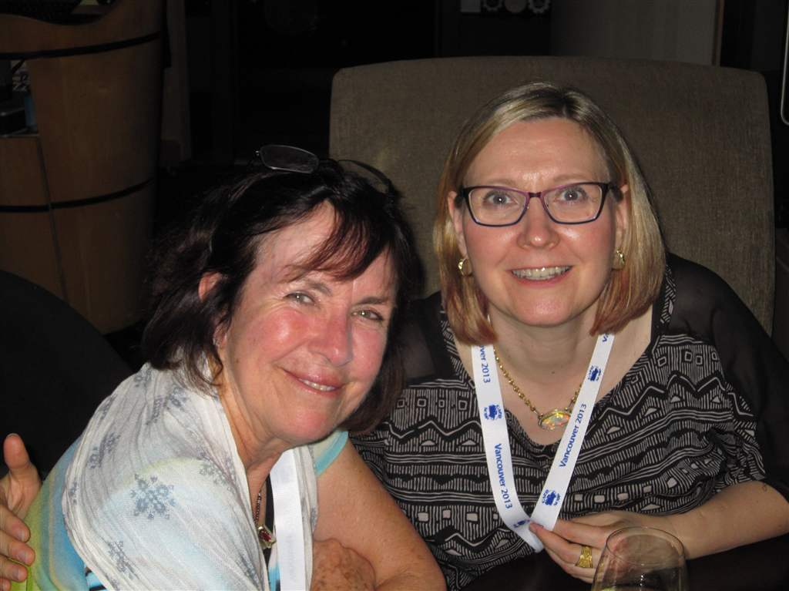
Diva night - Drs Penny Leggot & Anita Gartner

Slide 15
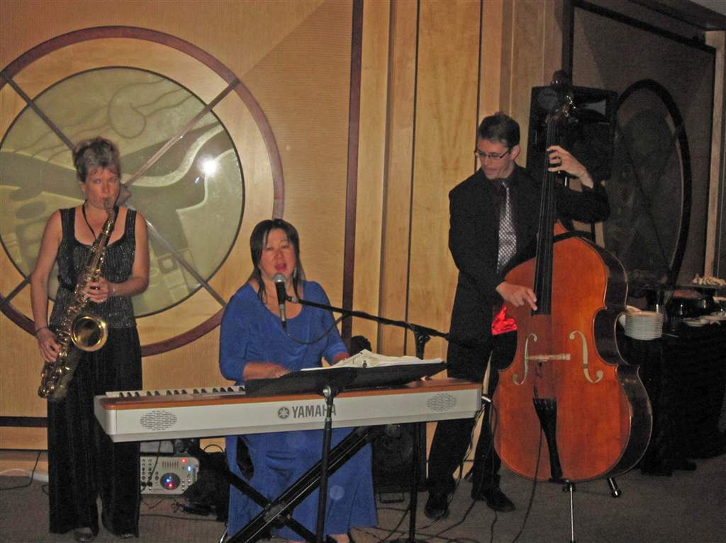
Diva night musicians

Slide 16
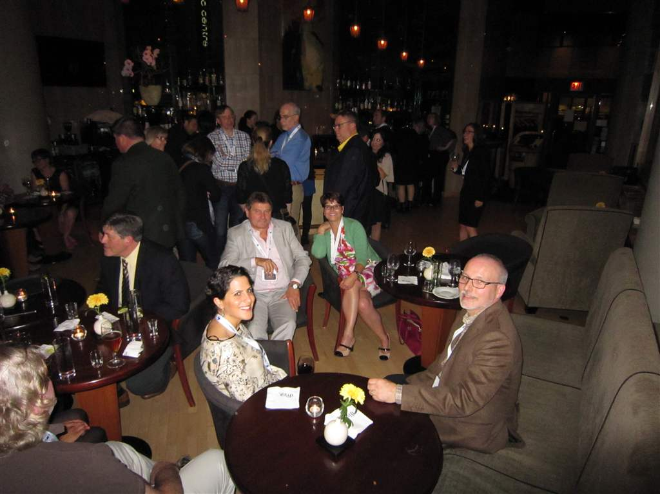
Diva night

Slide 17
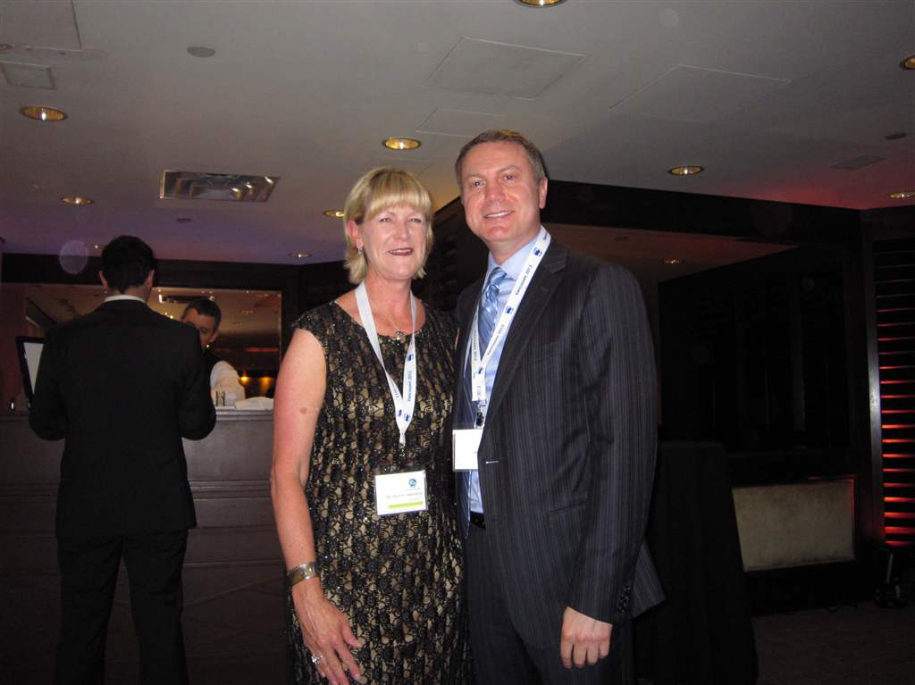
Dr. Hardwick & Mr Lori diFonzo from 3M ESPE

Slide 18
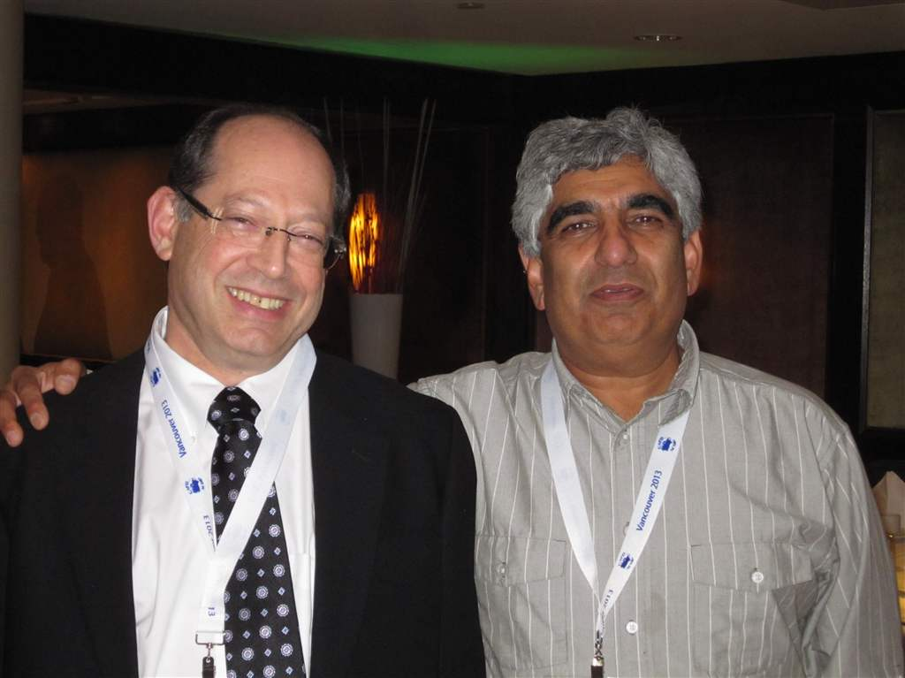
Double-click to enter title
Double-click to enter text
Drs Barsky & Joshi

Slide 19
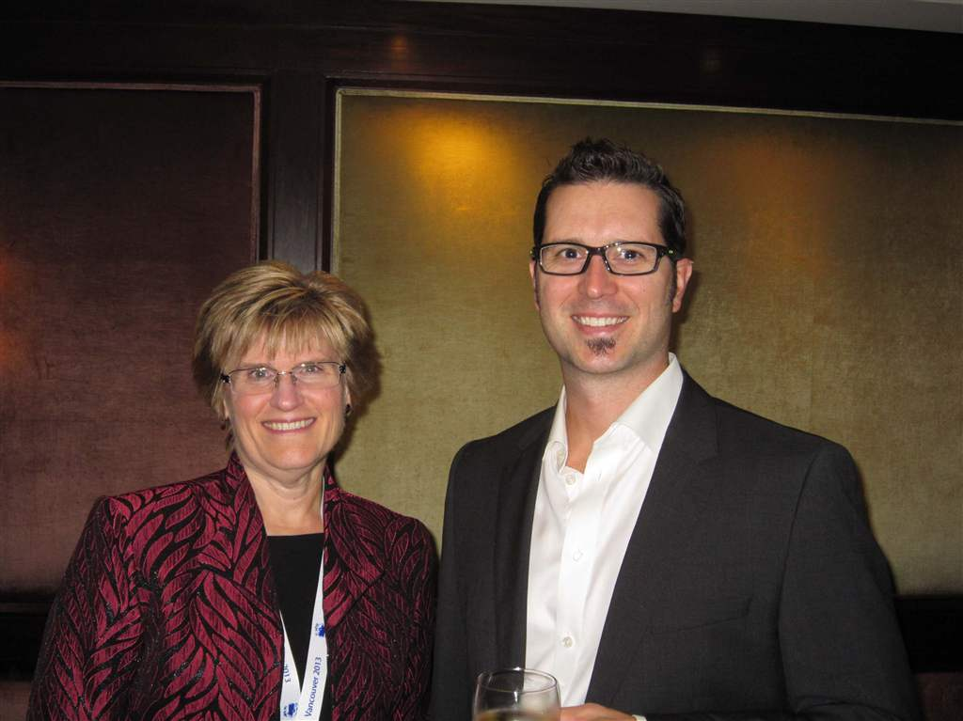
Drs Campbell & Farquhar - Gala Dinner

Slide 20
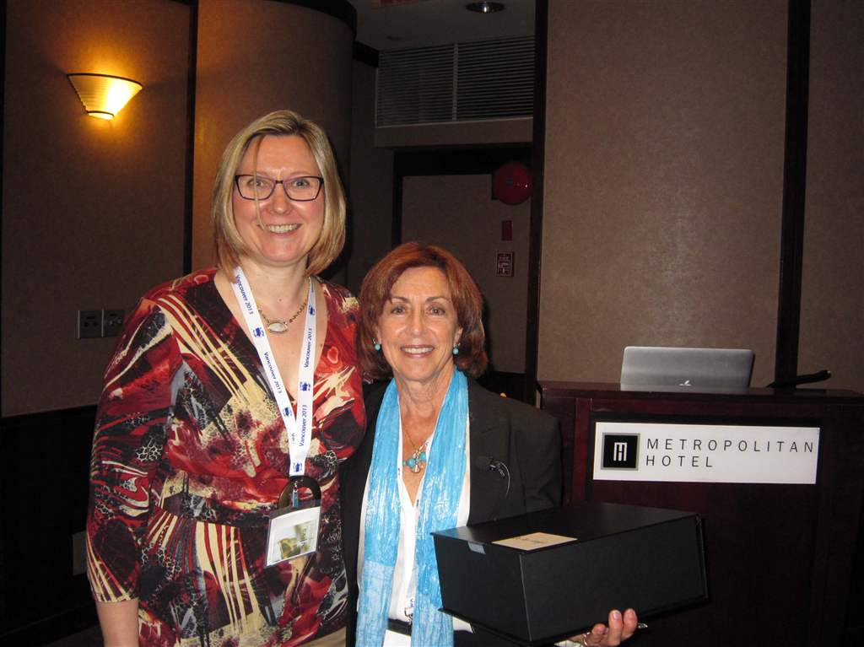
Drs Gartner & Lisagor

Slide 21
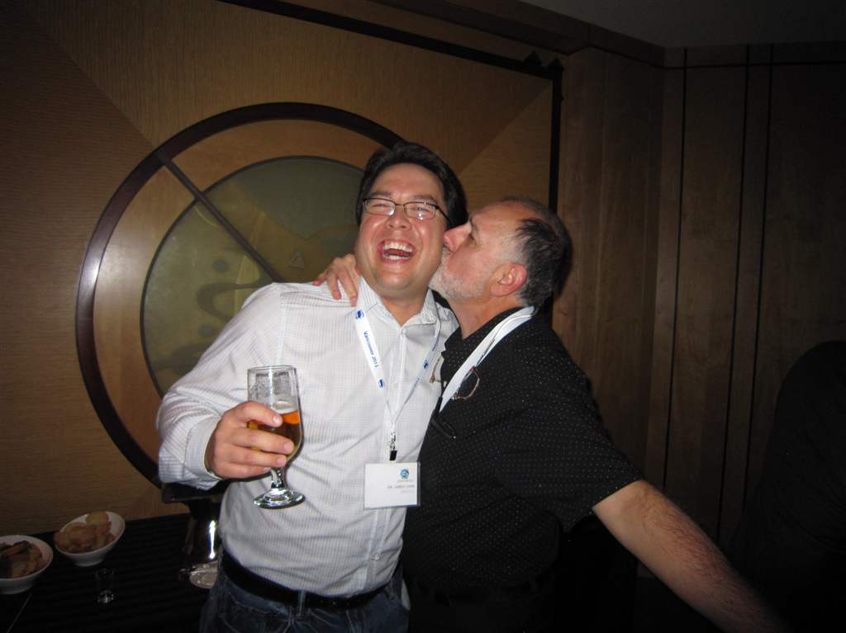
Drs Jim Chan & Ross Anderson

Slide 22
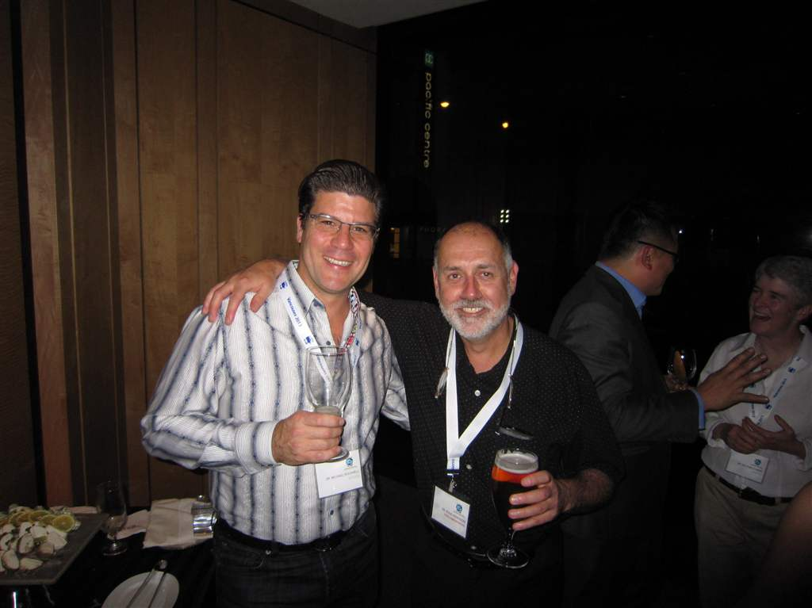
Drs Michael Rockwell & Ross Anderson

Slide 23
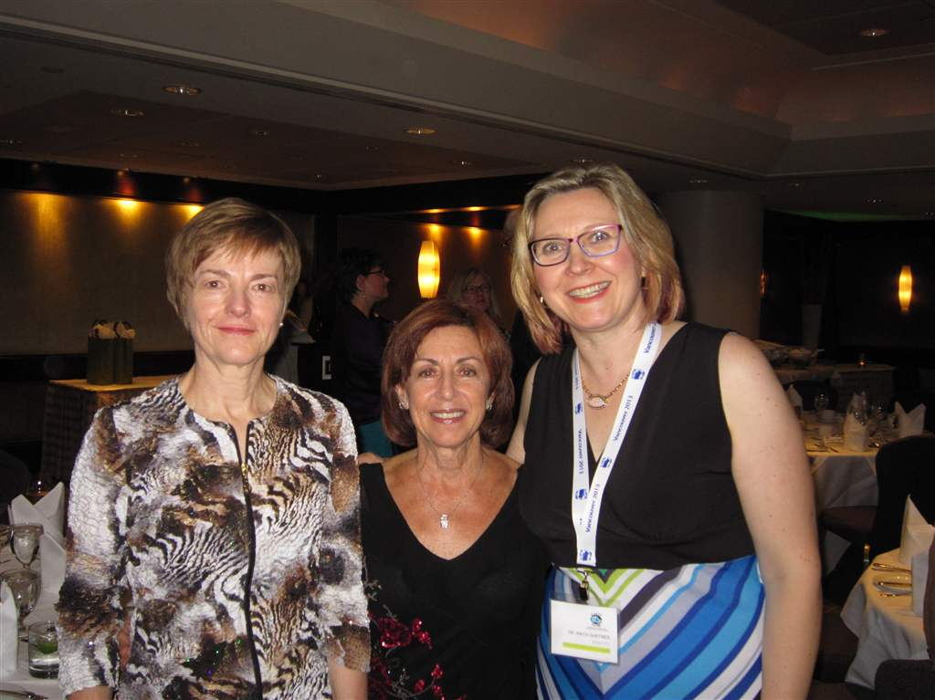
Drs Postello, Lisagor & Gartner

Slide 24
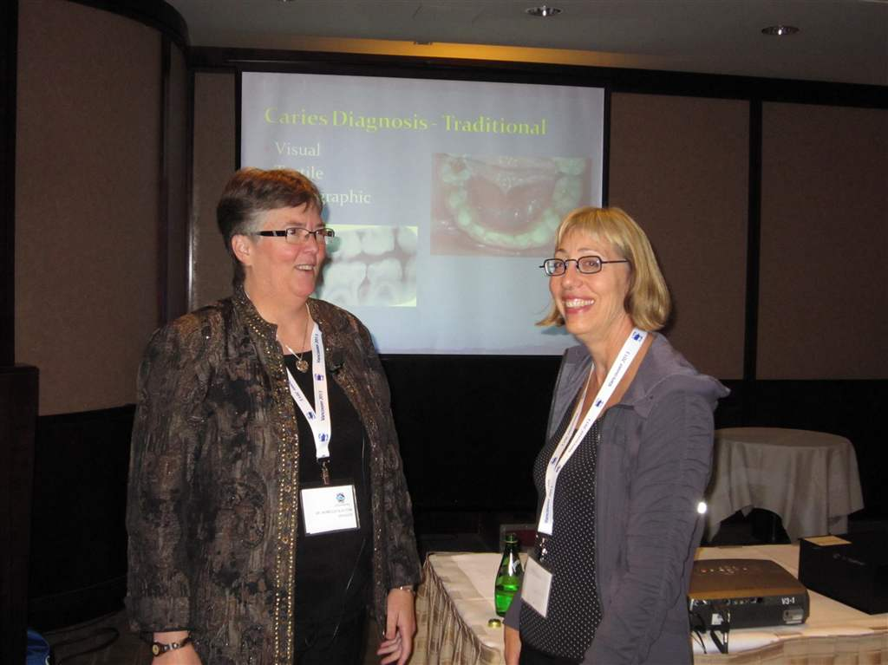
Drs Slayton & Richman

Slide 25
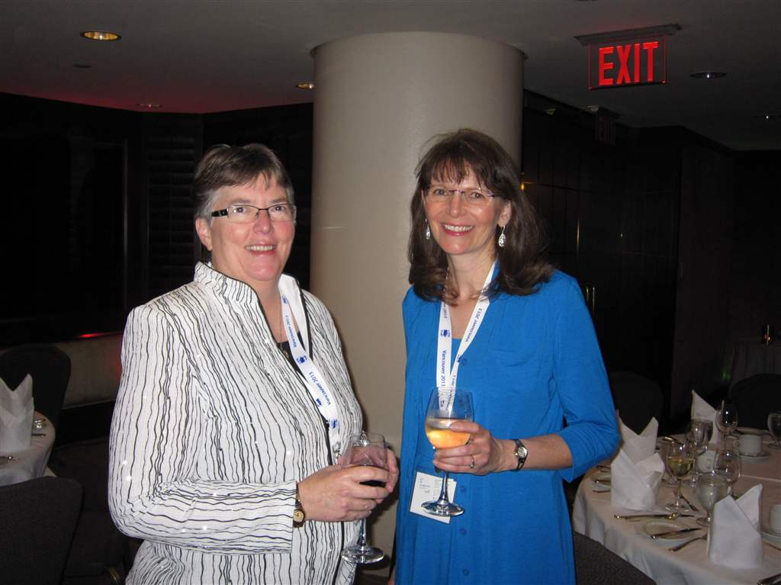
Drs Slayton & Sheller

Slide 26
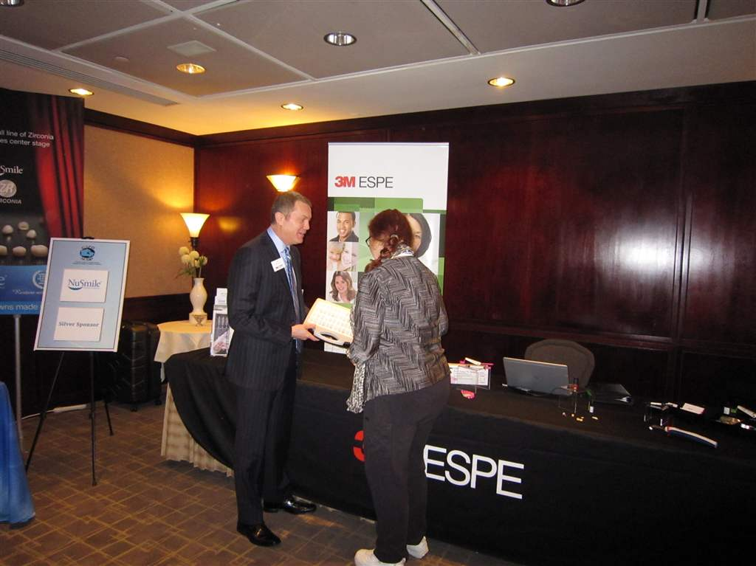
Exhibits

Slide 27
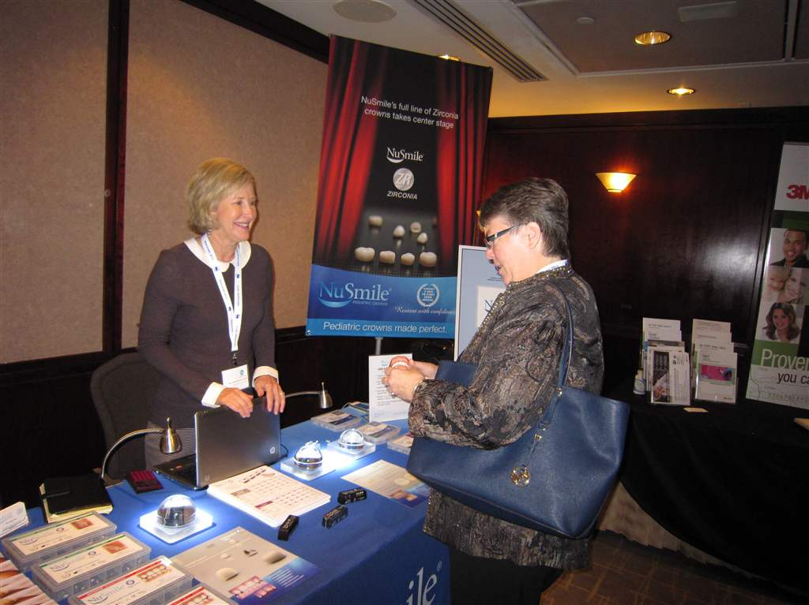
Exhibits

Slide 28
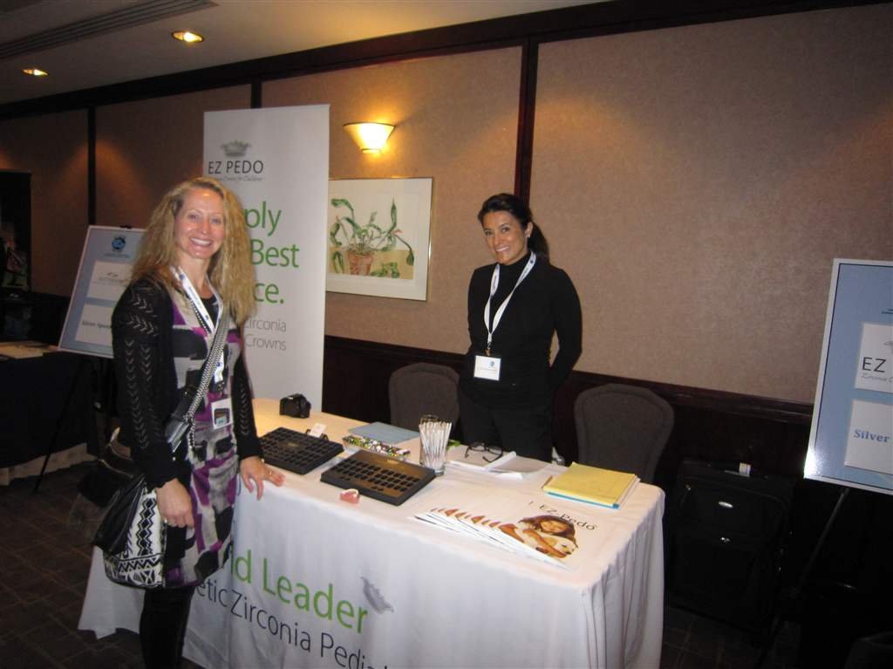
Exhibits

Slide 29
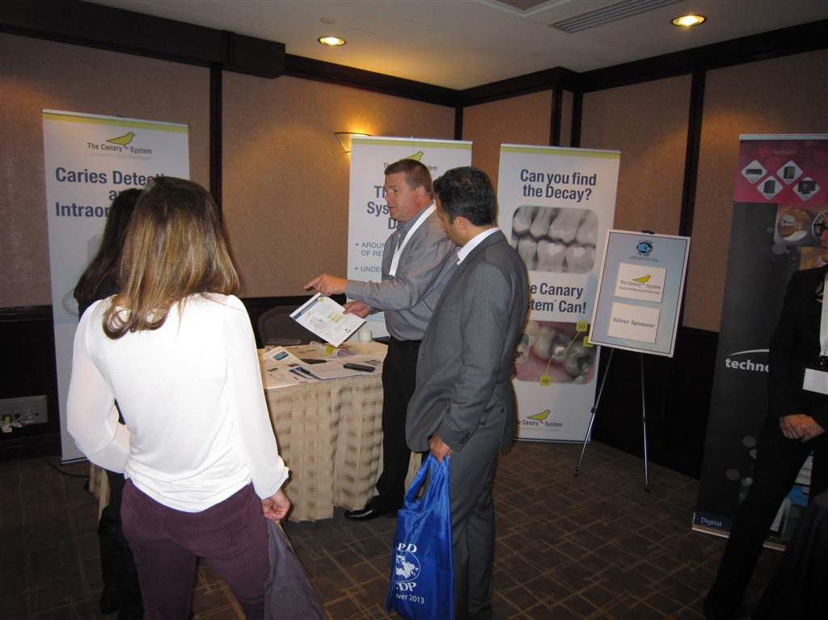
Exhibits

Slide 30
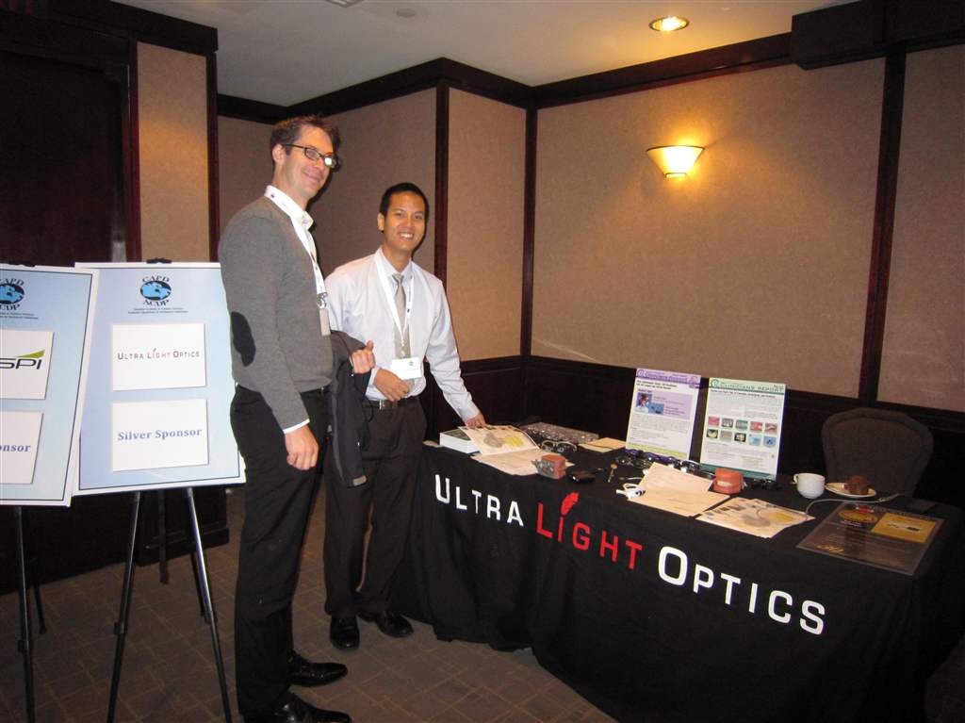
Exhibits

Slide 31
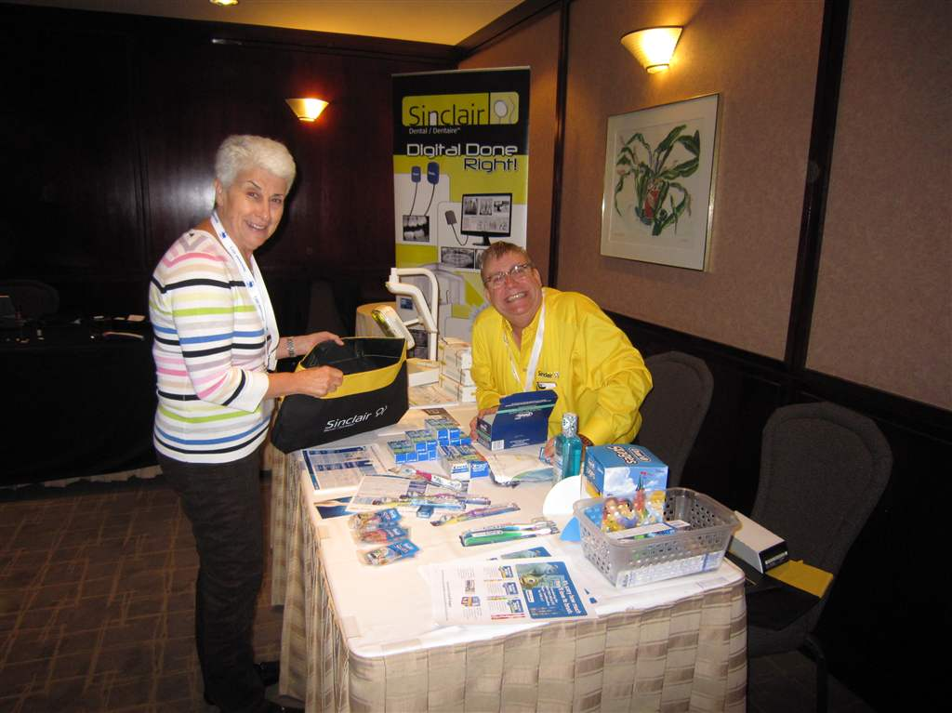
Exhibits

Slide 32
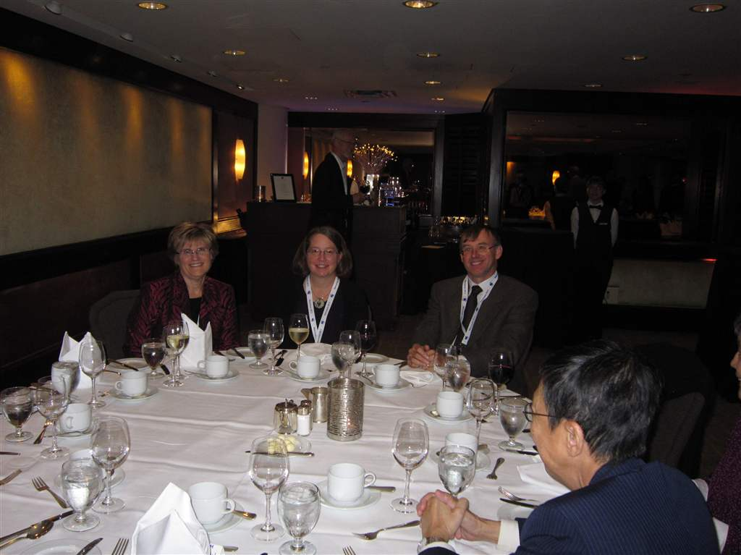
Gala Dinner

Slide 33
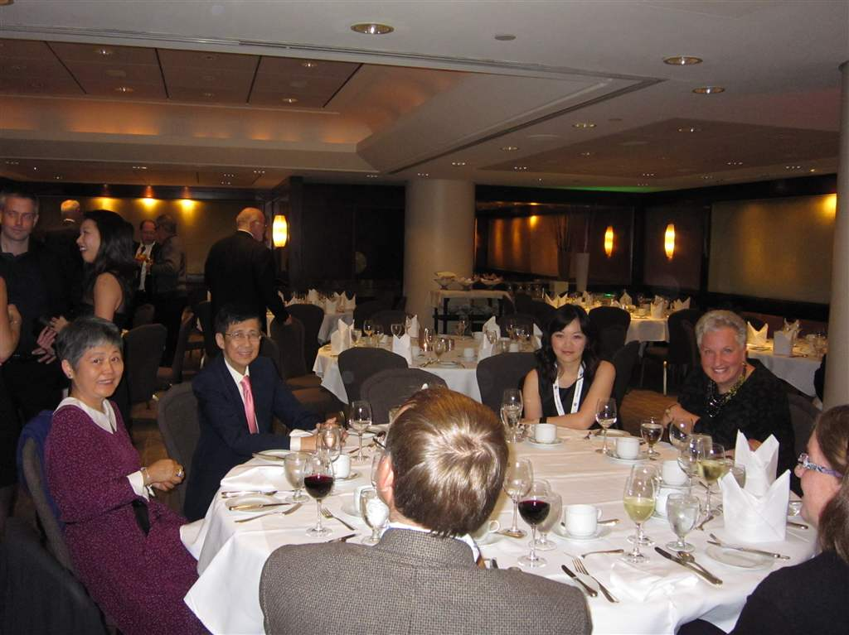
Gala Dinner

Slide 34
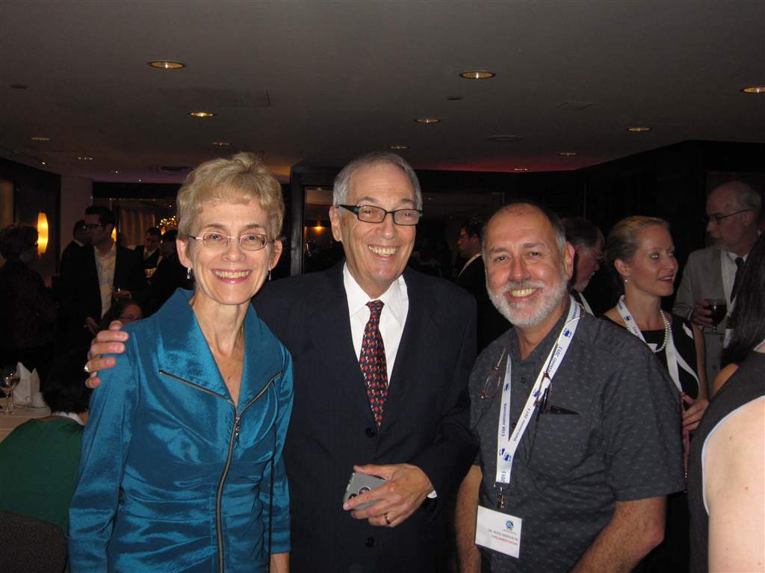
Gala Dinner

Slide 35
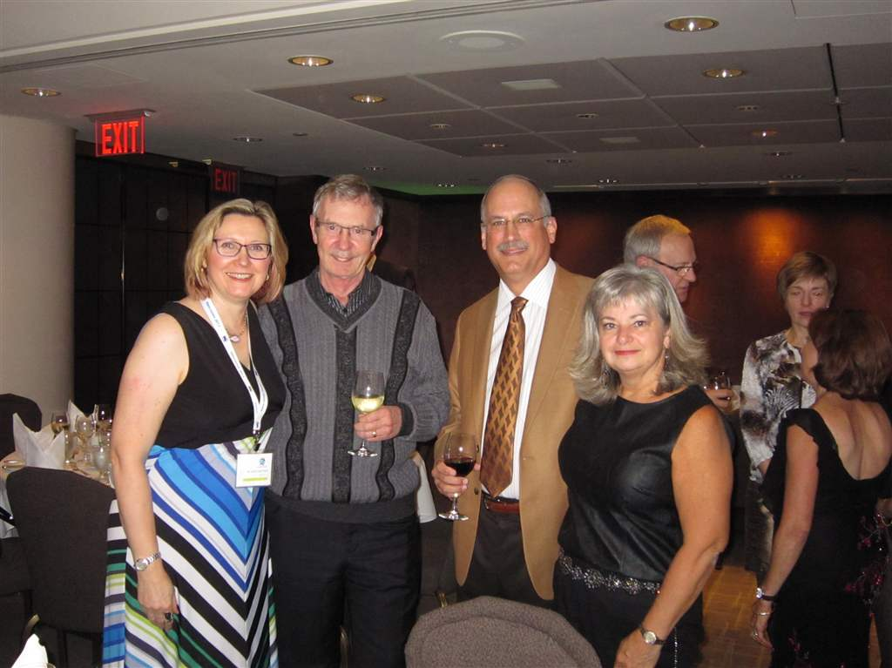
Gala Dinner

Slide 36
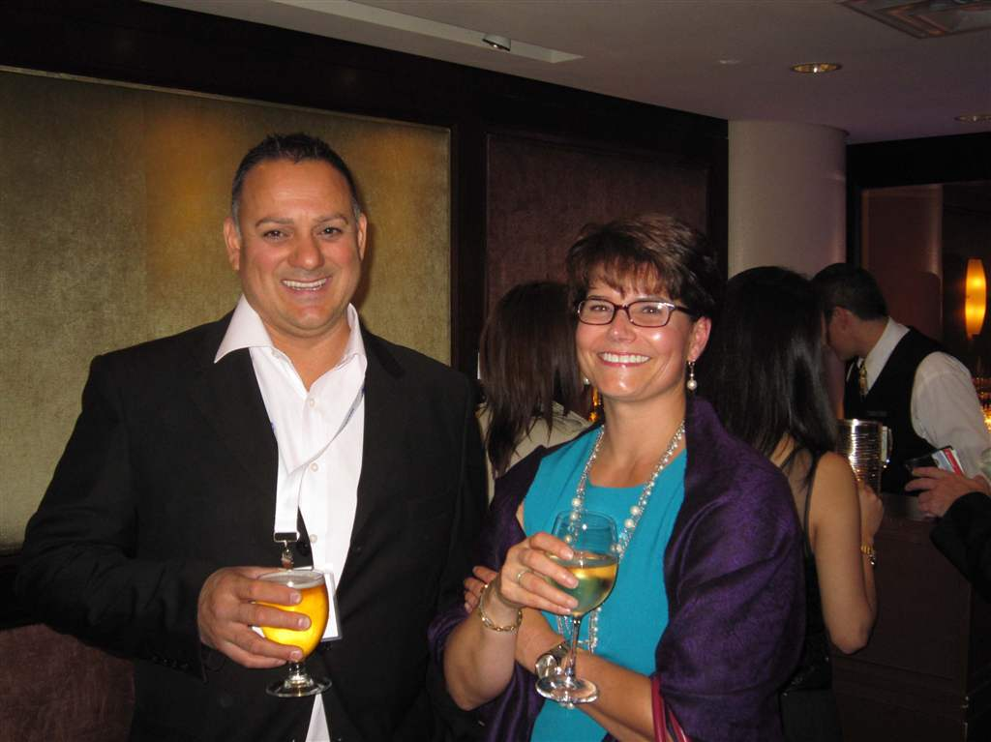
Gala Dinner

Slide 37
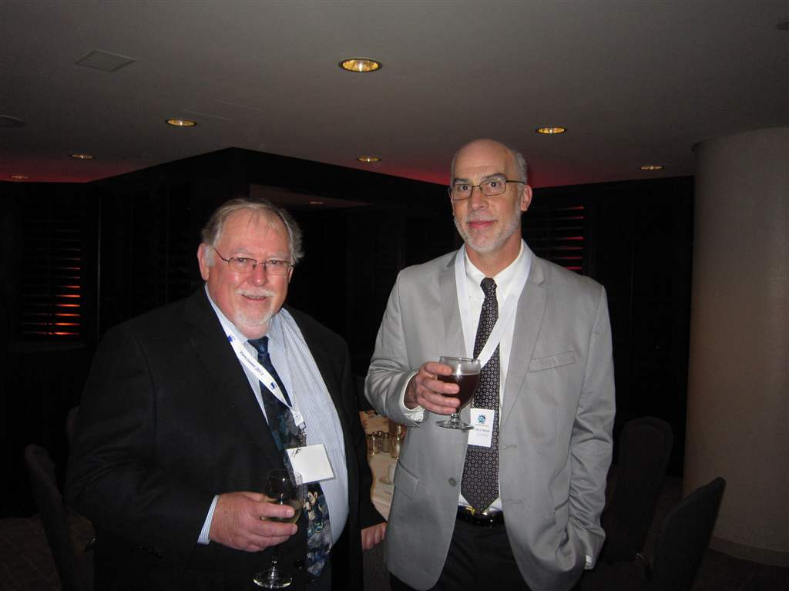
Gala Dinner

Slide 38
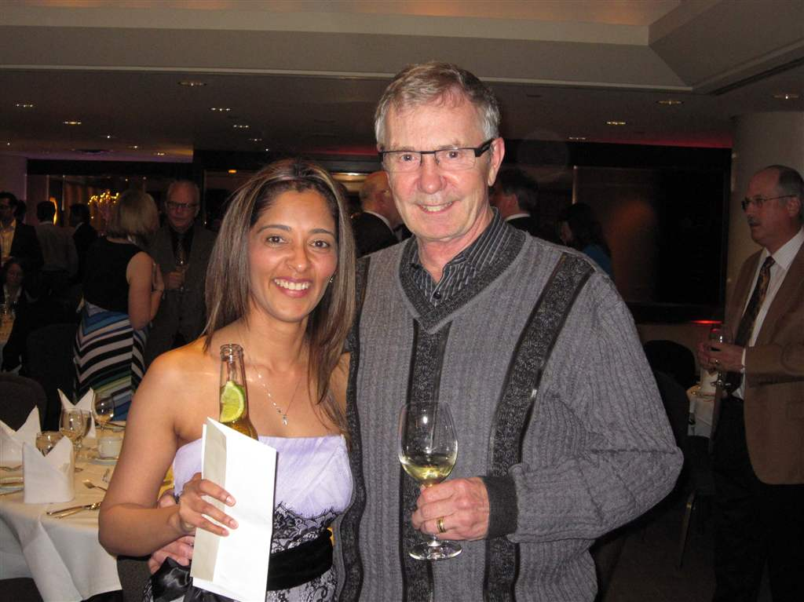
Gala Dinner

Slide 39
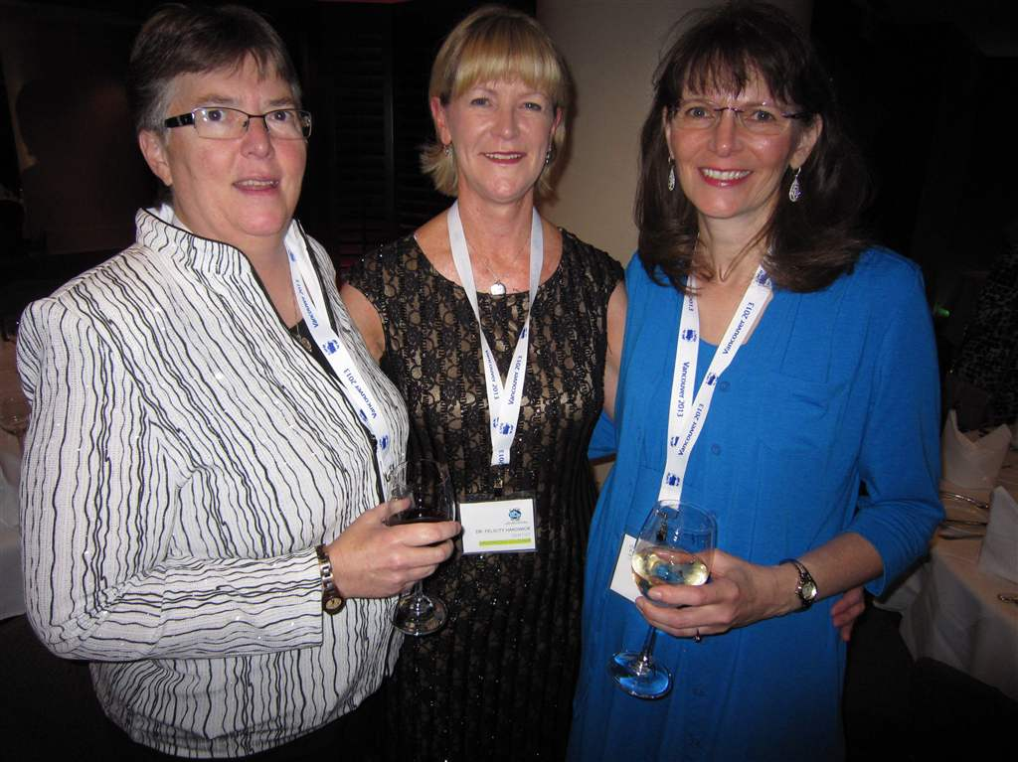
Gala Dinner

Slide 40
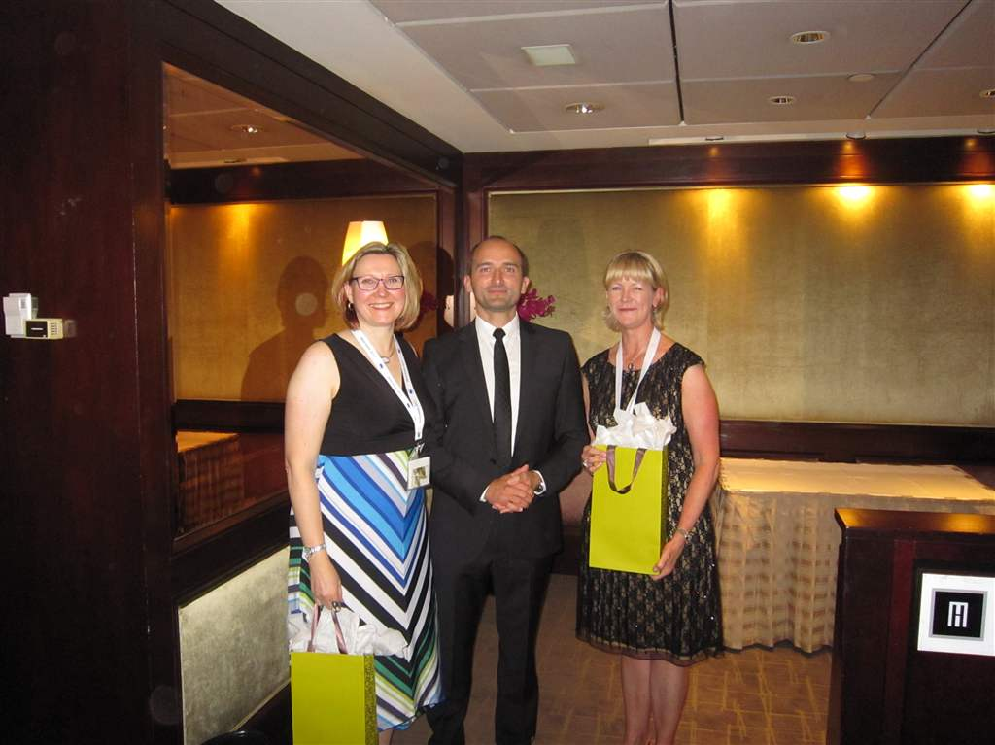
Gala dinner - Drs Gartner, Goralski & Hardwick

Slide 41
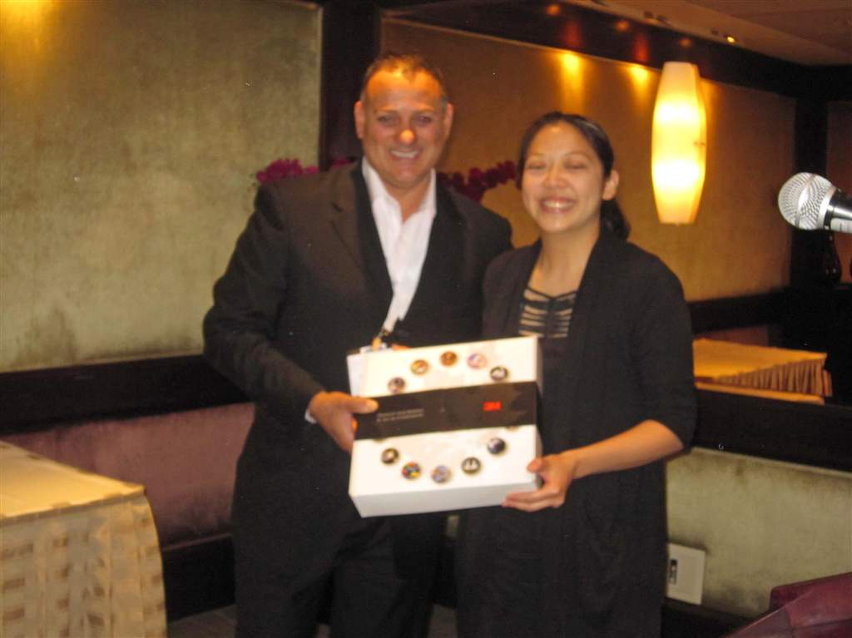
3M ESPE Grad Student Presentations
Mr. Krishna Baichwall presenting to Dr. Trang Nguyen
Winner of the 3rd Year 3M-ESPE Graduate Research Presentation

Slide 42
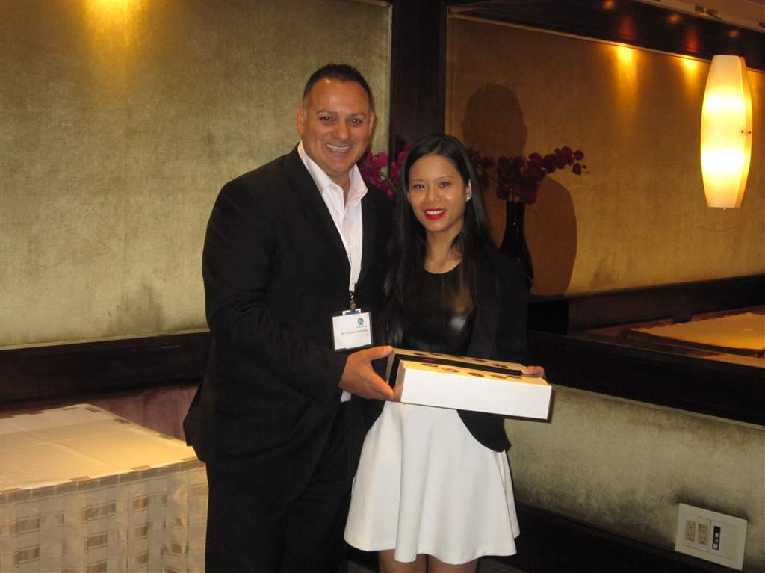
3M ESPE Grad Student Presentations
Mr. Baichwal presenting to Dr. Aimee Castro
Winner of the 2nd Year 3m-ESPS Graduate Research Presentation

Slide 43
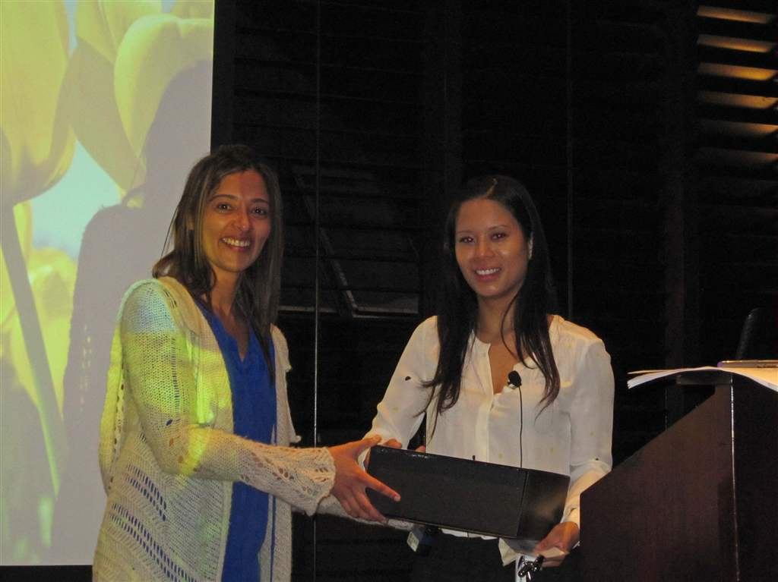
3M ESPE Grad Student Presentations
Dr. Zahra Kurji (Scientific Chair) and Dr. Aimee Castro

Slide 44
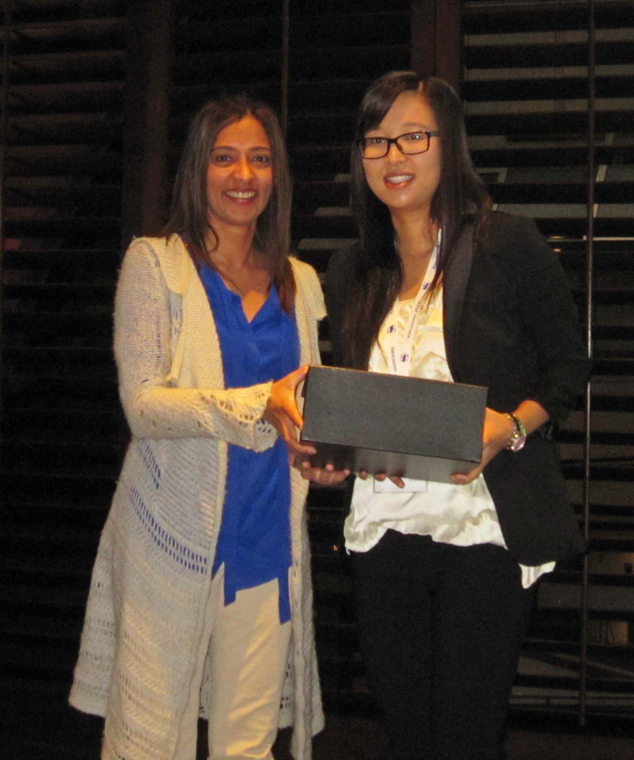
Graduate Student Presentations
Dr. Zahra Kurji and Dr. Jamie Ong

Slide 45
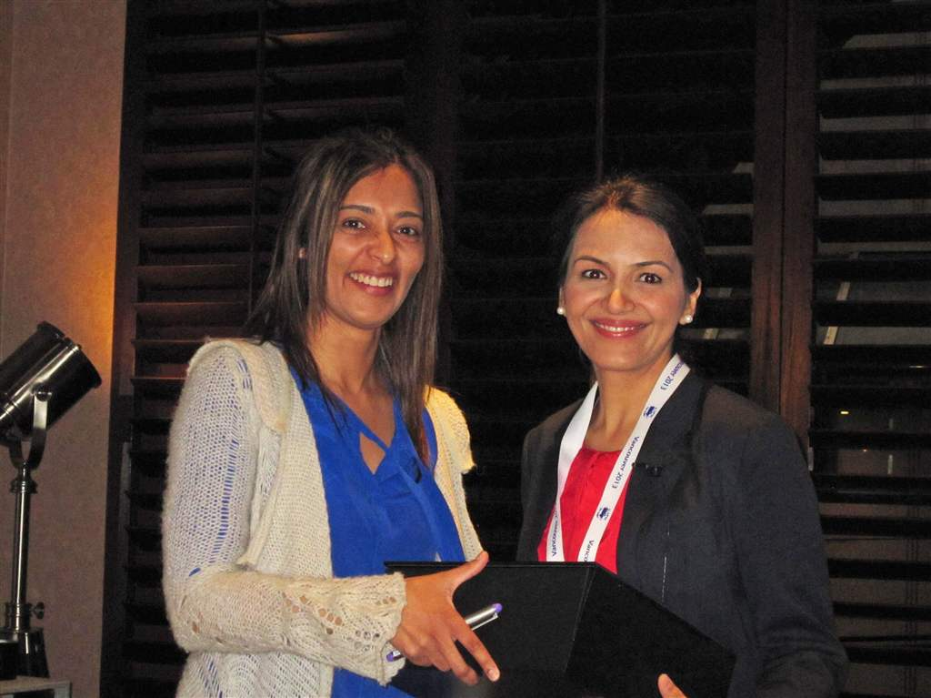
Graduate Student Presentations
Dr. Zahra Kurji and Dr. Anoushe Sekhavat

Slide 46
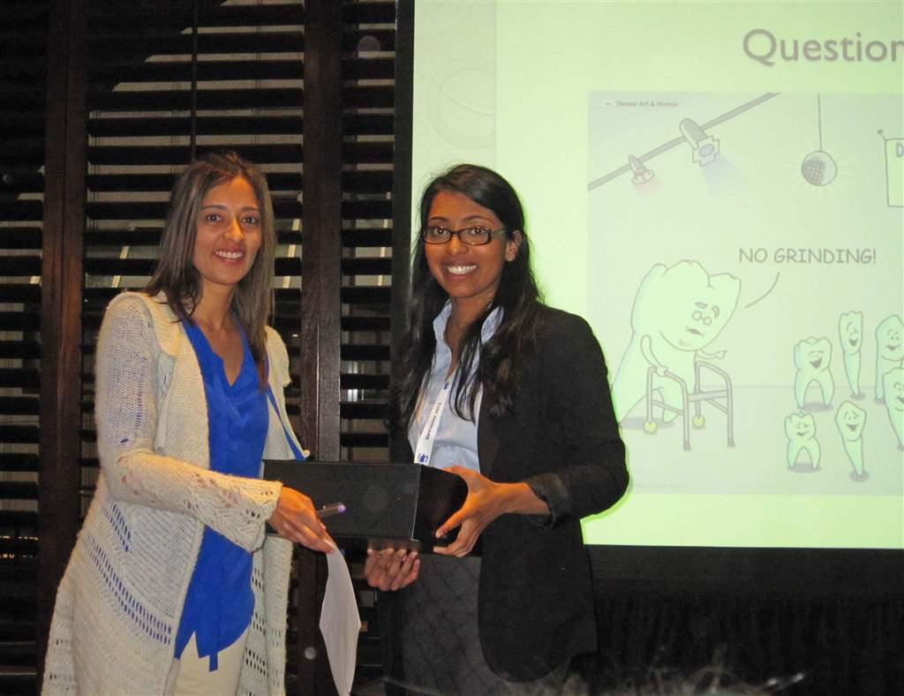
Graduate Student Presentations
Dr. Zahra Kurji and Dr. Rae Verughese

Slide 47
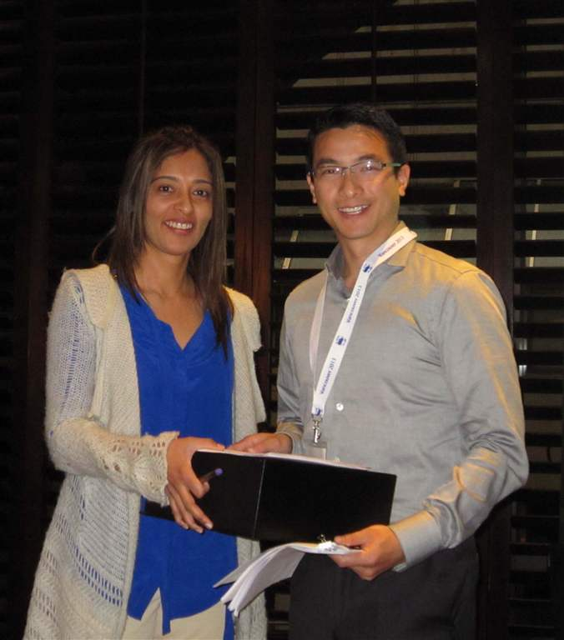
Graduate Student Presentations
Dr. Zahra Kurji and Dr. Carter Ng

Slide 48
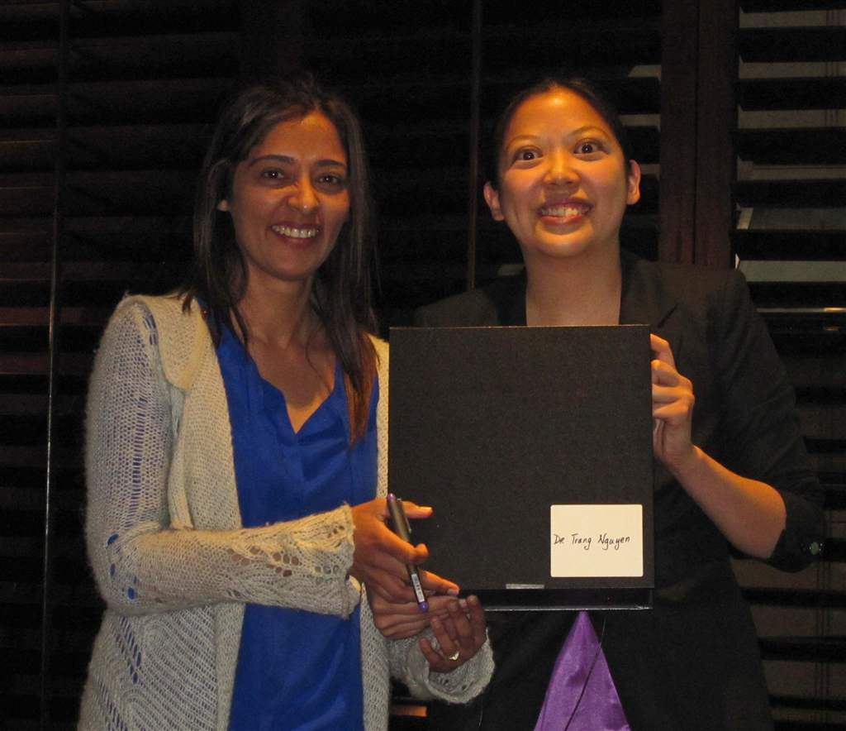
Graduate Student Presentations
Dr. Zahra Kurji and Dr. Trang Nguyen

Slide 49
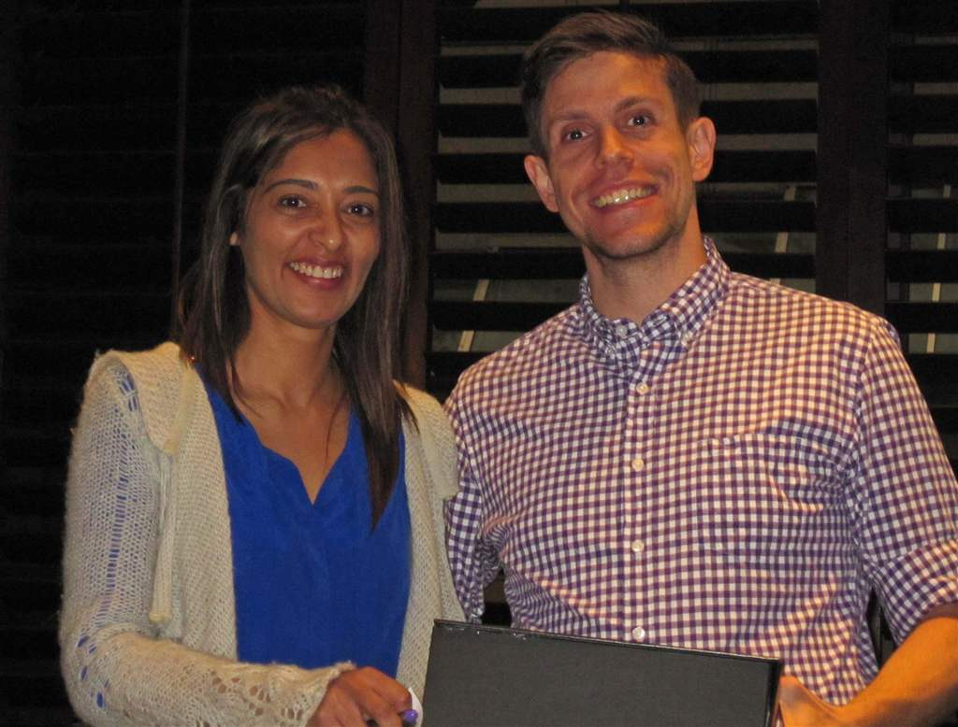
Graduate Student Presentations
Dr. Zahra Kurji and Dr. Darsi Perusini

Slide 50
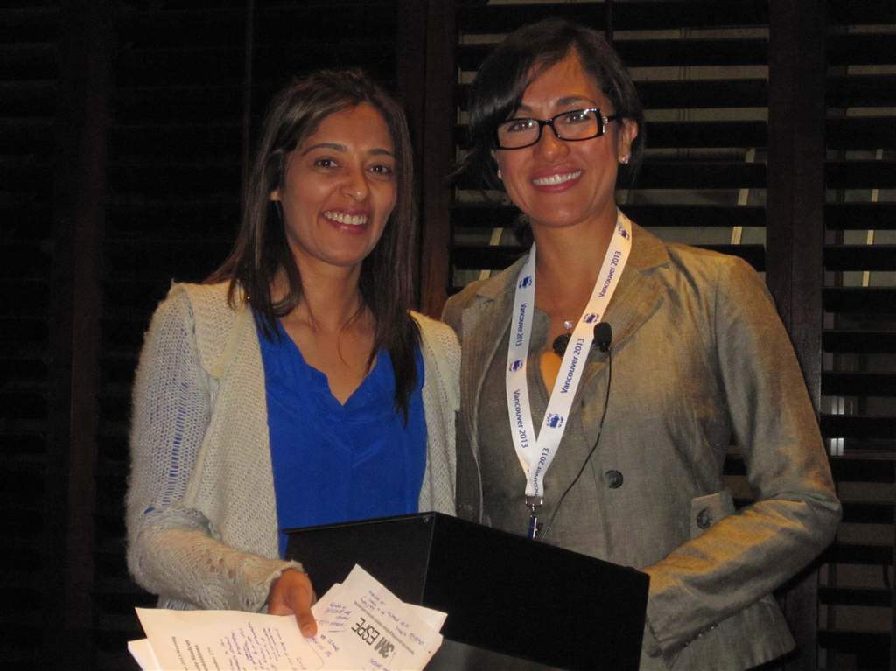
Graduate Student Presentations
Dr. Zahra Kurji and Dr. Nancy Vertel

Slide 51
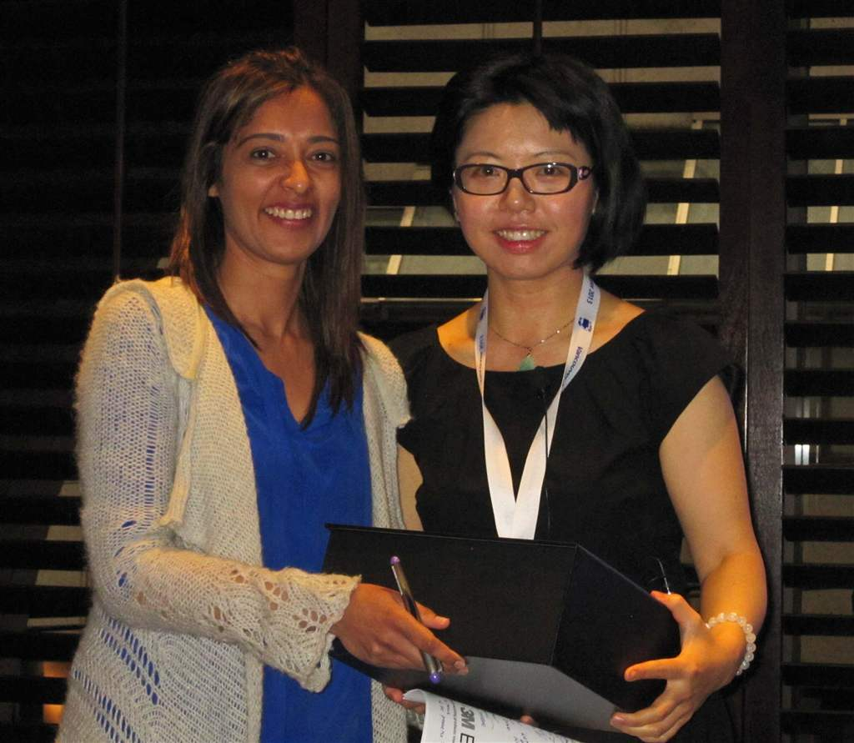
Graduate Student Presentations
Dr. Zahra Kurji and Dr. MH Zhao

Slide 52
Graduate Student Presentations
Dr. Zahra Kurji and Dr. Ella Choi

Slide 53
CAPD/ACDP Members

Slide 54
CAPD/ACDP Members

Slide 55
CAPD/ACDP Members

Slide 56
CAPD/ACDP Members

Slide 57
CAPD/ACDP Members

Slide 58
CAPD/ACDP Members

Slide 59
CAPD/ACDP Members

Slide 60
Dr. Ed Moody, AAPD President-Elect

Slide 61
Dr. Michal Goralski, CAPD-ACDP Pesident with Mr. Krishna Baichwal of 3M ESPE

Slide 64
Dr. Michal Goralski, Mr. Krishna Baichwal, Dr. Aimee Castro (Winner, Graduate Student Award) and Dr. Zahra Kurji

Slide 65
Thank you to our sustaining
Sponsor

Slide 66
Thank you
to our Annual Meeting sponsors
EZ Pedo
Nu Smile
Patterson Dental
Sinclair Dental
The Canary System
Ultra Light Optics

Slide 67
THANK YOU TO OUR MEMBERS FOR MAKING THIS EVENT SUCH A GREAT SUCCESS!

Slide 68
HOPE TO SEE YOU NEXT YEAR IN MONTREAL
SEPTEMBER 11-13, 2014
MONTREAL MARRIOTT CHATEAU CHAMPLAIN HOTEL

Slide 69
The National Voice of Pediatric Dentistry in Canada
www.capd-acdp.org

